Slide 1
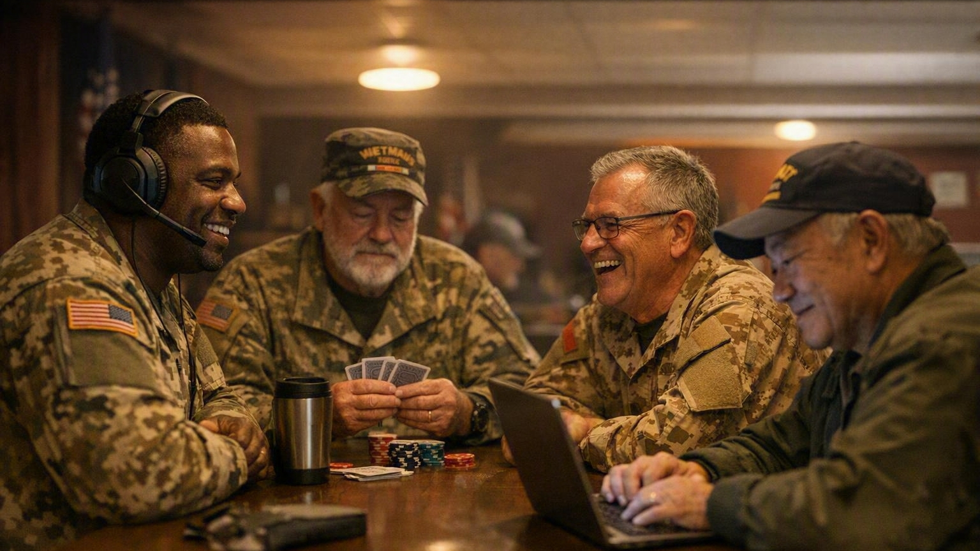

WHAT IS COMBAT TESTED GAMING?
Gaming Is The Tool.
Camaraderie Is The Mission.
The VFW’s fastest-growing veterans-only community - built on connection, not controllers.

Slide 2
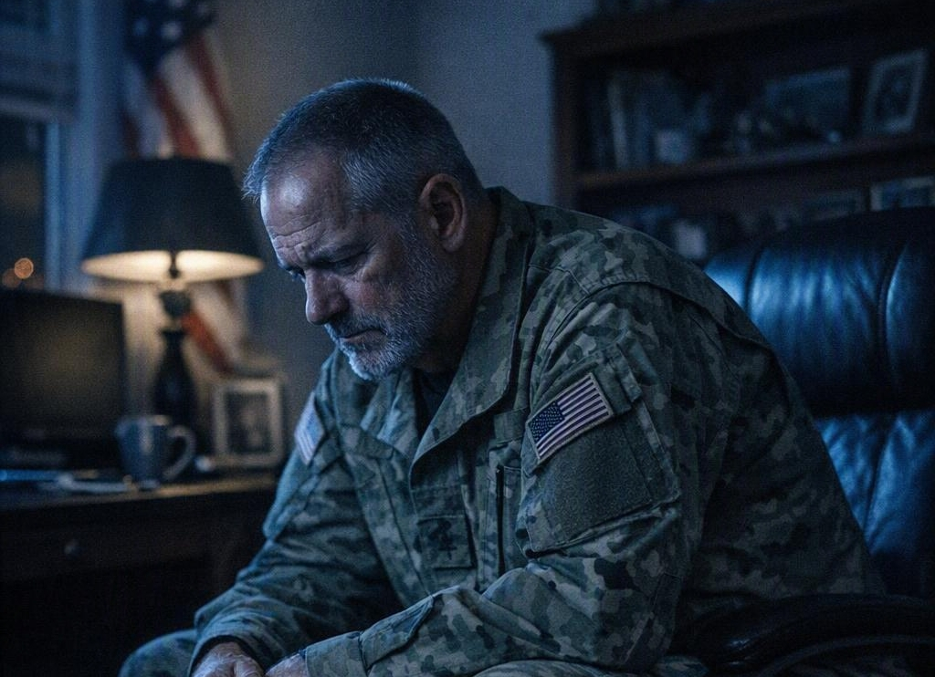

Why CTG Matters
Service ends. The need for the unit does not.
SERVICE ENDED
COMMUNITY CONTINUES
ISOLATION
Rank gone. Routine gone. The people who understood you are three states away.
CONNECTION
A squad again - on a headset, at a table, in a Post. Community continues.

Slide 3

CTG HAS SAVED LIVES
“Sometimes a game starts a conversation.
Sometimes a conversation saves a life.”
Veterans Service Officers answer VA claims and benefits questions inside the same community where the conversation started.

Slide 4
CTG Is Bigger Than Video Games
Poker Chips
Discord
D20 Dice
Everyone belongs here.
Tabletop, cards, racing, painting, strategy - if it brings veterans together, it counts as CTG.
Card Games
CTG
Combat Tested Gaming
Sim Racing
Chess & Strategy
Board Games
Hobby Painting

Slide 5
The CTG Community
One network, many front doors.
Podcasts
Tournaments
Discord
Family Nights
Combat Tested Gaming
Post Events
Hobby Painting
Racing League
Tabletop Gaming

Slide 6
Start CTG at Your Post
A five-step path any Post can start this quarter.
05
Gaming Center
A permanent space veterans keep coming back to.
04
Tournament
Open it to the District and the community.
03
Monthly Game Night
Cards, board games, or console - pick one night.
02
Promote Discord
Get members into the existing community - no cost.
01
CTG Chairman
Appoint one point of contact at the Post.
Each step is bigger than the last - Commanders can start at step one with zero budget.

Slide 7

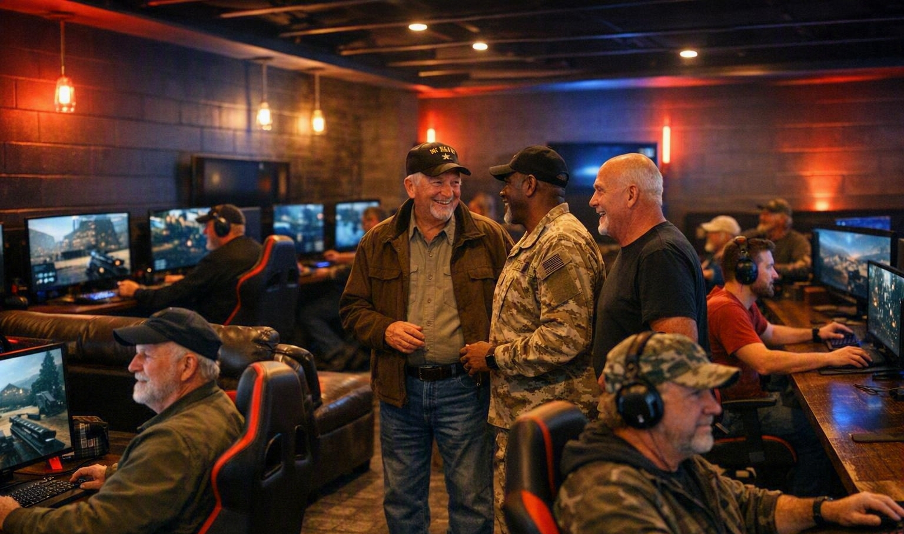
Funding & Grants
Startup cost is the objection. It is also the part that is already solved.
BEFORE
AFTER
$500 – $2,500
Post Assistance Grant available
VFW Foundation Post Assistance Grants reimburse qualifying equipment and improvements.
Posts willing to put in the work do not have to carry the infrastructure cost alone.
That makes Combat Tested Gaming mission-driven and financially attainable.

Slide 8
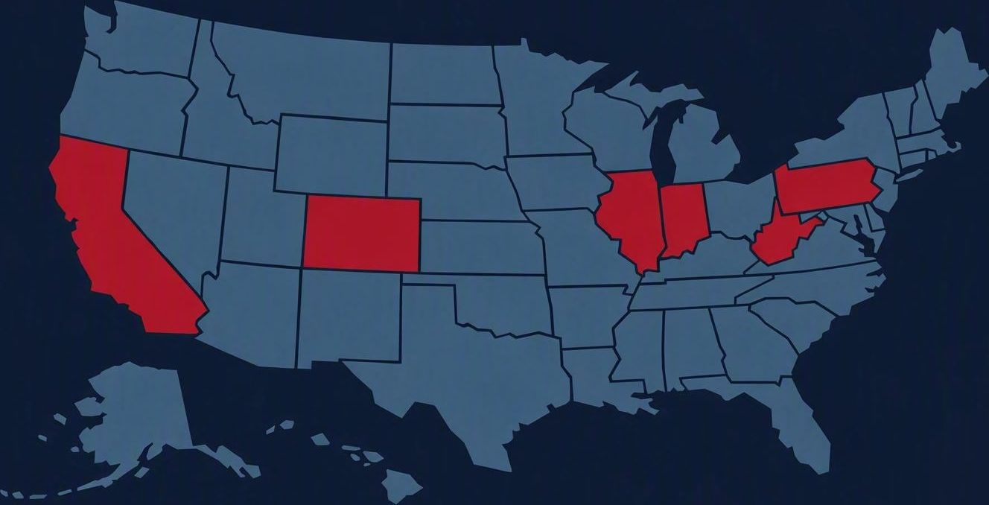
CTG Momentum
Chairpersons, events, and tournaments are already spreading state to state.
Florida
Active Department chairperson and Post-level events
Virginia
Tournament play and community-service reporting tie-ins
New Mexico
Growing Post participation and game nights
Military Order of the Cootie
MOC adoption extending CTG beyond VFW Posts
Where a Department names a chairperson, activity follows within a quarter.

Slide 9
Strategic Partnerships
Outside organizations are already investing in this community.
Healium
Discord
August Interactive
Combat Tested Gaming
Alexander PCs
Omnic.AI
Credibility, equipment, and mental-wellness technology - partnerships bring resources to Posts that VFW dollars alone would not reach.

Slide 10
Why Every Department Needs a CTG Chairman
National
Department
Engagement flows down
Success stories flow back up
District
Post
Veterans
One Department Chairman turns a good idea into a program.
Without one, CTG stops at whichever Post happened to hear about it.

Slide 11
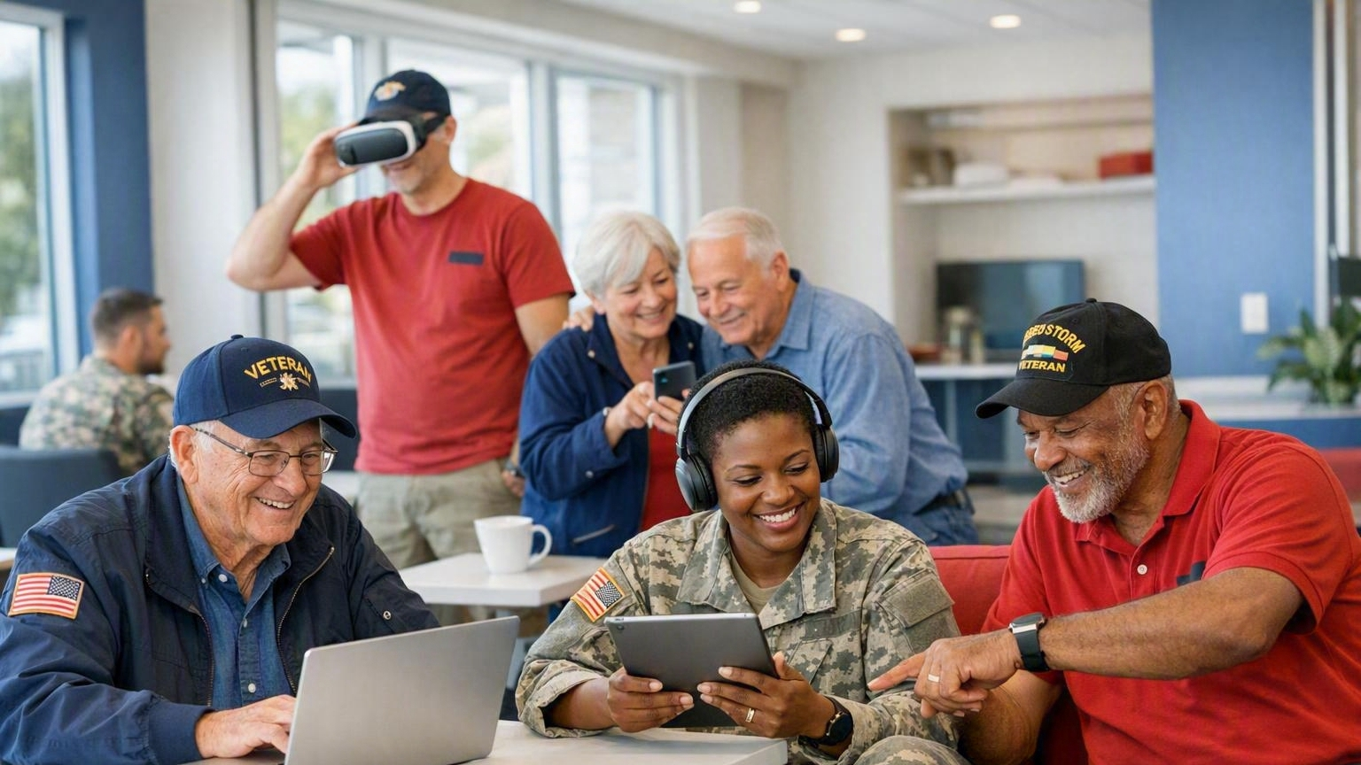
The Future
Five pillars of a modern, connected VFW.
01
Modern Posts
Spaces built for how veterans actually gather today.
02
CTG Communities
A live, moderated community at every Department.
03
Partnerships
Industry and technology partners funding the mission.
04
Mental Wellness
Connection first, benefits help one channel away.
05
Membership Growth
A front door for the veterans we have not reached.
None of this requires the VFW to become a gaming organization. It requires the VFW to meet veterans where they already are.

Slide 12
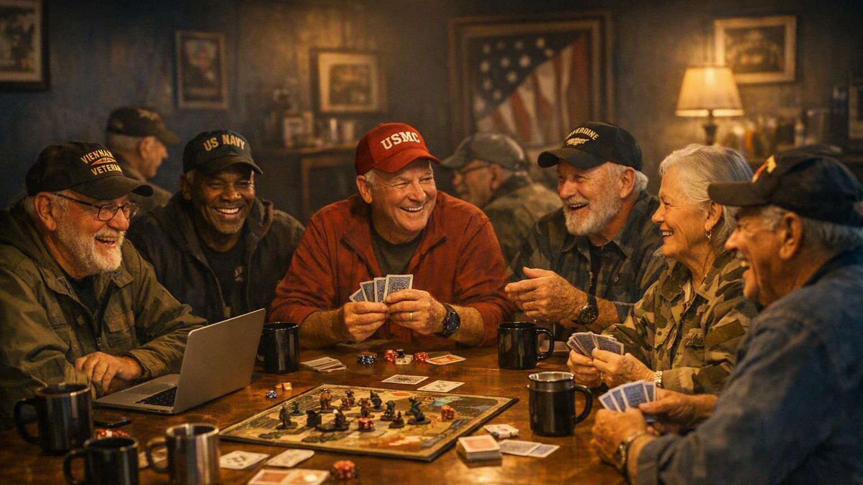
COMBAT TESTED GAMING
Connection. Camaraderie. Community.
“When veterans connect, the mission continues.”
Lynn W. Rolf III
816.968.1116
lrolf@vfw.org

Slide 13
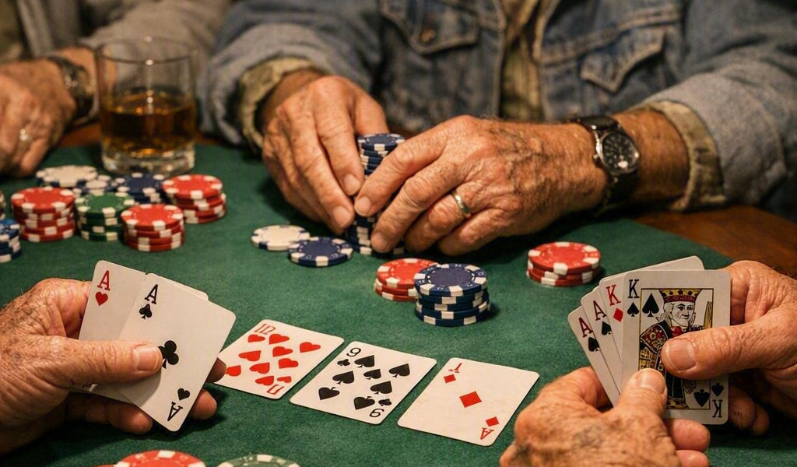
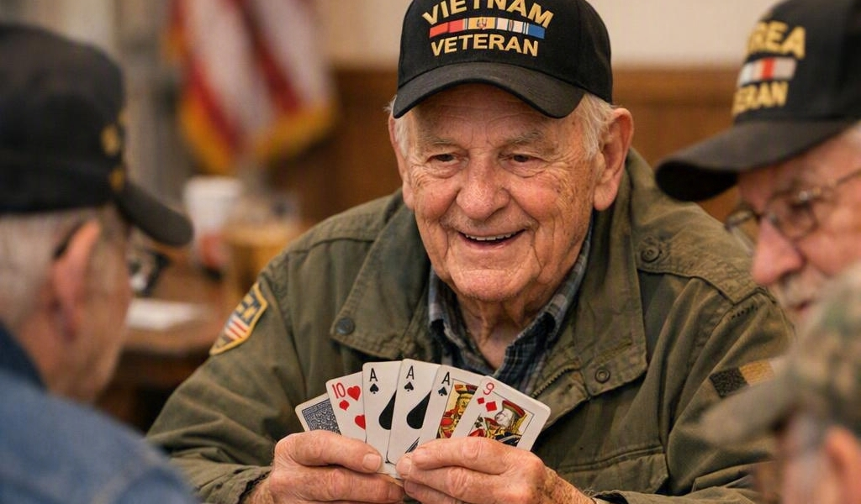
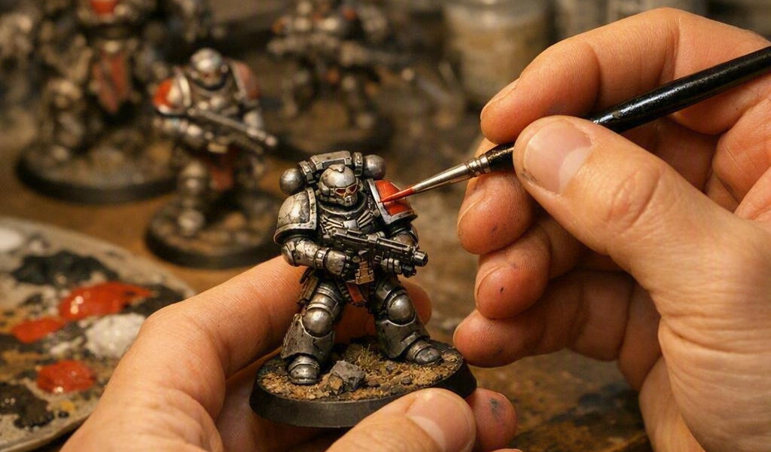
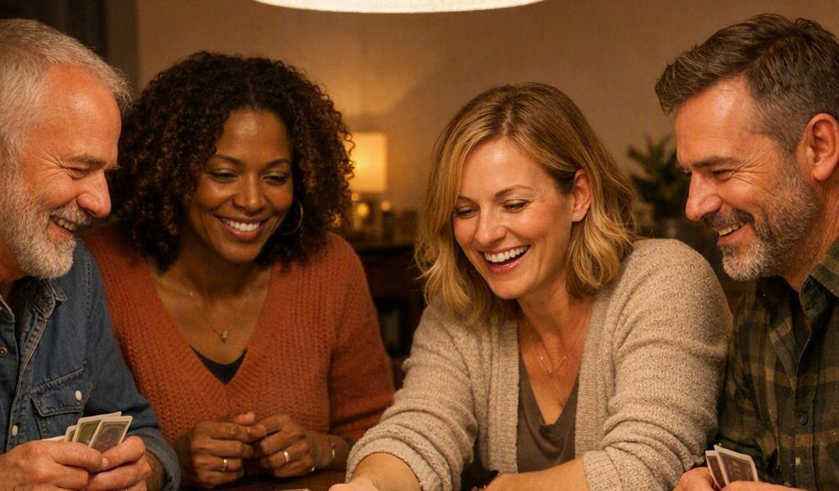

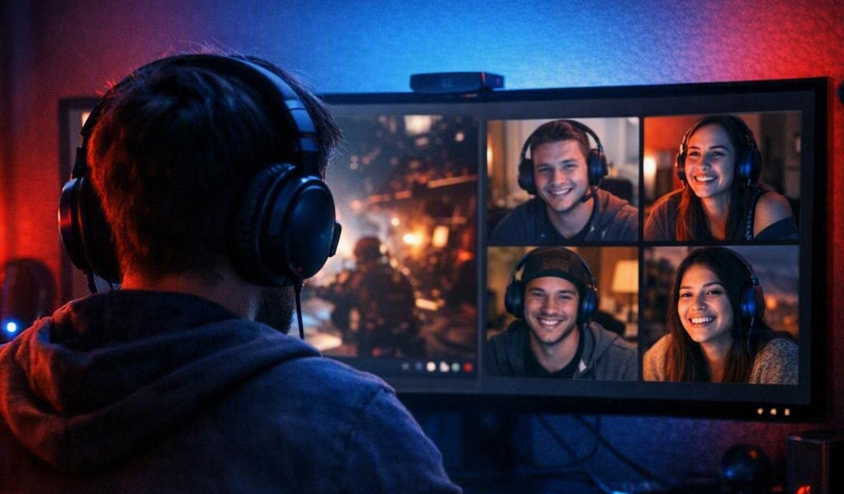
A CTG Event Can Be…
Removing the only objection that matters: “I’m not a gamer.”
Poker Night
Pinochle Tournament
Warhammer League
Family Board-Game Night
Mario Kart Tournament
Discord Watch Party
Not one of these requires a console, a controller, or a single hour of gaming experience.

