Slide 1
Trustee Training

Slide 2
Information pulled from:
VFW Trustees Guide for Proper Audit
2024-2025

Slide 3
What is a Trustee?

Slide 4
The Post Trustee is an elected auditor
A person tasked to routinely examine accounts and accounting records.
Compare the charges with the vouchers.
Verify balance sheets and income items.
State the result in order to ensure that all disbursements are in line with the Bylaws.
Ensure disbursements have been made with prior approval of the Post.
Trustees play a vital role in ensuring the funds of the Post are audited and accounted for accordingly.

Slide 5
What is a Trustee (Cont.)
Post Trustees are primarily the watchdogs of the Post funds.
They make certain no one has their fingers in the till and the assets of the Post are safeguarded and protected.
Equally important should be the prevention of fraud.
Where funds are guarded carelessly or poor record keeping is in place, the Trustee should call attention to this and make every effort to correct it.
The Trustees’ duties extend to all operations of the Post: their audits must cover all activities, including the club rooms, the bar, bingo, or any other source of income or financial transactions.

Slide 6
Post Trustees
• Serve a three-year term.
• Cannot serve on any committee that handles Post funds.
• Exist to hold all parties handling funds accountable.
• Report all audit findings to the Post membership.
• Before a new Post Quartermaster takes up the duties, the Post Trustees, should conduct a thorough audit of the previous Quartermaster to give a ‘clean slate’ to the new Quartermaster. This may be accomplished by virtue of the required audit processes.

Slide 7
Trustees Audits MUST
• Be completed every quarter.
• Extend to every operation of the Post.
• Highlight irregular banking practices.
• Be reported to the Post membership with any found discrepancies.

Slide 8
Trustees Scope
The Trustees do not have any authority over the management of the Post home, nor is property held in their name in an incorporated Post.
They cannot serve on any committee having to do with the handling of Post funds, and cannot therefore serve as members of the House Committee, bingo committee, etc.

Slide 9
Trustees Scope (Cont.)
There is nothing to keep a Trustee from serving as a volunteer worker or in an appointive capacity where Post funds are not handled.
They are elected to three-year terms to make certain that they do not all represent one "clique" which might happen to gain control for one year.

Slide 10
Use of Paid Accountants
Many Posts employ a private firm of accountants for the purpose of an audit. This is to be encouraged rather than discouraged as an audit by a certified public accountant will usually pay for itself in the improvements which will result.
In these cases, the auditor reports to the Trustees and the Trustees make certain that the audit is conducted correctly.

Slide 11
Use of Paid Accountants (Cont.)
Regardless of the size of the Post, a quarterly audit is mandatory. Failure to conduct one may result in the cancellation of the Post Quartermaster bond and will take away all voting privileges at Conventions.
If the Trustees do not function in a proper manner, the Commander may deem it an emergency situation and appoint an auditing committee on their own initiative.

Slide 12
If You See Something, Say Something!
The purpose of the audit is twofold.
It will reveal a shortage before it gets too large
It is the most successful preventative of fraud.
Remember, when conducting an audit, you are an independent reviewer and nobody's friend! Review all transactions with suspicion and give no one the benefit of the doubt. You can be friends again later, but right now you believe only what can be proven.

Slide 13
Report It!
If the books are not kept in an efficient manner; if they cannot be audited because of lack of records; or if you find definite discrepancies, report it to the Post.
Don’t just sit back and refuse to sign the audit. If the Post fails to act in order to correct deficiencies, immediately inform the Department for further guidance.
Remember - the Trustees do not tell the Post or the Quartermaster how to run their business; they just make certain that everything is on the up-and-up.

Slide 14
A number of dishonest Post Quartermasters tried these angles:
1. Deposited only a portion of the proceeds of special events.
2. Made check stubs payable to someone else and the checks to himself/herself.
3. Secured a personal loan with a Post check.
4. Made up fake bank statements.
5. Staged a fake break-in.
6. Collected membership dues or cash for a raffle but did not turn them in.
7. Cashed Post bonds and pocketed the money.
8. Paid their personal credit cards with the Post’s funds.
9. Paid personal expenses with the Post checking account or credit card.

Slide 15
Some items that should be spot-checked in the audit include:
1. Balance the monthly books to check accuracy.
2. Reconcile the books with the bank statement(s).
3. Count the cash on hand.
4. Actually view and count bonds and other investments.
5. Compare the cancelled checks with:
a. Check stubs.
b. Cash book entries.
c. Bank statements.
d. Vouchers and bills.

Slide 16
Some items that should be spot-checked in the audit include:
(Cont.)
6. Confirm the bank balance with the bank.
7. Check payments for unusual items against Adjutant minutes to determine authority for payment.
8. Check official receipts against book entries.
9. Check stubs of membership receipts against total membership as shown by books and by Quartermaster's copy of dues transmittals.

Slide 17
Some items that should be spot-checked in the audit include:
(Cont.)
10. Where committees have handled special events, determine just how much money was turned in and check it against entries.
11. Watch very closely any bills paid by cash, or income not covered by receipts.
12. Review all disbursements a Quartermaster makes to himself/herself.
13. Identify general ledger accounts with substantial changes in value since the last review was performed and investigate.

Slide 18
Some items that should be spot-checked in the audit include:
(Cont.)
14. Review payroll to ensure employees are paid the appropriate salary for the actual hours worked.
15. If applicable, review all expenses charged to Post debit/credit cards.

Slide 19
Watch for the following danger signals between audits:
1. Stalling in getting books ready for audit.
2. Slowness in paying bills of the Post.
3. Delay in making deposits.
4. Large amounts carried as "cash on hand."
5. Checks made out to others than the person to whom indebted.

Slide 20
Watch for the following danger signals between audits:
(Cont.)
6. Checks made out to others than payee.
7. Complaints by members of non-receipt of the VFW magazine or other publication.
8. Checks which have not cleared the bank at the time of the audit.
9. Lifestyle changes of the Post Quartermaster.
10. An honest person can slip if they need the money badly enough. A sudden air of prosperity is sometimes an indication of dishonesty.

Slide 21
Watch for the following danger signals between audits:
(Cont.)
It is up to the Trustees and the Commander to check on the honesty of any person handling Post funds. YOU do the checking and YOU form your conclusions and act accordingly. Do not convey your suspicions to others until you are certain. Do nothing which may hurt the reputation of an innocent person. Do not cover up for anyone.

Slide 22
Financial Report
The Post Quartermaster makes a report to the Post on its finances at each meeting. This report is taken directly from the records. It is made out on Financial Statement Form (Form #4208) and it must be accurate and current.

Slide 23
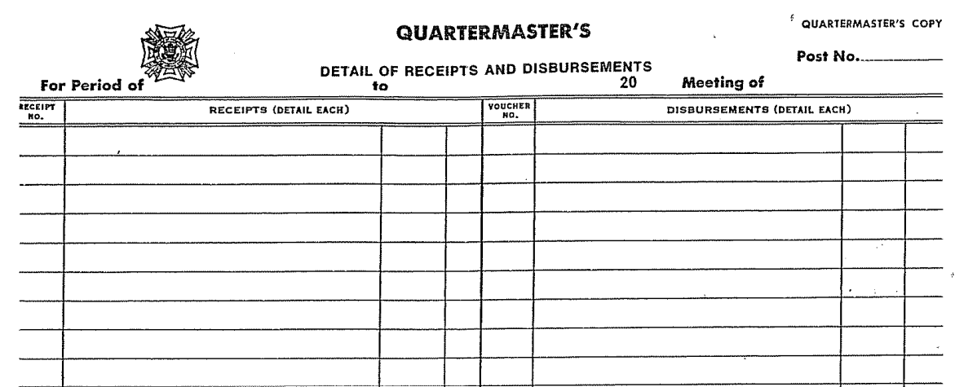
Quartermaster’s Monthly Report Form 4208

Slide 24
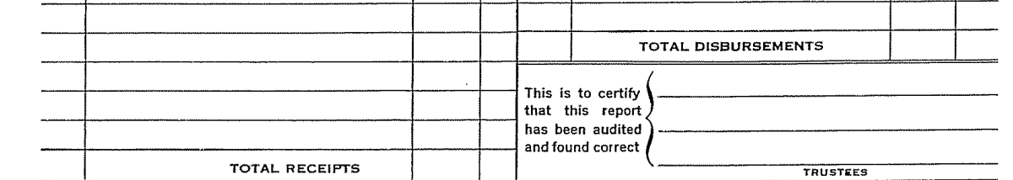
Quartermaster’s Monthly Report Form 4208

Slide 25
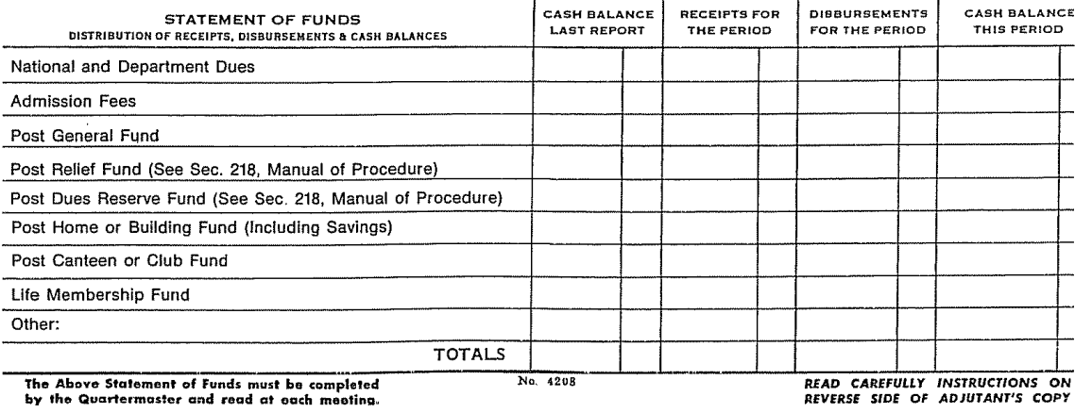
Quartermaster’s Monthly Report Form 4208

Slide 26
Club Funds
A.K.A Canteen Funds
Clubs are specialized businesses and require more specific safeguards than Posts which do not have clubs.
Besides the mere question of honesty, problems of management, governmental regulations, state law, etc., must be considered with additional opportunity as club managers/workers have thought up new angles to steal funds.

Slide 27
Some peculiars of Club Funds include:
Padded inventory of liquor on hand.
Bad or fictitious checks carried as “cash on hand.”
Leakage of petty cash.
Padded payrolls.
Bootlegging on the side.
Kickbacks from suppliers.
Gambling operations on the side.

Slide 28
Remember that a club manager is in a bad spot. Everyone is suspicious of him/her because he/she does handle quite a bit of cash that is not their own. The best favor you can do them is CHECK EVERYTHING and do it regularly. His/her best protection is the general knowledge that he/she is being watched.

Slide 29
There are a few danger signals to watch for, both from the standpoint of their honesty and the way they are running the club:
An exceptionally large inventory may mean that it is padded to account for missing funds. Make sure that what is carried as liquor is liquor.
An exceptionally large number of bad checks may mean that they are fakes to cover a shortage of cash.
Cash register tapes that always equal the amount they are supposed to show either means an impossibly accurate bartender or a little juggling to make them come out equal.

Slide 30
4. Watch for large variations in the gross profit each month.
5. Talk to the local police officers to find if they have had complaints of being open after hours, sale of liquor by the bottle, gambling on the premises, etc. They will be the first persons to know of any irregularities.
For the protection of the Post, the club manager and other employees handling funds should be bonded. Employee theft or dishonesty insurance may add additional protection; however, it is not a substitute for a Post Quartermaster bond as required by VFW National Bylaws.

Slide 31
Quartermaster’s Monthly Report Form 4208

Slide 32
Quartermaster’s Monthly Report Form 4208

Slide 33
Quartermaster’s Monthly Report Form 4208

Slide 34
Trustees’ Report of Audit Form
It is the responsibility of the Trustees to ensure the Trustees’ Report of Audit form is properly completed. To prepare for the audit, the following documents should be made available:
Previous quarterly audit
Ledger/voucher maintained by the Quartermaster
Banking statements for all accounts for the quarter being audited and Post Meeting minutes maintained by the Adjutant for the quarter being audited to ensure expenditures voted on by Post Members are being completed.

Slide 35
Trustees’ Report of Audit Form (cont.)
In addition, it is important to maintain a copy of the Post ByLaws with the financial documents if there is guidance on how monies are to be expended between Post meetings, e.g., a $ dollar limit on expenditures to maintain post operations or to assist a Veteran in need.

Slide 36
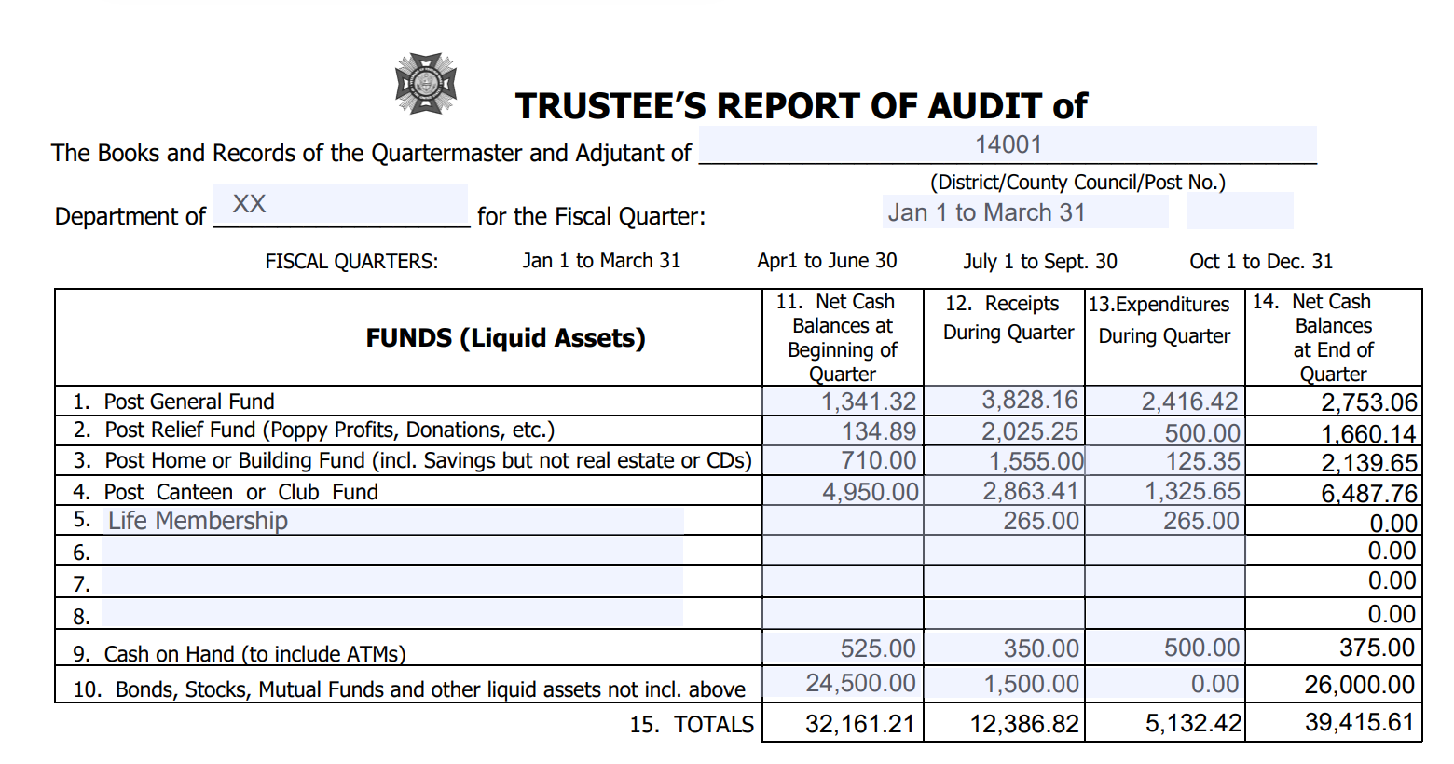
Trustee
Training

Slide 37
Lines #1-8 FUNDS (Liquid Assets) Listed are those funds most likely to be carried by a VFW Post and District. Any special funds may be added in the blank spaces. A “fund” is an account which normally has both income and expenditures. In most cases, just about all of your miscellaneous expenditures (community service, youth activities, expenses, etc.) are chargeable to your general fund and most miscellaneous income (proceeds from fundraising activities, dues, etc.) are credited to your general fund. Item

Slide 38
Line #9 CASH ON HAND (TO INCLUDE ATMS): Some posts own/operate ATMs, jukeboxes, gaming machines or other cash machines that that are not included in Item #4 above that require cash on hand to operate daily.
Line #10 BONDS, STOCKS, MUTUAL FUNDS AND OTHER LIQUID ASSETS NOT INCLUDED ABOVE This includes any financial instruments not previously included in any funds listed in Item #1-8 that can be liquidated without penalty by the financial institution. A loss in value of the account or processing fee charged by the financial institution to process the transaction does not equate to a penalty.

Slide 39
Column #11 NET CASH BALANCES AT BEGINNING OF QUARTER The figures in this column are obtained from different funds as listed in your ledger. The individual items in this column as well as the total at the bottom of the column should be the same as the ending balances of the previous quarterly audit.
Column #12 RECEIPTS DURING QUARTER The figures in this column are obtained by adding the amount shown in your ledger for the three months. This should include items transferred into a fund from another fund during the quarter.

Slide 40
Column #13 EXPENDITURES DURING QUARTER The figures in this column are obtained by adding the expenditures for the three months. Include items transferred out of another fund during the quarter.
Column #14 NET CASH BALANCE AT END OF QUARTER The figures in this column are obtained by adding items 11 & 12 and subtracting items 13.
Line #15 TOTALS The figures in this line are obtained by adding the totals of items 11& 12 and subtracting item 13 – you should arrive at the same by adding item 14.

Slide 42
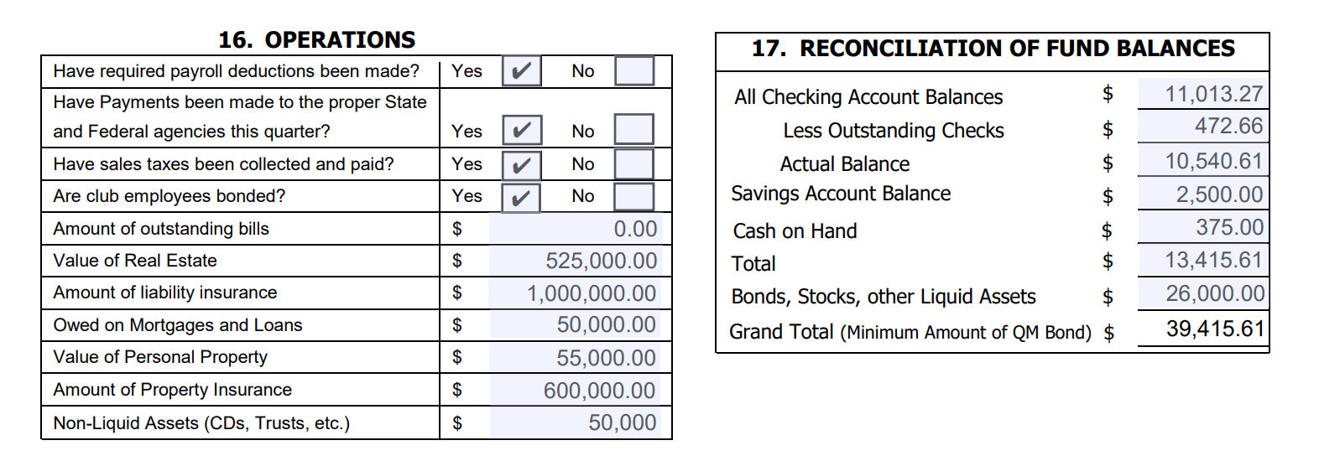

Slide 43
Section #16 OPERATIONS Answer questions as applicable. Non-liquid assets are types of assets that cannot be easily converted into cash within a short period without harsh penalties for early withdrawals. Trusts are a typical example. However, Certificate of Deposits less than $65,000 in value are typically non-liquid assets. Certificate of Deposits greater than $65,000 can be liquid assets. It is best to check with your banking institution on the type of CD and retain the information with the Post Financial Documents.

Slide 44
#17 RECONCILIATION OF FUND BALANCES:
All Checking Account Balances
Enter ending balance shown on bank statement. If more than one checking account, total ending balances for all accounts.
Less Outstanding Checks
Total checks written on or before the date of the last bank statement of the quarter that do not appear on the statement. If more than one checking account, total all outstanding checks.

Slide 45
#17 RECONCILIATION OF FUND BALANCES: (Cont.)
Account Balance
Subtract " Less Outstanding Checks" from "All Checking Account Balances. Add any deposits in transit that do not appear on bank statements. This should agree with the balance in your checkbook/ledger.
Savings Account Balance
Enter balances of any savings accounts.

Slide 46
#17 RECONCILIATION OF FUND BALANCES: (Cont.)
Cash on Hand
Amount of money on hand that has not been included in “Outstanding Deposits” above.
Total
Add "Account Balance" line, "Savings Account Balance", and"Cash on Hand" Line.
Bonds, Stocks and Other Liquid Assets
Enter current value of all bonds, stocks, and other liquid assets.

Slide 47
#17 RECONCILIATION OF FUND BALANCES: (Cont.)
Grand Total (Minimum Amount of QM Bond)
Add "Total Cash" line to "Bonds & Other Liquid Assets" line. Total in Item #15 Net Cash Balance at end of Quarter should equal Grand Total in Item #17. This is the minimum amount of QM Bond. Verify in #18, QM bond equal to or above this amount.

Slide 49
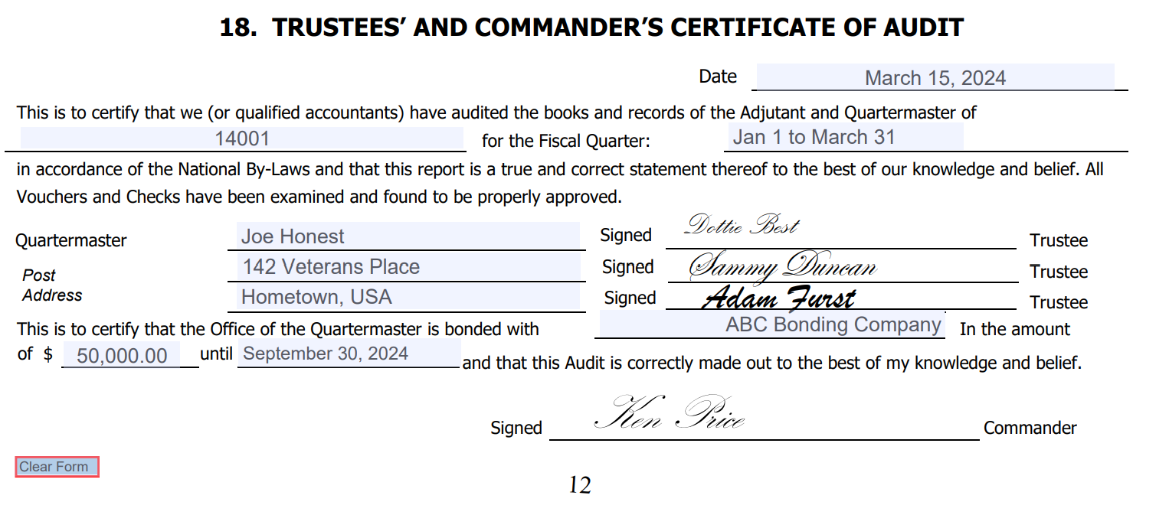

Slide 50
#18 TRUSTEES’ AND COMMANDER’S CERTIFICATE OF AUDIT:
Enter the date the audit is prepared, the Post name and number and the quarter for which the audit is prepared. The Post Commander and Trustees must sign the audit prior to submittal to the Department.
Enter the name of the Post Quartermaster, the name of the bonding company, the amount of the bond (verify in #17 Total that amount equal to or exceeds Total and the expiration date of the bond.
Remember, it is the duty of the Post Trustees to conduct the quarterly audits. It is the duty of the Commander to see that audits are made.

Slide 51
#18 TRUSTEES’ AND COMMANDER’S CERTIFICATE OF AUDIT: (Cont.)
The completed form, with the signature of the Post Trustees to attest to its accuracy, together with the signature of the Post Commander, should be forwarded to the Department Quartermaster. The Post Trustees should also sign the General Ledger at the ending point of the current audit period.

Slide 52
Read the Trustee’s Guide

Slide 53
Questions????

