Slide 1
Recruiting 101:
Building the Future of Our Post
Strategies for Growth, Engagement, and Retention

Slide 2
Why We Recruit
  Sustainability: Ensuring our Post remains a fixture in the community.
  Advocacy Power: More members = a louder voice in Washington D.C. for veteran benefits.
  Comradeship: Combatting veteran isolation by providing a safe "third space."
  Community Impact: More hands to help with service projects and relief funds.

Slide 3
Modernizing the Image
The Myth: "The VFW is just a dark bar for older guys."
The Reality: We are a service-first organization for all combat veterans.
Key Focus: Moving from a "Social Club" mentality to a "Service Organization" mentality.
Speaker Note: "If we want to attract younger veterans (Post-9/11), we need to lead with what we do, not just where we sit."

Slide 4
Who are we looking for?
Eligibility Check:
  Received a campaign medal.
  Served in a recognized "hostile fire" zone.
  Received Imminent Danger/Hostile Fire Pay.
The "Unreached" Groups:
  Active Duty/Guard/Reserve units nearby.
  Student Veterans at local colleges.
  First Responders who are also combat veterans.
  Female Veterans

Slide 5
How to Start the Conversation
Formula: Connection + Value + Invitation
Example: "I noticed your [Division/Unit] hat. I’m with VFW Post [Number]. We’re actually working on a project to help local vets with VA claims right now—you should come by for our coffee social on Saturday.“
Pro Tip: Don't ask "Do you want to join?" ask "Have you heard about what we're doing for veterans in this town?"

Slide 6
The "Front Door" Experience
Is the Post clean and welcoming?
Are new faces greeted immediately?
The "Buddy System": Assigning a current member to sit with a prospective member during their first visit.
Speaker Note: "You never get a second chance to make a first impression. A 'cliquey' atmosphere is the fastest way to lose a recruit."

Slide 7
Overcoming Common Objections
Objection | The Response
"I'm too busy." | "We have 'at-large' options and digital updates. Give us an hour a month."
"I don't drink." | "Neither do many of us. We are focused on community service and VA advocacy."
"It's for old timers." | "The older generation built it, but we need your generation to lead it into the future."

Slide 8
Keeping the Members We Have
Involve new members in committees immediately (make them feel needed).
Follow up with members who haven't shown up in 3 months.
Annual "Member Appreciation" events that include families.

Slide 9
Looking the Part: Your Recruiting Kit
The Essentials:
  The 10x10 Pop-Up: A clean, VFW-branded canopy (protects from sun/rain and defines your "territory").
  Professional Signage: High-visibility banners with the Post number and a QR code linking to your website/social media.
  Table Setup: Use a fitted tablecloth. Keep it organized—avoid "clutter.“
Pro Tip: Weights! Nothing looks less professional than a VFW tent blowing across a parking lot. Always use sandbags or weights.

Slide 10
Where the Veterans Are
High-Traffic Spots:
  Local Events: County fairs, 4th of July parades, and Farmers Markets.
  Military Hubs: Near Guard armories, Reserve centers, or VA clinics.
  Active Lifestyle Spots: 5K runs, "Coffee and Cars" meetups, and sporting goods stores.
  Educational Centers: Student Veteran Centers at local community colleges or trade schools.
Speaker Note: "Don't wait for them to walk into the canteen. Go to where they live their lives."

Slide 11
The Recruiting Toolkit (Materials)
Physical Items:
Brochures: VFW "Benefits" pamphlets and local Post flyers listing upcoming events.
Membership Apps: Have pens ready, but also have a QR Code for digital sign-ups on the spot.
"Swag" with Substance: Not just pens—think branded water bottles, cooling towels, or "Challenge Coins" for serious leads.
The Sign-Up Sheet: Even if they don't join today, get an email/phone number for a follow-up.

Slide 12
Growing the Sisterhood
The Reality: Women are the fastest-growing demographic in the veteran community but often feel the VFW "isn't for them."
Key Strategies:
Visibility: Ensure your photos and banners show female veterans in active, leadership, and combat-service roles.
The Approach: Avoid asking, "Is your husband a veteran?" Ask, "Did you serve?"
Targeted Outreach: Host events that cater to diverse interests (e.g., Women Veteran Brunches or family-oriented service projects).
Safety & Respect: Ensure the Post environment is inclusive and that female members hold visible leadership positions.

Slide 13
How to Talk (and How to Listen)
The "Two-Ear, One-Mouth" Rule: Listen to their story before telling yours.
The "Soft" Opening: "How was your transition back to civilian life?" or "Do you miss the camaraderie of your unit?“
Avoid the "Hard Sell":
  Instead of: "You should join the VFW."
  Try: "We’re building a group of local combat vets who actually look out for each other. I'd love to have your perspective at our next meeting."
Closing the Loop: Always end with a specific invitation: "Can I text you the info for our cookout next Friday?"

Slide 14
Presenter's "Boots on the Ground" Tip:
When recruiting female veterans or younger members, representation matters. If you are sending a team to a booth, try to have a diverse group of recruiters (age, gender, and branch) present. If a veteran sees someone who looks like them, the barrier to entry drops instantly.

Slide 15
Ditch the 1990s Aesthetic
The Concept: If your booth looks like a garage sale, people will think the organization is "junk."
The Strategy:
The Tech Table: Ditch the paper sign-in sheet. Have an iPad on a stand with a simple Google Form. It’s faster, cleaner, and looks modern.
The "Lifestyle" Brand: Don’t just give away VFW logo stickers. Create stickers that look like "Patriot" brands (e.g., Black Rifle Coffee or GoRuck style) that incorporate your Post number.
The High-End Pop-Up: Use a black or charcoal grey canopy instead of the standard "rental blue." It looks more tactical and premium.

Slide 16
The "Micro-Volunteering" Hook
Stop Selling "Meetings"
The Concept: No one under the age of 50 wants to sit through a 90-minute meeting with "Roberts Rules of Order."
The Strategy:
The "One-Hour Mission": Recruit for tasks, not membership. * "Hey, we’re fixing a ramp for a widow this Saturday for two hours. Can you help?"
Once they show up and sweat with you, they are 90% more likely to sign the membership form than if you asked them at a booth.
Speaker Note: "We are a service organization. Let's lead with the service, not the dues."

Slide 17
The "Influencer" Model
Every Member is a "Content Creator"
The Concept: Word of mouth is dead; "Social Proof" is king.
The Strategy:
  The "Live" Post: When the Post does something cool (a donation, a renovation, a guest speaker), go Live on Instagram/Facebook. * The "Tag-a-Vet" Contest: Post a photo of a great meal or event at the Post and say: "Tag a local combat vet who needs a night out. We're buying the first round of appetizers for the winner."
  Google Maps SEO: Ask every current member to go to Google Maps and leave a 5-star review of the Post with a photo. When a new vet moves to town and searches "Veterans," you need to be the top result.

Slide 18


The Cross of Malta:
Heritage vs. Recognition

Slide 19
Modernizing Our Look
The "Firefighter" Confusion: Let’s be honest—at a distance of 50 feet, the average civilian (and many younger veterans) thinks the Cross of Malta is a Fire Department emblem.
The Recognition Gap: In a world of "instant branding," the new logo tells people exactly who we are in one second. It’s clean, it’s bold, and it’s undeniably “VFW."
Heritage is for the Inside; Branding is for the Outside: * Keep the Cross of Malta on our official seals, our rituals, and our rings.
Use the New VFW Logo on our 10x10 tents, our Facebook ads, and our street-facing banners.

Slide 20
The "Hard Truth" Bullet
"We aren't a secret society." If a potential recruit has to ask what our symbol means, we’ve already failed the first step of recruiting.
Modern branding doesn't erase our history; it ensures we survive long enough to tell it.
Speaker Note: > "Comrades, we all love the Cross. It represents centuries of service. But if you’re at a community fair and people are coming up to your booth asking about fire safety, your branding is working against you. Use the new logo to grab their attention from across the parking lot. Use the Cross of Malta once they’re inside the tent and part of the family."

Slide 21
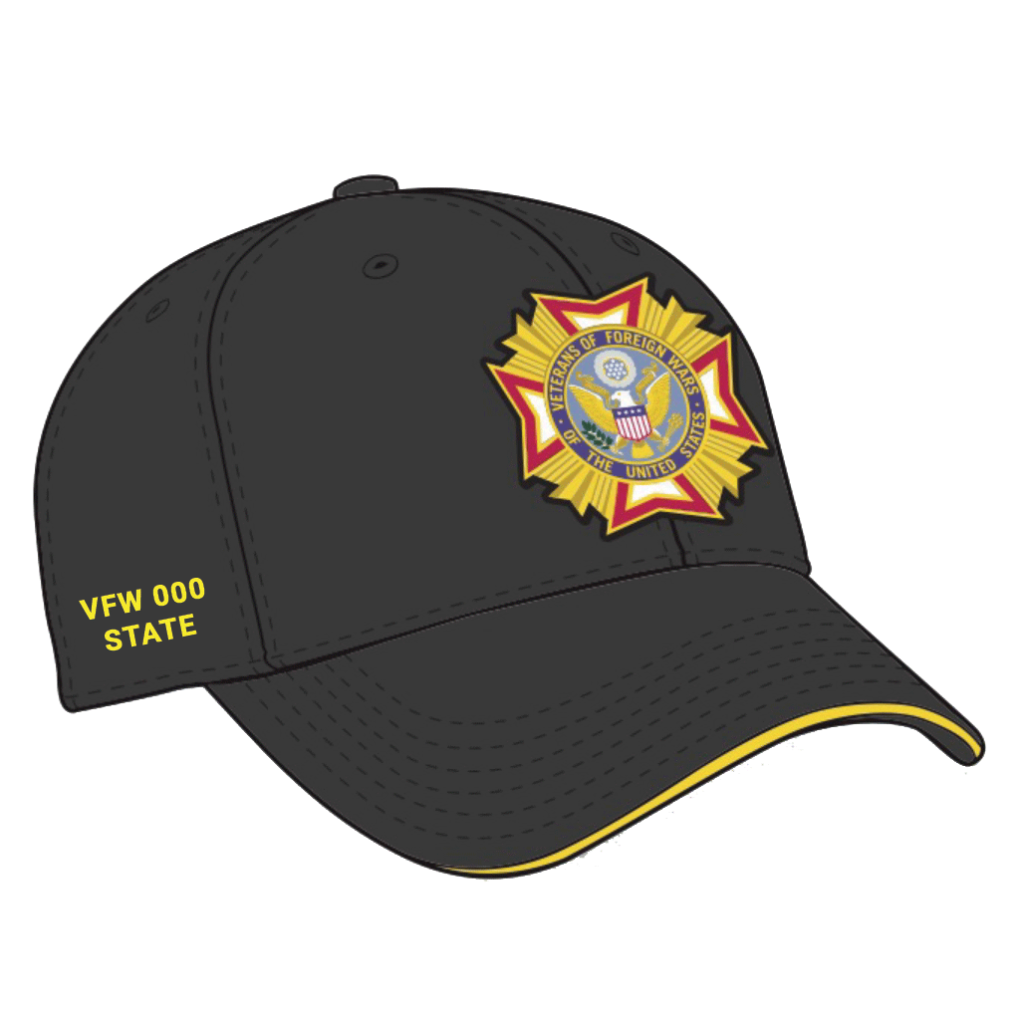

The Newly Approved Cap

Slide 22
The Alternative Cap: A Recruiting Game Changer
The "Why" for Recruiting:
The Icebreaker: It’s a natural conversation starter. It looks like a standard veteran "ball cap," making you appear more approachable in casual settings like coffee shops or gyms.
The "Modern" Signal: It immediately signals to younger veterans and female veterans that the VFW is modernizing and isn't just a "hat and vest" club.
Unified Team Look: When your recruiting team wears this cap with a matching polo, you look like a professional, cohesive unit rather than a group of individuals.

Slide 23
The Alternative Cap: A Recruiting Game Changer
The "Closing" Strategy:
The Instant Reward: Consider buying a few extra "unassigned" official caps. When a new member signs their application and pays their dues at your booth, hand them the hat immediately.
The Psychological Shift: Giving them the hat on the spot turns them from a "potential recruit" into a "member of the team" instantly. It’s the ultimate "welcome to the family" gesture.

