Slide 1
2026-2027
Training
Notes:
KEY TAKEAWAY: This is the title slide for the 2026-2027 Quartermaster Training program.
→ Welcome everyone and set the tone — this training is essential for every incoming Quartermaster.
→ Mention that the material covers financial duties, compliance, and best practices.
🎯 ENGAGE: Ask how many attendees are first-time Quartermasters vs. returning.

Slide 2
Quartermaster Training
May 2026
Notes:
KEY TAKEAWAY: Quartermaster Training is a structured program to prepare officers for their financial stewardship role.
→ Emphasize this training is based on official VFW guidelines and is not optional.
→ Set expectations for the session length and topics covered.
🎯 ENGAGE: Ask attendees what they find most challenging about the QM role.

Slide 3
Information pulled from:
VFW Quartermaster Guide
2024-2025
Notes:
KEY TAKEAWAY: All content is sourced from the official VFW Quartermaster Guide (2024-2025 edition).
→ Encourage everyone to obtain their own copy of the guide for reference.
→ Note that while this training covers key points, the full guide has much more detail.
🎯 ENGAGE: Ask who has already read the Quartermaster Guide.

Slide 4
What is a Quartermaster
The Post Quartermaster is the chief financial officer of the Post. The Quartermaster is the custodian of all Post property and the officer responsible for safeguarding Post funds and property. The Quartermaster is accountable to the Post, Department and the National Organization for all of the monies, securities, vouchers and property of the Post. The Quartermaster is the only one authorized under the Bylaws, to receive, handle, and account for funds of the Post. As Quartermaster, you may authorize a person to disburse funds on your behalf; however, they must be bonded. There are no exceptions to this rule!.
Notes:
KEY TAKEAWAY: The Quartermaster is the Post's chief financial officer — the ONLY person authorized to handle Post funds.
→ Stress the word 'custodian' — you are responsible for ALL Post property and funds.
→ Emphasize accountability goes three ways: to the Post, Department, AND National.
→ Critical point: If you authorize someone else to disburse funds, they MUST be bonded. No exceptions.
🎯 ENGAGE: Pause and ask — does everyone understand what 'bonded' means?

Slide 5
What is a Quartermaster (Cont.)
No committee, holding company, canteen manager, group or individual in the Post or in any way connected with the Post’s activities, can take this authority and responsibility from the Post Quartermaster. All funds, monies or property accumulated under the name of the Veterans of Foreign Wars for the Post, regardless of the nature of the activity which accumulates them, are the property of the Post and are subject only to disposition by Post action. No Post member can mandate the expenditure of funds or disposition of Post property unless properly authorized by the Post and executed by the Quartermaster or the Quartermaster's authorized person.
Notes:
KEY TAKEAWAY: No one can take the Quartermaster's authority away — all Post funds belong to the Post, period.
→ This is a common source of conflict — canteen managers, committees, or individuals sometimes try to control funds independently.
→ All money raised under the VFW name is Post property, regardless of which activity generated it.
→ Expenditures require proper Post authorization AND Quartermaster execution.
🎯 ENGAGE: Has anyone experienced a situation where someone tried to bypass the QM? Share lessons learned.

Slide 6
Qualifications of a Post Quartermaster
A major factor in the success or failure of a Post is the ability and efficiency of the Quartermaster..
The National Bylaws are more explicit on the duties of the Post Quartermaster than those for any other office
The Quartermaster is the custodian of the money and property of the Post.
The guardian of its finances and the keeper of the financial records.
The Quartermaster also plays an important role in collecting and processing dues
.
Notes:
KEY TAKEAWAY: The Quartermaster role is the most explicitly defined in the National Bylaws — it demands ability and efficiency.
→ A Post's success or failure often hinges on the Quartermaster's performance.
→ You are the custodian of money AND property — the guardian of finances and keeper of records.
→ Dues collection and processing is also a key part of the role.
🎯 ENGAGE: What skills do you think are most important for a successful Quartermaster?

Slide 7
Qualifications of a Post Quartermaster (Cont.)
The Quartermaster is meant to be, and must be, more than a bookkeeper, although maintaining adequate financial records is very important. The Quartermaster generally knows more about the Post than any other individual and MUST BE dependable, honest and capable.
Notes:
KEY TAKEAWAY: The Quartermaster must be more than a bookkeeper — they must be dependable, honest, and capable.
→ The QM often knows more about the Post's operations than anyone else.
→ While record-keeping is critical, the role requires broader leadership and integrity.
→ Emphasize the trust placed in this position.
🎯 ENGAGE: Pause here — integrity is the foundation of everything that follows.

Slide 8
Qualifications of a Post Quartermaster (Cont.)
In Post meetings, the Chaplain prays that we may “live lives of stainless integrity.” This petition applies to all Post Officers, but especially the Post Quartermaster. You must keep an accurate account of your stewardship. You must be everything the finest VFW character should be and with it all . . . be the hardest worker in the Post.
Notes:
KEY TAKEAWAY: The Quartermaster must be the hardest worker in the Post and maintain the highest standards of integrity.
→ Reference the Chaplain's prayer about 'lives of stainless integrity' — this especially applies to the QM.
→ Accurate accounting is not just a duty, it's a matter of personal character.
→ This is a role of service, not prestige.
🎯 ENGAGE: Take a moment to reflect on what this commitment means to you personally.

Slide 9
Duties of the Post Quartermaster
The duties of the Quartermaster are set forth in Section 218 (a) (5) of the Manual of Procedure.
Among the duties of a Post Quartermaster, the Quartermaster shall:
Notes:
KEY TAKEAWAY: The Quartermaster's duties are formally defined in Section 218(a)(5) of the Manual of Procedure.
→ This is the legal foundation for everything you'll do as QM.
→ The next several slides will detail each specific duty.
→ Encourage attendees to bookmark this section in their manual.
🎯 ENGAGE: How many of you have read Section 218? It's required reading.

Slide 10
Duties of the Post Quartermaster (Cont.)
Qualify and secure a bond in a sum at least equal to the amount of the liquid assets for which they may be accountable in accordance with Section 703.
b) Collect all monies due the Post, giving receipt therefore, and have charge of the funds, securities and other property of the Post, all of which shall be placed in their care. They shall be the accountable officer of the Post and the Treasurer of all committees handling funds.
Notes:
KEY TAKEAWAY: Duty (a): Secure a bond equal to or greater than the Post's liquid assets.
→ Bonding protects the Post financially — think of it like insurance against mishandling of funds.
→ Duty (b): Collect ALL monies due to the Post, issue receipts, and serve as treasurer of ALL committees handling funds.
→ You are the single point of accountability.
🎯 ENGAGE: Does your Post currently have adequate bonding? Many don't — let's discuss.

Slide 11
Duties of the Post Quartermaster (Cont.)
c) Disburse funds as properly authorized by the Post using accepted banking practices. Unless otherwise provided for in Post Bylaws(ie Digital Payments), all disbursements of Post funds shall bear the signature of the Quartermaster or other person(s) authorized by the Quartermaster. Such other authorized person(s) shall be bonded with an indemnity company as surety in a sum at least equal to the amount of the liquid assets for which they may be accountable in accordance with Section 703.
Notes:
KEY TAKEAWAY: Duty (c): Disburse funds only through proper authorization using accepted banking practices.
→ All disbursements need the QM's signature (or authorized person's signature).
→ Anyone authorized to sign must also be bonded per Section 703.
→ Post Bylaws may allow digital payments — but the accountability rules still apply.
🎯 ENGAGE: How does your Post currently handle disbursements? Checks only or digital too?

Slide 12
Duties of the Post Quartermaster (Cont.)
d) Receive annual membership dues and Life membership fees and forward the Department and National dues and Life membership fees immediately to National Headquarters as prescribed in Section 104.
e) Provide the Post Trustees with all records, files and statements required or necessary for the preparation of the Post Trustees Quarterly Report of Audit.
.
Notes:
KEY TAKEAWAY: Duty (d): Forward Department and National dues IMMEDIATELY. Duty (e): Support the Trustees' audit process.
→ Don't sit on membership dues — forward them right away to National HQ.
→ Life membership fees follow the same rule.
→ Providing complete records to Trustees for quarterly audits is mandatory, not optional.
🎯 ENGAGE: What's your current turnaround time for forwarding dues?

Slide 13
Duties of the Post Quartermaster (Cont.)
f) Reconcile and verify all transactions listed on all bank statements to assure the accuracy of Post records. The books and records of the Quartermaster shall be maintained in a legible and uniform format. Record keeping by electronic means may be used, provided a backup is maintained. Books and records shall be available for inspection by authorized officers and Post members at all reasonable times. Unless specifically authorized by the Post to remove such books and records from its facilities, they will be kept at the Post facilities.
Notes:
KEY TAKEAWAY: Duty (f): Reconcile ALL bank statements and maintain legible, uniform records.
→ Electronic record-keeping is allowed but you MUST maintain backups.
→ Books must be available for inspection by authorized officers and members at reasonable times.
→ Unless specifically authorized, keep records at the Post facility — don't take them home.
🎯 ENGAGE: What record-keeping system does your Post use? Spreadsheet, software, paper ledger?

Slide 14
Duties of the Post Quartermaster (Cont.)
g) Provide access and transfer to their successor in office or anyone designated by higher authority, without delay, all books, records, papers, monies, securities and other property of the Post in their possession or under their control.
h) Comply with and perform all duties required of them by the laws and usages of this organization, applicable Bylaws and orders from lawful authority and perform such other duties as are incident to such office.
Notes:
KEY TAKEAWAY: Duty (g): Transfer everything to your successor without delay. Duty (h): Comply with all laws and orders.
→ When your term ends, all books, records, money, and property must be handed over promptly.
→ Holding onto records or delaying transfer can create serious problems.
→ You must also follow all organizational laws, bylaws, and lawful orders.
🎯 ENGAGE: Has anyone experienced a difficult transition? What made it hard?

Slide 15
Duties of the Post Quartermaster (Cont.)
Report on transactions concerning receipts and expenditures, for any given period, at a regular or special meeting of the Post.
File appropriate forms as required by Federal, State and Local
Statutes or regulations.
Notes:
KEY TAKEAWAY: Report on receipts and expenditures at every Post meeting, and file all required government forms.
→ Transparency with the membership is essential — report at every regular or special meeting.
→ Federal, State, and Local filing requirements must all be met.
→ Missing deadlines can have serious legal consequences.
🎯 ENGAGE: Are you aware of all the filing requirements for your specific state and locality?

Slide 16
Taking Over as Quartermaster
Before a new Post Quartermaster takes up the duties, the previous Quartermaster must be given a “clean slate” by the Post Trustees or auditors. This may be accomplished by virtue of the required audit processes. You want to avoid picking up a headache from someone else. Remember, you are bonded, and, once you take over officially, you will be the person “in the middle” if the deck has not been cleared beforehand.
Notes:
KEY TAKEAWAY: Before taking over, ensure the outgoing QM gets a clean audit from the Post Trustees.
→ This protects YOU — don't inherit someone else's problems.
→ Remember, once you officially take over, YOU are the bonded person responsible.
→ The audit process gives the previous QM a 'clean slate' and establishes your starting point.
🎯 ENGAGE: This is critical — never skip this step. Has anyone taken over without an audit? What happened?

Slide 17
Taking Over as Quartermaster (Cont.)
Before you undertake any business as the new Post Quartermaster, check with the bank in which Post funds are deposited to satisfy yourself the funds are correct and in order. Be sure that proper signature cards are on file with the bank with specimen signatures of all persons authorized to make and endorse checks on behalf of the Post. When new officers are elected the new signatures must be provided to the bank.
Notes:
KEY TAKEAWAY: Verify bank balances and update signature cards before conducting any business.
→ Physically verify that the funds are correct and in order at the bank.
→ Ensure proper signature cards are on file with current authorized signers.
→ When new officers are elected, new signatures must be filed immediately.
🎯 ENGAGE: Make a checklist right now — bank verification is step one.

Slide 18
Taking Over as Quartermaster (Cont.)
You should deposit money and draw checks for disbursements for authorized Post expenses. A Quartermaster should make deposits at regular intervals, rather than letting checks and money accumulate. Get them in the bank as soon as possible. In making deposits it is a better practice to put what you have received into the bank in the same physical form in which you received it. Coins and bills should be deposited as such and checks and negotiable paper must be deposited in the same manner.
Notes:
KEY TAKEAWAY: Deposit money promptly and in the same form you received it.
→ Don't let checks and cash accumulate — get them to the bank regularly.
→ Deposit coins as coins, bills as bills, checks as checks.
→ This makes reconciliation much easier when matching deposits to your ledger.
🎯 ENGAGE: What's a reasonable deposit schedule? Most Posts should deposit at least weekly.

Slide 19
Taking Over as Quartermaster (Cont.)
By putting your receipts in the bank in the same form in which they appear in your ledger, the deposit slips can be easily checked against your ledger for verification and errors can be more easily located. No checks or other negotiable paper received by the Post Quartermaster should be endorsed to a third party or cashed. They should be deposited to the Post account. No bills should be paid in cash. All disbursements should be by check only. This assures an adequate, accurate record.
Notes:
KEY TAKEAWAY: Never endorse checks to third parties or pay bills in cash — all disbursements must be by check.
→ Depositing receipts in the same form as your ledger entries makes verification easy.
→ No cashing checks received by the Post — deposit them to the Post account.
→ Check-only disbursements ensure a clear, auditable paper trail.
🎯 ENGAGE: Why is this so important? Because it creates an ironclad audit trail.

Slide 20
IRS Form 8822-B
Change in an Entity’s “Responsible Party”
In an effort to ensure that the correct person is contacted when resolving a tax matter, the IRS imposes a requirement to report a change in the identity of the “responsible party” for any entity that has an Employer Identification Number. An organization must report a change in its “responsible party” to the IRS on Form 8822-B within 60 days of the change. The IRS instructions define a “responsible party” as the person who has a level of control over, or entitlement to, the funds or assets in the entity, that as a practical manner, enable the individual, directly or indirectly to control, manage or direct the entity and the disposition of its funds and assets.
Notes:
KEY TAKEAWAY: When the 'responsible party' changes (new QM), file IRS Form 8822-B within 60 days.
→ This is an IRS requirement for any entity with an EIN.
→ The 'responsible party' is whoever controls the funds and assets.
→ Failure to file can cause problems when the IRS needs to contact your Post.
🎯 ENGAGE: Has your Post filed this form during past transitions? Many Posts miss this requirement.

Slide 21
Control of Clubroom Funds
Title to all real property of unincorporated Posts, County Councils and Districts shall be taken in the name of the regularly elected Trustees of said units, and their successors in office, to be held, used and enjoyed in trust for its members. When the laws of the respective states shall require the delivery of a bill of sale to establish ownership of property, such bills of sale shall also be made to the Trustees of said units, and their successors in office, in trust for the members thereof.
Notes:
KEY TAKEAWAY: All Post property must be held in trust by elected Trustees — not by individuals.
→ Title to real property goes to the Trustees and their successors, in trust for members.
→ Bills of sale follow the same rule where required by state law.
→ This protects the Post if individual officers change.
🎯 ENGAGE: Is your Post's property properly titled? This is worth verifying.

Slide 22
Clear and Accessible Records
Financial record keeping should include complete and clear documentation of all financial transactions. It cannot be reiterated enough the importance of being prudent in the financial record keeping of your Post, as it can determine the survival or failure of the Post. Every financial transaction must be documented, so it can be easily traced in the event of an audit or inquiry.
Notes:
KEY TAKEAWAY: Every financial transaction must be documented — complete and clear record-keeping determines the Post's survival.
→ This cannot be overstated — documentation is your best protection.
→ Records must be easily traceable for audits or inquiries.
→ Sloppy record-keeping is the number one reason Posts get into financial trouble.
🎯 ENGAGE: What's your documentation system? If you can't explain a transaction in 30 seconds, it's not documented well enough.

Slide 23
Payment Platforms
Payment platforms such as Venmo, CashApp, Zelle, etc. are acceptable forms of collecting and disbursing funds from the membership as long as the process follows Section 218(a)(5)(b). However, Post business accounts must be established on these platforms; do not use personal accounts. The selected platform must have the ability to pull transaction reports that can be integrated into the Quartermaster’s Detailed Report of Receipts and Disbursements.
Notes:
KEY TAKEAWAY: Digital payment platforms (Venmo, CashApp, Zelle) are acceptable IF they follow proper procedures.
→ Must use POST business accounts — never personal accounts.
→ Must follow Section 218(a)(5)(b) disbursement rules.
→ The platform must generate transaction reports that integrate with your financial records.
🎯 ENGAGE: Does your Post use any digital payment platforms? What has your experience been?

Slide 24
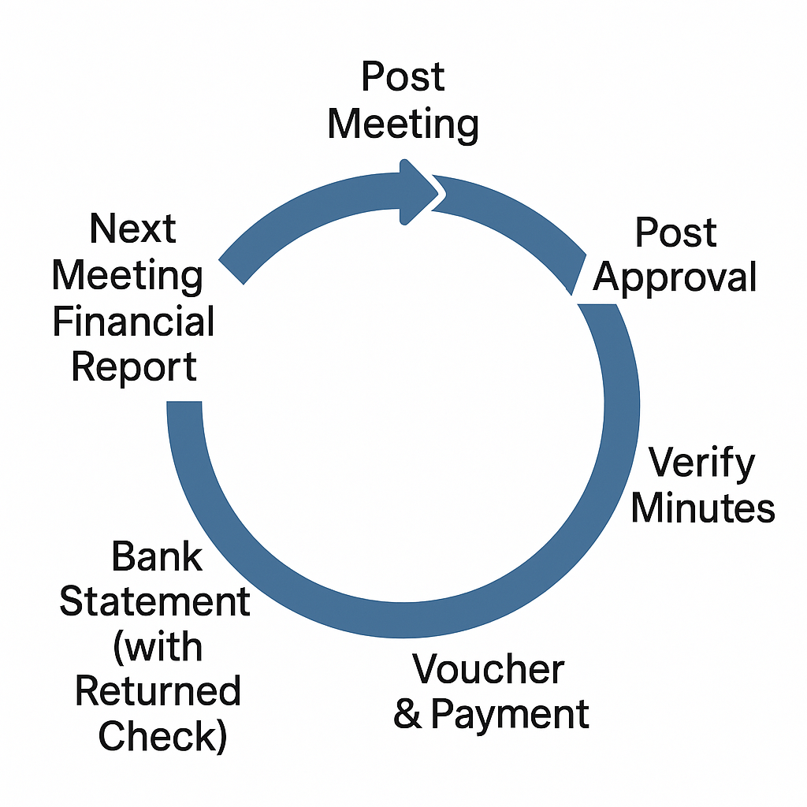
Payment Cycle
Notes:
KEY TAKEAWAY: This diagram illustrates the payment cycle — understand the flow of money through the Post.
→ Walk through the visual step by step.
→ Every payment follows a defined path with checkpoints.
→ Understanding this cycle prevents unauthorized disbursements.
🎯 ENGAGE: Can someone walk me through this cycle from memory?

Slide 25
Membership
QM
Payment Cycle
QM/CMDR
Trustee
CMDR /QM
Notes:
KEY TAKEAWAY: The payment cycle involves multiple parties — Membership, QM, Commander, and Trustees each have a role.
→ Notice the checks and balances built into the system.
→ The QM is at the center but doesn't act alone — Commander approval and Trustee oversight are required.
→ This prevents any single person from having unchecked control.
🎯 ENGAGE: Which part of this cycle does your Post struggle with most?

Slide 26
Authority to Disburse
A Quartermaster may NOT disburse funds of the Post, outside of an approved annual budget, without receiving proper authority from that Post by action on the floor at a regular or special meeting and the approval of the Post Commander.
Notes:
KEY TAKEAWAY: The QM cannot spend Post money outside the approved budget without a floor vote AND Commander approval.
→ This is a hard rule — no exceptions for 'emergencies' or 'small amounts.'
→ Proper authority means action on the floor at a regular or special meeting.
→ Both the Post vote AND Commander approval are required — not one or the other.
🎯 ENGAGE: What happens if you need to make an urgent expenditure? Plan ahead with your budget.

Slide 27
Vouchers/Orders
A Quartermaster may NOT disburse funds of the Post, outside of an approved annual budget, without receiving proper authority from that Post by action on the floor at a regular or special meeting and the approval of the Post Commander.
When approved by the Post and properly signed by the Post Commander, it is the authority for the Post Quartermaster to disburse funds in the amount designated on that voucher/order.
Notes:
KEY TAKEAWAY: Vouchers/Orders are the formal authorization mechanism for disbursing Post funds.
→ The Post votes to approve, the Commander signs, and THEN the QM disburses.
→ The voucher amount is the maximum you can pay — no rounding up.
→ This creates a clear chain of authorization.
🎯 ENGAGE: Does your Post use a formal voucher system? If not, you should start.

Slide 28
Vouchers/Orders (Cont.)
The returned check properly endorsed is proof the money has been paid. In this manner, the Quartermaster has authority to pay and also proof that payment has been made. Vouchers/Orders must be carefully and permanently filed, and cashed checks accounted for properly, audited and filed for future reference, with correct notations in your books. This is what is known as a clear record and, as a good Quartermaster, you should never operate any other way.
Notes:
KEY TAKEAWAY: Keep vouchers and cashed checks as permanent proof of authorization and payment.
→ The returned endorsed check proves payment was made.
→ Vouchers prove you had authority to pay.
→ File everything carefully — this is your protection.
🎯 ENGAGE: Where do you store your vouchers and records? They need to be secure but accessible.

Slide 29
Vouchers/Orders (Cont.)
Always keep this in mind. You can never have too much proof for the proper receipt and disbursement of funds, because doubt can attach to any person, despite a record of probity and honesty. A Quartermaster may, with or without cause, be called upon at any time to account for stewardship. Never honor a voucher marked “miscellaneous expense.” If such expense cannot be detailed and itemized for Post approval, you are not required to make that disbursement.
Notes:
KEY TAKEAWAY: You can never have too much proof — and NEVER honor a voucher marked 'miscellaneous expense.'
→ Doubt can attach to anyone, regardless of their reputation.
→ You can be called to account for your stewardship at any time.
→ If an expense can't be detailed and itemized, you are NOT required to pay it.
🎯 ENGAGE: This is your protection — say it with me: 'No detail, no payment.' Remember that.

Slide 30
Financial Report
The Post Quartermaster makes a report to the Post on its finances at each meeting. This report is taken directly from the records. It is made out on Financial Statement Form (Form #4208) and it must be accurate and current.
Notes:
KEY TAKEAWAY: The QM reports Post finances at every meeting using Form 4208 — it must be accurate and current.
→ This report comes directly from your records — no estimates or approximations.
→ Financial Statement Form 4208 is the standard format.
→ Members have a right to know the Post's financial status.
🎯 ENGAGE: Are you reporting at every meeting? If not, why not?

Slide 31
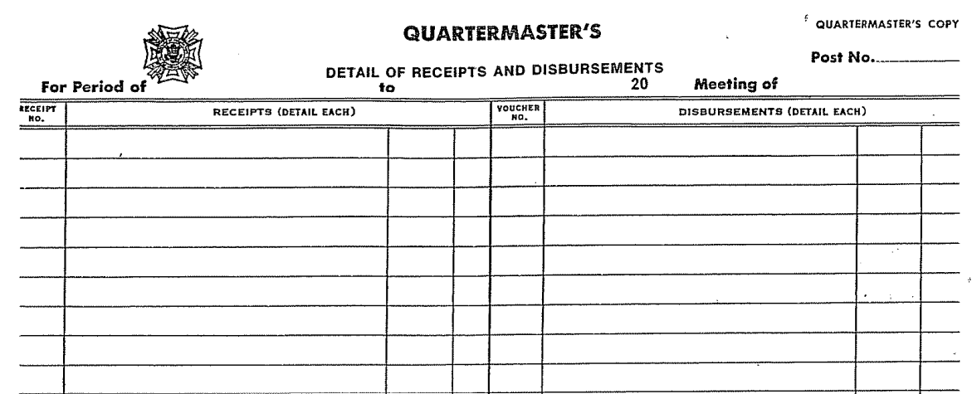
Quartermaster’s Monthly Report Form 4208
Notes:
KEY TAKEAWAY: This is the Quartermaster's Monthly Report Form 4208 — study its layout and sections.
→ Walk through each section of the form.
→ Familiarity with this form will make monthly reporting routine.
→ Accuracy here prevents problems at quarterly audit time.
🎯 ENGAGE: Has everyone seen this form before? Let's walk through it together.

Slide 32

Quartermaster’s Monthly Report Form 4208
Notes:
KEY TAKEAWAY: Continuation of Form 4208 — pay attention to the detail sections.
→ Each line item must be filled in accurately.
→ Don't leave blanks — enter zero if there's no activity.
→ Consistency in how you fill this out makes auditing easier.
🎯 ENGAGE: What questions do you have about specific line items?

Slide 33
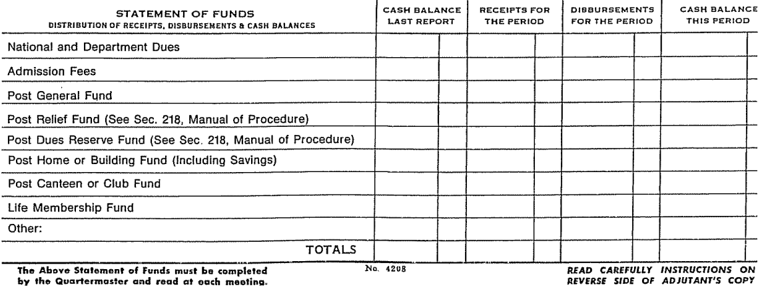
Quartermaster’s Monthly Report Form 4208
Notes:
KEY TAKEAWAY: Additional sections of Form 4208 — ensure completeness.
→ Review all remaining sections of the form.
→ The form must be complete before presenting to the Post.
→ Incomplete reports undermine member confidence.
🎯 ENGAGE: Practice filling this out with sample numbers before your first real report.

Slide 34
Financial Report (Cont.)
The Post Quartermaster will ensure at a minimum, a detailed Financial Report and a register of receipts and disbursements for the previous month is presented at the Post’s monthly meeting. The report will stand as printed or as distributed at the monthly membership meeting and no action shall be taken to accept the report, accept the report pending audit, or accept the report subject to changes so that Post Trustees can complete their responsibilities through quarterly audit process.
Notes:
KEY TAKEAWAY: Present a detailed Financial Report and receipt/disbursement register at every monthly meeting.
→ The report stands as printed — it is NOT voted on for acceptance at the monthly meeting.
→ Don't accept, accept pending audit, or accept subject to changes.
→ The Trustees handle verification through the quarterly audit process.
🎯 ENGAGE: This is often misunderstood — the monthly report is presented, not voted on. Questions?

Slide 35
Financial Report (Cont.)
After the Post Trustees have completed the quarterly audit, that is the report presented to the Post’s membership for acceptance. This process is important because it is the Post’s official record showing the Trustees have properly audited the Quartermaster’s monthly financial reports and have brought any discrepancies found to the Post’s membership.
Notes:
KEY TAKEAWAY: The quarterly audit by Trustees is the official record — THAT report is what the membership accepts.
→ The Trustees audit the QM's monthly reports and bring any discrepancies to the membership.
→ This is the Post's formal financial accountability mechanism.
→ The quarterly audit process protects both the QM and the Post.
🎯 ENGAGE: How is your Post's quarterly audit process working? Any issues?

Slide 36
Insurance
Any Post owning and/or operating, directly or by reason of a holding company or other entity substantially controlled by the Post or its members, a canteen, clubroom or other facility available to members or guests must maintain general liability insurance, including, if necessary or appropriate, liquor liability insurance. Such insurance must be of a type and amount sufficient to protect the Post and must name, as additional insureds, the Veterans of Foreign Wars of the United States and the Department in which such Post is located.
Notes:
KEY TAKEAWAY: Posts with facilities must maintain general liability insurance AND liquor liability insurance if applicable.
→ Insurance must name VFW National and your Department as additional insureds.
→ Coverage must be sufficient type and amount to protect the Post.
→ This applies whether the Post operates directly or through a holding company.
🎯 ENGAGE: When was the last time your Post reviewed its insurance coverage? Do it annually.

Slide 37
Bonds
All Posts are required by the Bylaws (Section 703) to have each officer accountable for funds or property bonded in a sum at least equal to the amount of the liquid assets for which, so far as can be anticipated, the Quartermaster may be accountable. Failure to comply with this provision of the Bylaws is a dangerous practice because the Post will be without the protection a bond affords
Notes:
KEY TAKEAWAY: ALL Posts must bond officers accountable for funds — the bond must equal or exceed liquid assets.
→ This is required by Section 703 of the Bylaws — it's not optional.
→ Going without a bond is dangerous — the Post has no financial protection.
→ The bond amount must cover the maximum liquid assets the QM may be accountable for.
🎯 ENGAGE: Is your Post's bond amount adequate? When did you last verify?

Slide 38
Bonds (Cont.)
In addition to the Post Quartermaster, positions should be bonded that are specifically identified in Post bylaws, operating / standing procedures, or any other position that has custody of funds or access to Post accounts of liquid assets. For example, many Posts list the Commander as an account signatory in addition to the Quartermaster, or the Canteen/Bar Manager or House Committee Chair may be listed on accounts and have access to the Post’s funds and could clean out an account with just their signature. These positions should be bonded
Notes:
KEY TAKEAWAY: Bond anyone with access to Post funds — Commander, Canteen Manager, anyone who could sign on accounts.
→ Look beyond just the QM — who else is on signature cards?
→ A Canteen Manager with account access could clean out the Post with their signature alone.
→ Check your bylaws and standing procedures for all positions that handle money.
🎯 ENGAGE: Make a list right now of every person in your Post with access to funds. Are they all bonded?

Slide 39
Bonds (Cont.)
In contrast, a bartender who only has access to their drawer while on shift or a member running a Buddy Poppy drive who only has access to a limited amount of funds does not require a bond. A bond is like fire insurance, you hope you never need it but, if you do and do not have it, you could have serious financial problems.
Notes:
KEY TAKEAWAY: Not everyone needs bonding — a bartender with drawer access or a Poppy drive volunteer doesn't require it.
→ The key question is: can this person access significant Post liquid assets?
→ Limited, supervised access to small amounts doesn't require bonding.
→ Think of a bond like fire insurance — you hope you never need it, but if you do and don't have it, you're in serious trouble.
🎯 ENGAGE: When in doubt, bond the position. The cost is minimal compared to the risk.

Slide 40
Document Retention
See the VFW Quartermaster’s Guide,
Document Retention Section for clear guidelines on how long you have to retain records by type. Don’t be that person who doesn’t follow the guidelines. Most are based off of Federal Law.
Notes:
KEY TAKEAWAY: Follow the document retention guidelines in the VFW Quartermaster's Guide — most are based on Federal Law.
→ Different types of records have different retention periods.
→ Don't be the person who throws away records too early.
→ Refer to the specific guidelines in the Guide for each document type.
🎯 ENGAGE: Do you have a document retention schedule posted? If not, create one this week.

Slide 41
“Buddy”® Poppy
Every Post should participate in the Buddy Poppy program at least once a year, even if your Post has NEVER distributed poppies. You will not fulfill your duty and responsibility as Post Quartermaster unless you assist your Commander in conducting a Buddy Poppy program during your respective terms in office.
Notes:
KEY TAKEAWAY: Every Post MUST participate in the Buddy Poppy program at least once a year — no exceptions.
→ Even if your Post has never distributed poppies before, you must start.
→ As QM, it's your duty to help the Commander conduct this program.
→ This is about honoring veterans — it's core to the VFW mission.
🎯 ENGAGE: When is your Post planning its Buddy Poppy distribution? Let's set a date if you haven't.

Slide 42
Where to Order Buddy
All Buddy Poppies and allied materials, advertising, promotional and worker’s supplies are obtained by the Post through its own Department (state) Headquarters.
If you have not received order forms and a list of available material and prices, contact your Department Quartermaster.
It is suggested that all orders be placed with your Department Headquarters 6-8 weeks prior to anticipated program date.
Notes:
KEY TAKEAWAY: Order Buddy Poppies through your Department HQ 6-8 weeks before your planned distribution date.
→ Contact your Department Quartermaster for order forms and pricing.
→ Advertising, promotional, and worker supplies are also available.
→ Don't wait until the last minute — plan ahead.
🎯 ENGAGE: Has everyone identified their Department Quartermaster contact for ordering?

Slide 43
How to Use Buddy Poppy Proceeds
Your Post proceeds must be used for “the assistance of needy veterans and members of the Armed Forces and their dependents, surviving spouses and orphans.” No Buddy Poppy funds can be used for any other purpose. Net proceeds must be put in the Post Relief Fund. Adherence is mandatory as provided in Section 219, VFW, the Manual of Procedure states:
The Quartermaster of the Post will be the custodian of the relief fund and will expend monies there from, as directed by the Post, for the following purposes:
Notes:
KEY TAKEAWAY: Buddy Poppy proceeds MUST go to the Post Relief Fund — they can ONLY be used for veteran assistance.
→ This is mandatory per Section 219 of the Manual of Procedure.
→ Net proceeds go into the Relief Fund — the QM is custodian.
→ Expenditures from the Relief Fund are directed by Post action.
🎯 ENGAGE: Does your Post have a separate Relief Fund account? If not, set one up.

Slide 44
How to Use Buddy Poppy Proceeds (Cont.)
Aid, assistance, relief, and comfort of needy or disabled veterans or members of the Armed Forces and their dependents, and the surviving spouses and orphans of deceased veterans.
Maintenance and expansion of the VFW National Home for Children and other facilities devoted exclusively to the benefit and welfare of the dependents, surviving spouse, and orphans of disabled, needy or deceased veterans or members of the Armed Forces.
Notes:
KEY TAKEAWAY: Relief Fund uses include aid to needy veterans, their families, and support for the VFW National Home for Children.
→ (a) Direct aid, assistance, relief, and comfort to needy or disabled veterans and their families.
→ (b) Support the VFW National Home and similar facilities for veteran dependents.
→ These are the only authorized uses — no exceptions.
🎯 ENGAGE: How has your Post used Relief Fund money in the past?

Slide 45
How to Use Buddy Poppy Proceeds (Cont.)
c) Necessary expenses in providing entertainment, care, and assistance to hospitalized veterans or members of the Armed Forces.
d) Veterans' rehabilitation, welfare and service work.
e) To perpetuate the memory of deceased veterans and members of the Armed Forces and to comfort their survivors.
Notes:
KEY TAKEAWAY: Relief Fund can also cover hospitalized veteran care, rehabilitation work, and honoring the memory of deceased veterans.
→ (c) Entertainment, care, and assistance for hospitalized veterans.
→ (d) Veterans' rehabilitation, welfare, and service work.
→ (e) Perpetuating memory of deceased veterans and comforting survivors.
🎯 ENGAGE: There are many meaningful ways to use these funds. What ideas does your Post have?

Slide 46
How to Use Buddy Poppy Proceeds (Cont.)
f) To foster true patriotism through historical and educational programs.
g) Remission of dues of sick, needy or disabled members.
h) Necessary expenses to support the relief fund such as the purchase of Buddy Poppies.
Relief funds may be invested in approved securities but shall not be loaned to the Post or other units or transferred from the relief fund in any manner or under any guise, except that relief funds may be transferred to the general fund for remission of dues of sick, needy or disabled members.
Notes:
KEY TAKEAWAY: Additional Relief Fund uses include patriotic programs, dues remission for needy members, and Poppy purchase costs.
→ (f) Historical and educational programs to foster patriotism.
→ (g) Remission of dues for sick, needy, or disabled members.
→ (h) Purchasing Buddy Poppies to support the Relief Fund.
→ Relief funds may be invested but NEVER loaned to the Post or transferred out improperly.
🎯 ENGAGE: The only transfer allowed from Relief to General Fund is for dues remission. Remember that.

Slide 47
Financial Reporting
The Uniform System of Post Records and Accounts is a system that has been in use for many years by many VFW Posts with exceptional results. This system is the preferred method of record keeping; however, as technology continues to develop, many VFW Posts are transitioning to electronic-based methods utilizing differing types of accounting software. When searching for new electronic-based methods, any automated system that follows Generally Accepted Accounting Principles (GAAP) used in the United States is acceptable. GAAP sets standard accounting rules for preparing, presenting, and reporting financial statements in the U.S. The following link includes an accounting glossary of terms at the bottom of the page. https:// www.investopedia.com.
Notes:
KEY TAKEAWAY: Use GAAP-compliant accounting systems — the traditional Uniform System or approved electronic methods.
→ The Uniform System of Post Records has worked for years.
→ Electronic systems are fine as long as they follow Generally Accepted Accounting Principles (GAAP).
→ Investopedia.com has a useful accounting glossary for reference.
🎯 ENGAGE: What accounting system does your Post currently use? Is it GAAP-compliant?

Slide 48
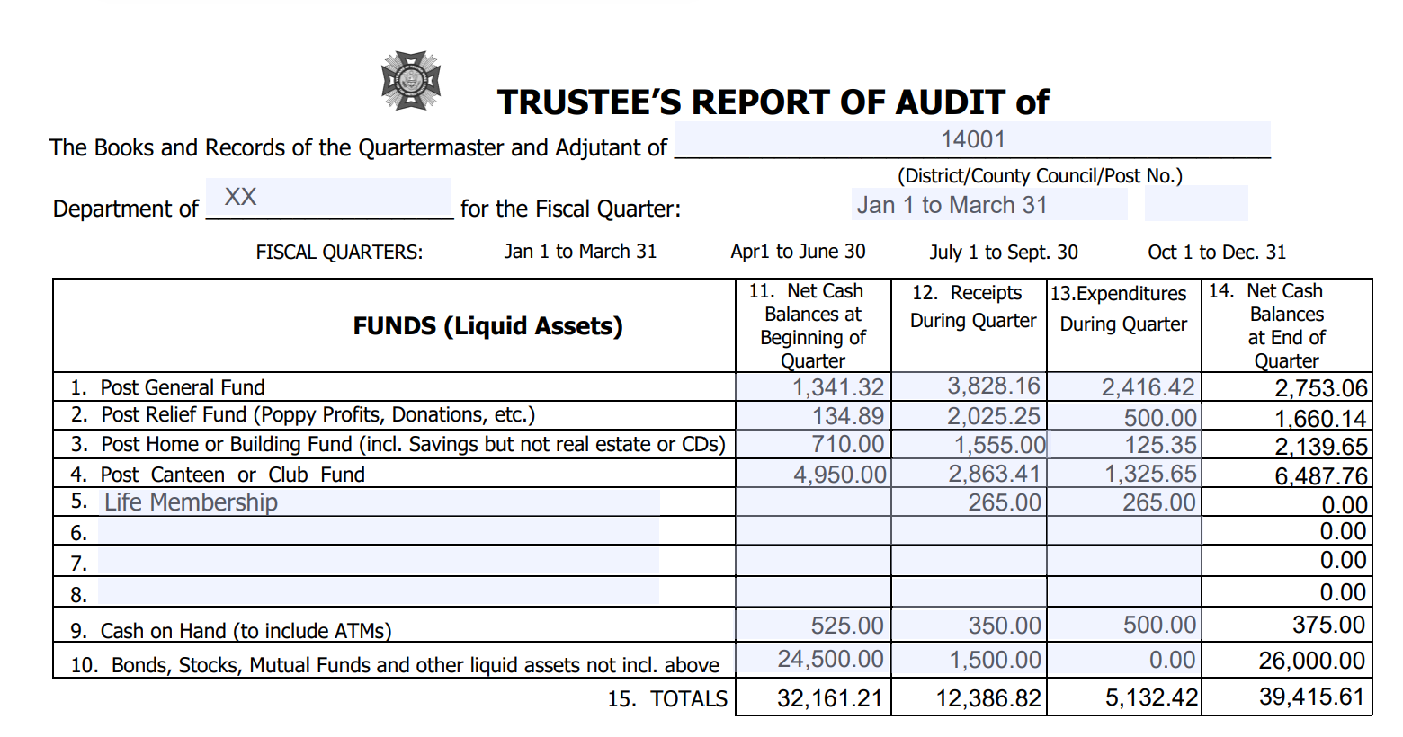
Notes:
KEY TAKEAWAY: This is the Trustees' Report of Audit form — study its structure carefully.
→ Walk through the form layout and sections.
→ Understanding this form helps you prepare records that make the audit smooth.
→ The QM and Trustees need to work together on this.
🎯 ENGAGE: Have you and your Trustees reviewed this form together?

Slide 49
Lines #1-8 FUNDS (Liquid Assets) Listed are those funds most likely to be carried by a VFW Post and District. Any special funds may be added in the blank spaces. A “fund” is an account which normally has both income and expenditures. In most cases, just about all of your miscellaneous expenditures (community service, youth activities, expenses, etc.) are chargeable to your general fund and most miscellaneous income (proceeds from fundraising activities, dues, etc.) are credited to your general fund. Item
Notes:
KEY TAKEAWAY: Lines 1-8 cover your Post's Funds (liquid assets) — most income and expenses flow through the General Fund.
→ A 'fund' has both income and expenditures.
→ Most miscellaneous expenses (community service, youth activities) are charged to the General Fund.
→ Most miscellaneous income (fundraising, dues) is credited to the General Fund.
→ Special funds can be added in the blank spaces.
🎯 ENGAGE: What funds does your Post currently maintain? List them out.

Slide 50
Line #9 CASH ON HAND (TO INCLUDE ATMS): Some posts own/operate ATMs, jukeboxes, gaming machines or other cash machines that that are not included in Item #4 above that require cash on hand to operate daily.
Line #10 BONDS, STOCKS, MUTUAL FUNDS AND OTHER LIQUID ASSETS NOT INCLUDED ABOVE This includes any financial instruments not previously included in any funds listed in Item #1-8 that can be liquidated without penalty by the financial institution. A loss in value of the account or processing fee charged by the financial institution to process the transaction does not equate to a penalty.
Notes:
KEY TAKEAWAY: Line 9 covers Cash on Hand (including ATMs), Line 10 covers other liquid assets like bonds and stocks.
→ Cash machines, jukeboxes, gaming machines may require cash on hand.
→ Financial instruments that can be liquidated without penalty are liquid assets.
→ A loss in market value is NOT the same as a penalty — include these assets.
🎯 ENGAGE: Does your Post have any of these types of assets? Make sure they're all accounted for.

Slide 51
Column #11 NET CASH BALANCES AT BEGINNING OF QUARTER The figures in this column are obtained from different funds as listed in your ledger. The individual items in this column as well as the total at the bottom of the column should be the same as the ending balances of the previous quarterly audit.
Column #12 RECEIPTS DURING QUARTER The figures in this column are obtained by adding the amount shown in your ledger for the three months. This should include items transferred into a fund from another fund during the quarter.
Notes:
KEY TAKEAWAY: Column 11 is beginning balance, Column 12 is receipts — they must match previous audit ending balances.
→ Beginning balances come from your ledger and should match the prior quarter's ending balances.
→ Receipts include all income for the three months, including inter-fund transfers IN.
→ If these numbers don't match, investigate before proceeding.
🎯 ENGAGE: Consistency between quarters is key — discrepancies mean errors that need to be found.

Slide 52
Column #13 EXPENDITURES DURING QUARTER The figures in this column are obtained by adding the expenditures for the three months. Include items transferred out of another fund during the quarter.
Column #14 NET CASH BALANCE AT END OF QUARTER The figures in this column are obtained by adding items 11 & 12 and subtracting items 13.
Line #15 TOTALS The figures in this line are obtained by adding the totals of items 11& 12 and subtracting item 13 – you should arrive at the same by adding item 14.
Notes:
KEY TAKEAWAY: Column 13 is expenditures, Column 14 is ending balance (11 + 12 - 13), Line 15 is totals.
→ Expenditures include inter-fund transfers OUT.
→ The math is simple: beginning + receipts - expenditures = ending balance.
→ Line 15 totals must cross-check: total of (11+12-13) should equal total of column 14.
🎯 ENGAGE: If the math doesn't balance, stop and find the error. Don't force it.

Slide 53
Notes:
KEY TAKEAWAY: Review this section of the audit form carefully — every line matters.
→ Walk through the form details shown.
→ Accuracy here directly impacts the quarterly audit outcome.
→ Take your time with this section.
🎯 ENGAGE: Any questions about specific lines? Now is the time to ask.

Slide 54
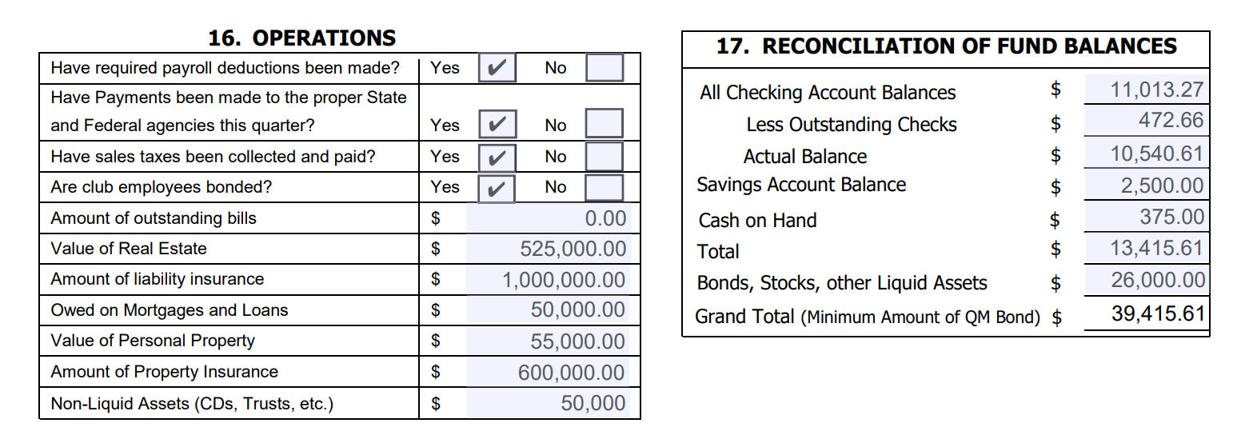
Notes:
KEY TAKEAWAY: Continue reviewing the audit form — completeness is essential.
→ Every section must be filled in properly.
→ Blank fields raise red flags during audits.
→ If a line doesn't apply, note it rather than leaving it blank.
🎯 ENGAGE: Practice filling in each section with your Post's actual numbers.

Slide 55
Section #16 OPERATIONS Answer questions as applicable. Non-liquid assets are types of assets that cannot be easily converted into cash within a short period without harsh penalties for early withdrawals. Trusts are a typical example. However, Certificate of Deposits less than $65,000 in value are typically non-liquid assets. Certificate of Deposits greater than $65,000 can be liquid assets. It is best to check with your banking institution on the type of CD and retain the information with the Post Financial Documents.
Notes:
KEY TAKEAWAY: Section 16 covers Operations — answer all applicable questions about non-liquid assets.
→ Non-liquid assets can't be easily converted to cash (e.g., trusts, certain CDs).
→ CDs under $65,000 are typically non-liquid; over $65,000 may be liquid.
→ Check with your bank about the specific terms of your CDs.
🎯 ENGAGE: Do you know the difference between liquid and non-liquid assets? This matters for bonding amounts.

Slide 56
#17 RECONCILIATION OF FUND BALANCES:
All Checking Account Balances
Enter ending balance shown on bank statement. If more than one checking account, total ending balances for all accounts.
Less Outstanding Checks
Total checks written on or before the date of the last bank statement of the quarter that do not appear on the statement. If more than one checking account, total all outstanding checks.
Notes:
KEY TAKEAWAY: Section 17 is Fund Balance Reconciliation — start with all checking account ending balances.
→ If you have multiple checking accounts, total all ending balances.
→ Subtract outstanding checks (written but not yet on the statement).
→ If multiple accounts, total ALL outstanding checks across accounts.
🎯 ENGAGE: How many bank accounts does your Post maintain? Each one needs to be reconciled.

Slide 57
#17 RECONCILIATION OF FUND BALANCES: (Cont.)
Account Balance
Subtract " Less Outstanding Checks" from "All Checking Account Balances. Add any deposits in transit that do not appear on bank statements. This should agree with the balance in your checkbook/ledger.
Savings Account Balance
Enter balances of any savings accounts.
Notes:
KEY TAKEAWAY: Calculate Account Balance, then add Savings Account balances.
→ Account Balance = Checking Balance minus Outstanding Checks plus Deposits in Transit.
→ This should match your checkbook/ledger balance.
→ Add all savings account balances separately.
🎯 ENGAGE: If your calculated balance doesn't match your ledger, find the discrepancy before moving on.

Slide 58
#17 RECONCILIATION OF FUND BALANCES: (Cont.)
Cash on Hand
Amount of money on hand that has not been included in “Outstanding Deposits” above.
Total
Add "Account Balance" line, "Savings Account Balance", and"Cash on Hand" Line.
Bonds, Stocks and Other Liquid Assets
Enter current value of all bonds, stocks, and other liquid assets.
Notes:
KEY TAKEAWAY: Add Cash on Hand and calculate the Total, then add Bonds/Stocks/Liquid Assets.
→ Cash on Hand = money not yet deposited and not included in outstanding deposits.
→ Total = Account Balance + Savings + Cash on Hand.
→ Add current value of bonds, stocks, and other liquid assets.
🎯 ENGAGE: Make sure you're using CURRENT values for investments, not original purchase prices.

Slide 59
#17 RECONCILIATION OF FUND BALANCES: (Cont.)
Grand Total (Minimum Amount of QM Bond)
Add "Total Cash" line to "Bonds & Other Liquid Assets" line. Total in Item #15 Net Cash Balance at end of Quarter should equal Grand Total in Item #17. This is the minimum amount of QM Bond. Verify in #18, QM bond equal to or above this amount.
Notes:
KEY TAKEAWAY: Grand Total equals the minimum QM Bond amount — verify the bond meets or exceeds this number.
→ Grand Total = Total Cash + Bonds & Other Liquid Assets.
→ This MUST equal Line 15 (Net Cash Balance at end of Quarter).
→ Check Section 18 to verify the QM bond is adequate.
🎯 ENGAGE: This is the moment of truth — if your bond is too low, increase it immediately.

Slide 60
Notes:
KEY TAKEAWAY: Review this section of the form — attention to detail prevents audit findings.
→ Walk through the visual carefully.
→ Every number must be supported by documentation.
→ Cross-reference with your ledger entries.
🎯 ENGAGE: Take notes on any sections you find confusing — we'll clarify.

Slide 61
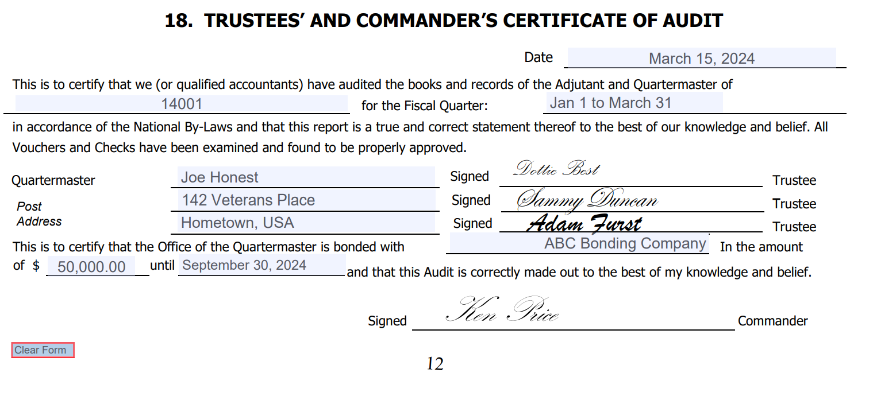
Notes:
KEY TAKEAWAY: Continue reviewing the form sections — consistency across all pages is essential.
→ Numbers on different pages must agree with each other.
→ Internal consistency is what auditors check first.
→ Any mismatch will trigger deeper investigation.
🎯 ENGAGE: Double-check your math on every page before submitting.

Slide 62
#18 TRUSTEES’ AND COMMANDER’S CERTIFICATE OF AUDIT:
Enter the date the audit is prepared, the Post name and number and the quarter for which the audit is prepared. The Post Commander and Trustees must sign the audit prior to submittal to the Department.
Enter the name of the Post Quartermaster, the name of the bonding company, the amount of the bond (verify in #17 Total that amount equal to or exceeds Total and the expiration date of the bond.
Remember, it is the duty of the Post Trustees to conduct the quarterly audits. It is the duty of the Commander to see that audits are made.
Notes:
KEY TAKEAWAY: Section 18 is the Trustees' and Commander's Certificate of Audit — requires signatures from all parties.
→ Enter date, Post name/number, and quarter being audited.
→ Commander AND Trustees must sign before submitting to Department.
→ Verify the QM bond amount meets or exceeds the Grand Total from Section 17.
🎯 ENGAGE: The Commander's duty is to ensure audits are completed. Trustees conduct them. Both must sign.

Slide 63
#18 TRUSTEES’ AND COMMANDER’S CERTIFICATE OF AUDIT: (Cont.)
The completed form, with the signature of the Post Trustees to attest to its accuracy, together with the signature of the Post Commander, should be forwarded to the Department Quartermaster. The Post Trustees should also sign the General Ledger at the ending point of the current audit period.
Notes:
KEY TAKEAWAY: Forward the signed audit to the Department QM, and have Trustees sign the General Ledger.
→ The completed form with all signatures goes to the Department Quartermaster.
→ Trustees should also sign the General Ledger at the audit period's ending point.
→ This creates a complete chain of verification.
🎯 ENGAGE: Is your Post current on submitting quarterly audits to the Department?

Slide 64
Federal Tax Information
Income Tax Issues for Exempt Organizations
As long as there have been federal income taxes, there have been organizations that Congress has exempted from those taxes. Congress decided that the work of some organizations was so important it wanted them to keep their funds for their work, rather than paying part to the federal government. Many Posts erroneously assume that, because they are a VFW Post and are non-profit, they are automatically exempt from federal taxes. That is not the case.
Notes:
KEY TAKEAWAY: Being a VFW Post does NOT automatically make you tax-exempt — don't assume.
→ Congress exempts certain organizations, but exemption must be obtained.
→ Many Posts wrongly assume they're automatically exempt because they're nonprofit.
→ This is a dangerous assumption that can lead to serious IRS problems.
🎯 ENGAGE: Do you know your Post's tax-exempt status? If not, find out TODAY.

Slide 65
Federal Tax Information
Veterans of Foreign Wars National Headquarters has obtained its exemption under a special veteran's service organization provision, Section 501(c)(19). The National Headquarters exemption does not cover other units. In most cases, the Department Headquarters has obtained a “group exemption” that covers Posts in the Department.
Notes:
KEY TAKEAWAY: National HQ's 501(c)(19) exemption does NOT cover individual Posts — check your Department's group exemption.
→ VFW National has its own exemption under Section 501(c)(19).
→ Most Departments obtain a 'group exemption' that covers their Posts.
→ Verify your Post is included in your Department's group exemption.
🎯 ENGAGE: Contact your Department to confirm your Post is covered. Don't just assume.

Slide 66
IRS Form 990
Organizations exempt from income tax under Section 501(c) of the Internal Revenue Code are generally required to file Form 990 by the 15th day of the fifth month following the close of their accounting fiscal year. If the organization’s annual gross receipts are normally more than $50,000, the organization must file Form 990 or 990-EZ. Small tax-exempt organizations whose annual gross receipts are normally $50,000 or less are required to electronically submit Form 990-N, also known as the e-Postcard.
Notes:
KEY TAKEAWAY: File Form 990, 990-EZ, or 990-N (e-Postcard) by the 15th day of the 5th month after your fiscal year ends.
→ Gross receipts over $50,000: File Form 990 or 990-EZ.
→ Gross receipts $50,000 or less: File Form 990-N (e-Postcard) electronically.
→ Know your filing deadline and don't miss it.
🎯 ENGAGE: What is your Post's fiscal year end date? Calculate your filing deadline right now.

Slide 67
IRS Form 990 (Cont.)
There is no penalty assessment for late filling the e-Postcard, but an organization that fails to file required information returns for three consecutive years will automatically lose its tax-exempt status. The revocation of the organization’s tax-exempt status will not take place until the filing due date of the third year. In the event that an organization loses its tax exemption for failure to file for three consecutive years, the organization
can no longer be covered under a group exemption and must individually file Form 1024 and reapply for tax exemption.
Notes:
KEY TAKEAWAY: Missing three consecutive annual filings means AUTOMATIC loss of tax-exempt status.
→ There's no penalty for late e-Postcard filing, BUT three consecutive misses = revocation.
→ Once revoked, you can't be covered by the group exemption anymore.
→ You'd have to individually file Form 1024 and reapply — a costly and time-consuming process.
🎯 ENGAGE: This is one of the biggest risks for Posts. Is your filing history current? Check NOW.

Slide 68
Gambling/Bingo
The Internal Revenue Service has been very active in recent years with respect to gambling activity by tax exempt organizations. This includes such things as pull tabs, machines, raffles, etc. Such activities may be subject to Unrelated Business Income Tax (UBIT) and may also be subject to the Federal Wagering Excise Tax and Federal Occupational Tax. The rules with respect to gaming income are also complicated and you should consult IRS Publication 3079 for details. You should also consult a professional tax advisor.
Notes:
KEY TAKEAWAY: Gambling activities (pull tabs, machines, raffles, bingo) may trigger Unrelated Business Income Tax.
→ The IRS is VERY active in scrutinizing gaming by tax-exempt organizations.
→ May be subject to UBIT, Federal Wagering Excise Tax, and Federal Occupational Tax.
→ Consult IRS Publication 3079 and a professional tax advisor.
🎯 ENGAGE: Does your Post have gambling activities? If so, are you properly reporting and paying taxes on them?

Slide 69
Warnings for VFW Posts
a) Don’t assume your Post is exempt. Check with your Department to see if they have your Post under a group exemption. If not, obtain your own exemption.
b) Know which section of the Internal Revenue Code your Post is exempt under and know what the requirements are to maintain the exemption.
Notes:
KEY TAKEAWAY: Warning (a): Verify your exemption — don't assume. Warning (b): Know which IRC section you're exempt under.
→ Check with your Department about group exemption coverage.
→ If not covered, obtain your own exemption.
→ Know the specific requirements to MAINTAIN your exemption — it's not automatic forever.
🎯 ENGAGE: These warnings exist because Posts have lost their exemptions. Don't be that Post.

Slide 70
Warnings for VFW Posts(Cont.)
c) Remember that Auxiliaries are separate organizations. They may not be exempt under the Post exemption. If a Post has “social members,” the Post is not in compliance with the Bylaws and the Post may not be in compliance with the requirements for exemption under 501(c)(19). Member documentation (such as member applications) should be maintained and up-to-date.
Notes:
KEY TAKEAWAY: Warning (c): Auxiliaries are separate organizations and may NOT be covered under the Post's exemption.
→ If your Post has 'social members,' you may be out of compliance with Bylaws AND tax requirements.
→ Member documentation must be maintained and up-to-date.
→ 501(c)(19) has specific membership requirements.
🎯 ENGAGE: Review your membership rolls — are all members properly documented?

Slide 71
Warnings for VFW Posts(Cont.)
d) Non-reporting and non-payment of payroll taxes for Post employees not only puts your Post at risk with the IRS but also puts the individual Post officers at risk.
e) Become acquainted with what constitutes Unrelated Business Income and ensure it is reported properly and taxes are paid if required.
Notes:
KEY TAKEAWAY: Warning (d): Pay payroll taxes — officers are personally at risk. Warning (e): Understand Unrelated Business Income.
→ Not reporting/paying payroll taxes puts individual Post officers at personal risk with the IRS.
→ The IRS can come after YOU personally, not just the Post.
→ Know what constitutes Unrelated Business Income and report it properly.
🎯 ENGAGE: If your Post has employees, are payroll taxes current? This is serious — personal liability is real.

Slide 72
Payroll Taxes
Tax exempt status does not relieve the Post of the obligation to file returns and pay federal and state payroll taxes (with- holding, FICA, FUTA, etc.). If payments are being made to individuals for services rendered to the Post or any club room or any facility operated by the Post, it is likely that returns must be made and taxes paid. Failure to do so can result in severe tax consequences to the individual, the Post and responsible Post officers.
Notes:
KEY TAKEAWAY: Tax-exempt status does NOT exempt you from payroll taxes — withholding, FICA, FUTA all apply.
→ If anyone is being paid for services to the Post, you likely owe payroll taxes.
→ This includes canteen workers, maintenance staff, and any paid positions.
→ Failure to comply can result in severe consequences for the Post AND individual officers.
🎯 ENGAGE: Does your Post pay anyone for services? If yes, are all payroll tax filings current?

Slide 73
IRS Form 1099-Misc and Form 1099-NEC
Form 1099-Misc and Form 1099-NEC are used to report miscellaneous income for individuals and companies that have been paid $600 or more in non-employee compensation during a calendar year. Do not send a Form 1099 to an employee. Employee compensation is reported on Form W-2.
Notes:
KEY TAKEAWAY: Issue Form 1099-MISC or 1099-NEC to non-employees paid $600 or more in a calendar year.
→ This is for non-employee compensation — contractors, vendors, etc.
→ Do NOT send a 1099 to employees — use Form W-2 for them.
→ The $600 threshold is per calendar year per recipient.
🎯 ENGAGE: Keep track of all payments to non-employees throughout the year — don't scramble at tax time.

Slide 74
IRS Form 8822-B
Change in an Entity’s “Responsible Party”
In an effort to ensure that the correct person is contacted when resolving a tax matter, the IRS imposes a requirement to report a change in the identity of the “responsible party” for any entity that has an Employer Identification Number. An organization must report a change in its “responsible party” to the IRS on Form 8822-B within 60 days of the change. The IRS instructions define a “responsible party” as the person who has a level of control over, or entitlement to, the funds or assets in the entity, that as a practical manner, enable the individual, directly or indirectly to control, manage or direct the entity and the disposition of its funds and assets.
Notes:
KEY TAKEAWAY: File IRS Form 8822-B within 60 days when the responsible party changes.
→ This applies to any entity with an EIN — including your Post.
→ The 'responsible party' is whoever controls the funds and assets.
→ Typically, the incoming Quartermaster is the new responsible party.
🎯 ENGAGE: Add this to your transition checklist — it's easy to forget and required by law.

Slide 75
IRS Publication 3386
The IRS has issued a very useful publication entitled, “Tax Guide for Veterans’ Organization,” Publication 3386. It is highly recommended that you obtain a copy and consult it when questions arise concerning your Posts’ tax obligations. A copy can be downloaded from the IRS website at irs.gov/pub/irs-pdf/p3386.pdf
Notes:
KEY TAKEAWAY: IRS Publication 3386 ('Tax Guide for Veterans' Organizations') is essential reading for every QM.
→ Download it free from irs.gov/pub/irs-pdf/p3386.pdf.
→ It answers most tax questions specific to veteran organizations.
→ Keep a copy at the Post and consult it when questions arise.
🎯 ENGAGE: Download this publication today. It will save you headaches and potentially save the Post money.

Slide 76
Read the Quartermaster Guide
and
IRS Publication 3386
Notes:
KEY TAKEAWAY: Read both the Quartermaster Guide AND IRS Publication 3386 — these are your two essential references.
→ The QM Guide covers your organizational duties.
→ Publication 3386 covers your tax obligations.
→ Together, they provide a comprehensive foundation for the role.
🎯 ENGAGE: Commit to reading both documents within your first month. Your Post depends on it.

Slide 77
Questions????
Notes:
KEY TAKEAWAY: This concludes the training — now is your chance to ask questions and clarify anything.
→ No question is too basic — it's better to ask now than make a costly mistake later.
→ Remember, you can always reach out to your Department Quartermaster for guidance.
→ Consider connecting with experienced QMs in your District for mentorship.
🎯 ENGAGE: Open the floor for questions. Take your time — this is the most valuable part of the training.

