Slide 1
2026-2027
Training

Slide 2
Quartermaster Membership Training
August 2026

Slide 3
Membership Processing
Currently the Post Quartermaster is the only officer who can process membership.
You must log-in to OMS at the national website. VFW.org

Slide 4

Login to the vfw.org
Go to vfw.org and click on Login in the upper right corner

Slide 5
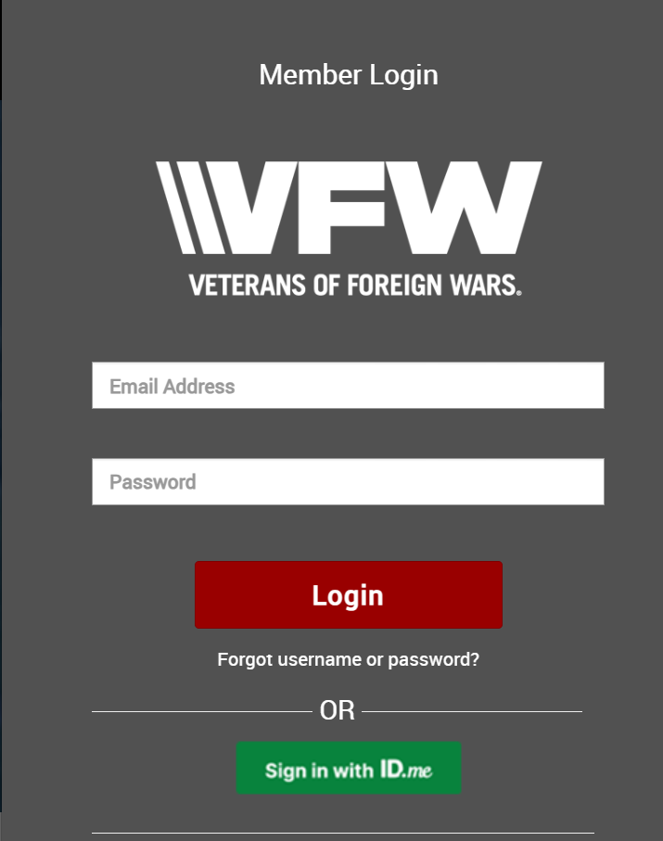

Slide 6
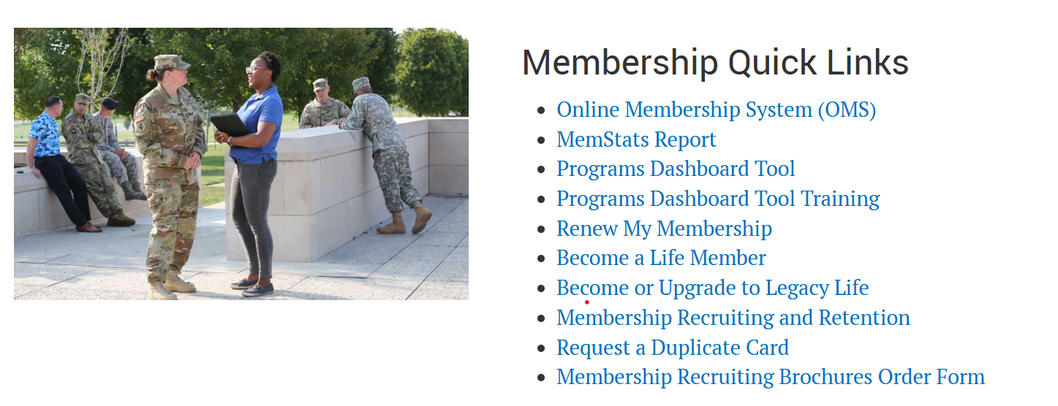

Slide 7
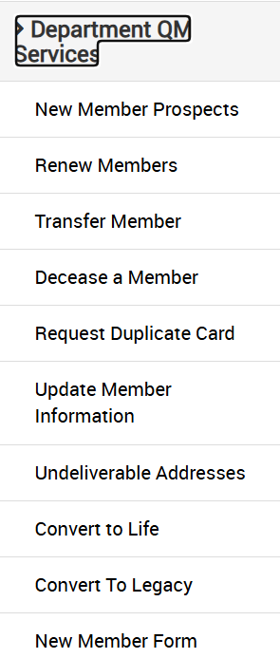

New Member Prospects is not
where you put in new members
Only for prospective members put in by National/State recruiters

Slide 8
This is where you will process annual renewals

Slide 9


Slide 10
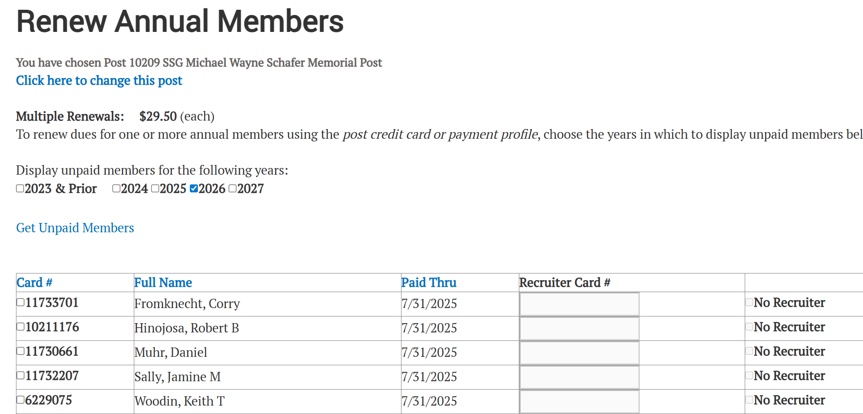

Slide 11
This is where you will process transfers into your post

Slide 12
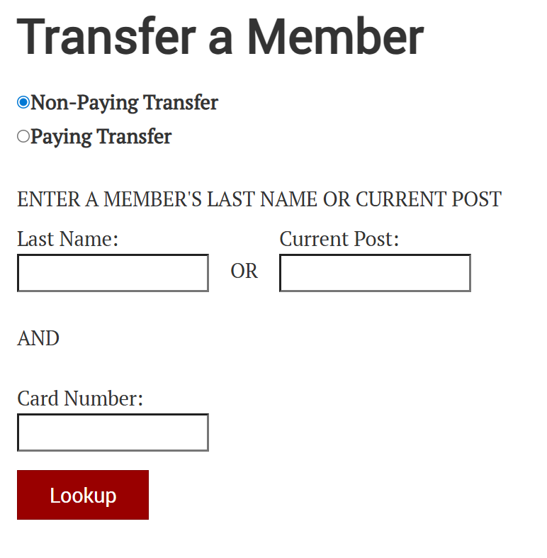

Slide 13
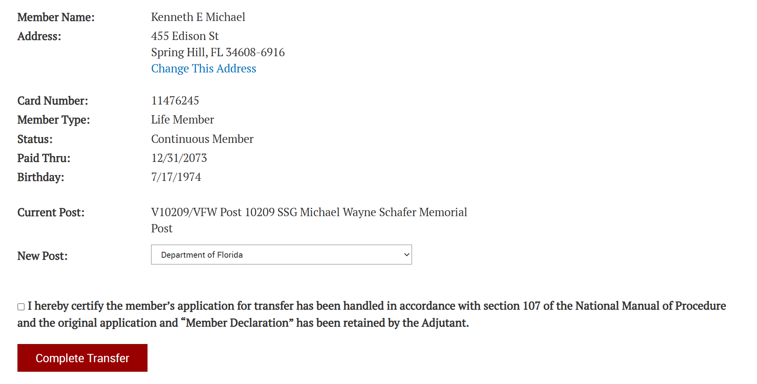

Slide 14
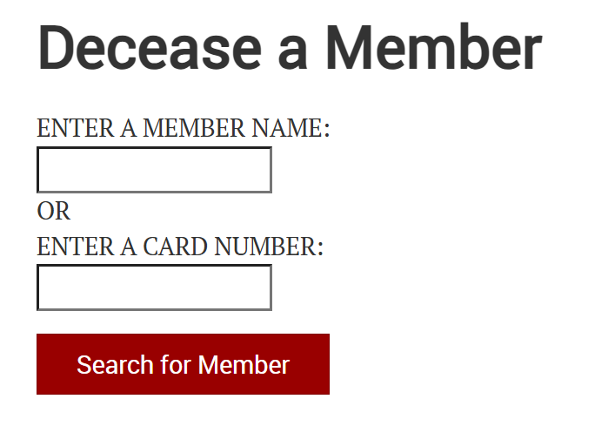
This is where you will Decease members in your post
This is where you will process transfers into your post

Slide 15
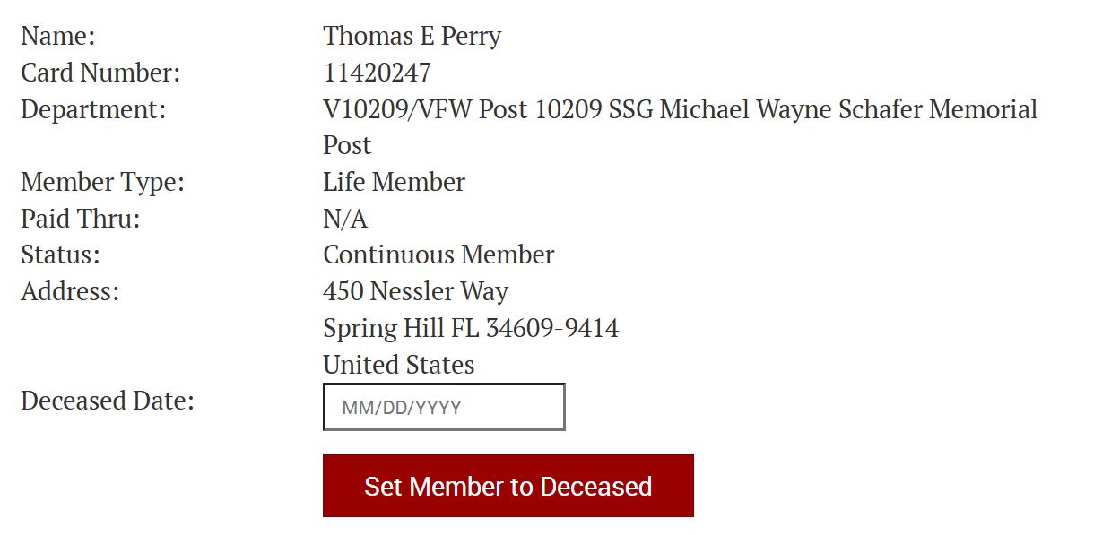

Slide 16
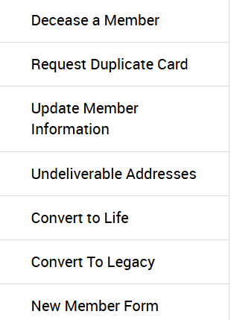
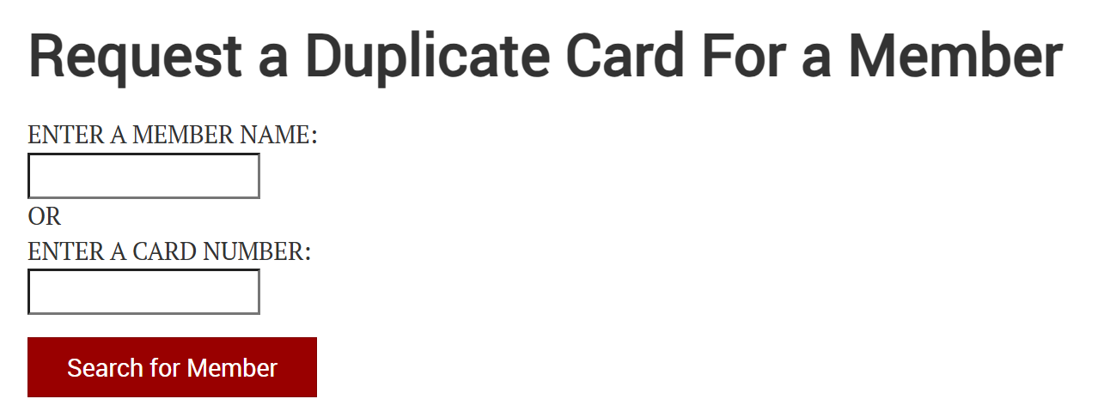
This is where you will request Duplicate cards for your members

Slide 17
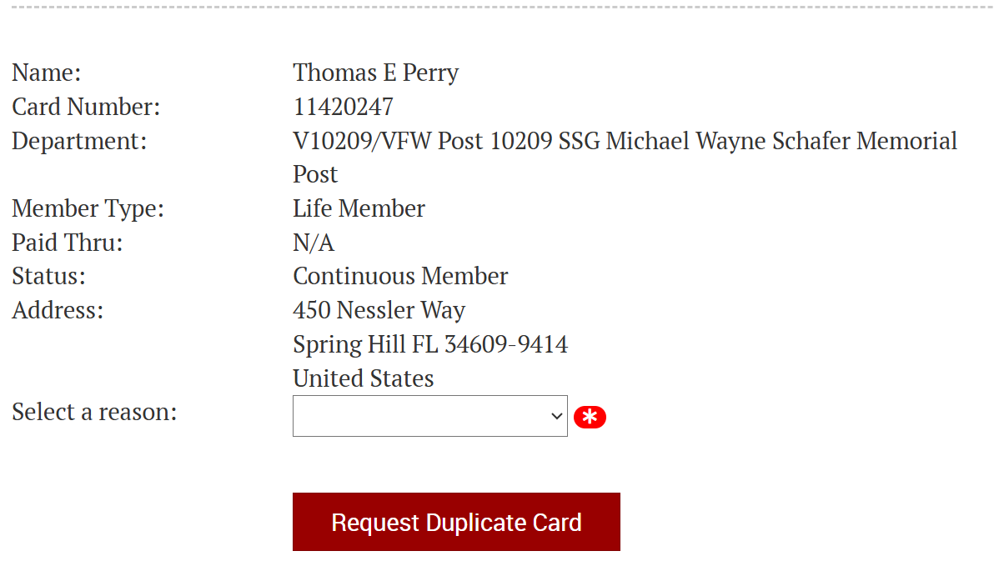
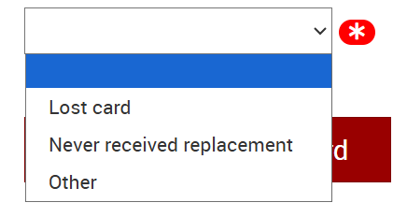

Slide 18
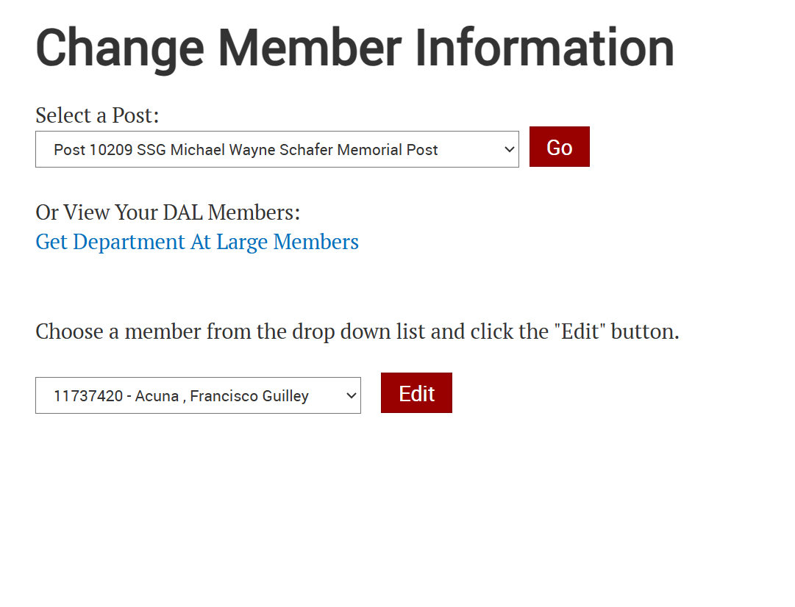
This is where you will update your member’s information

Slide 19
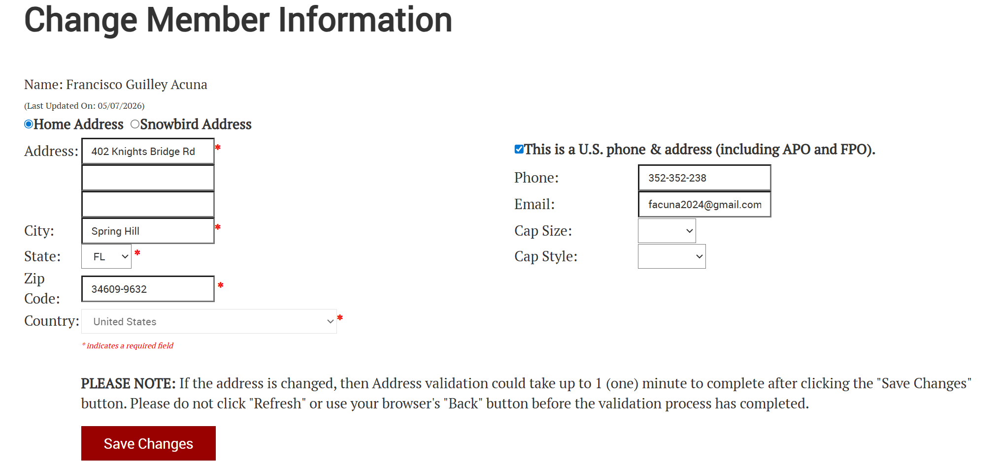

Slide 20
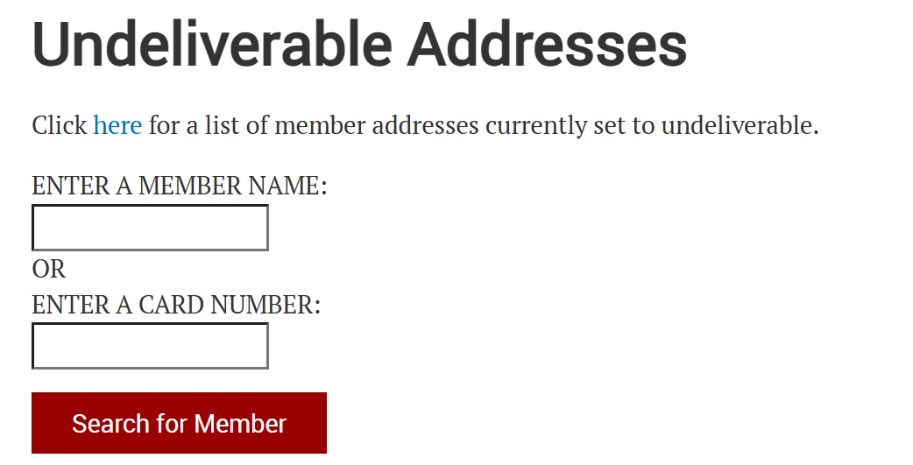
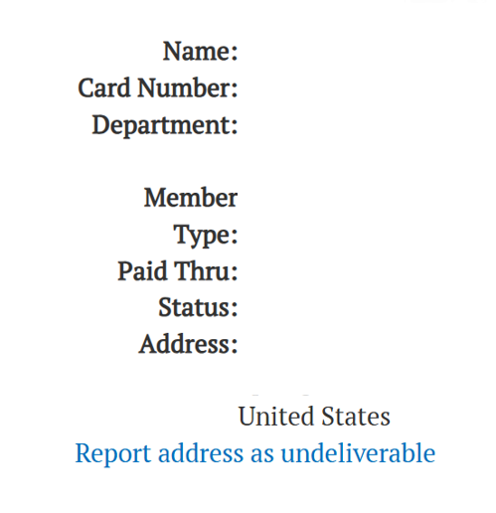

Slide 21
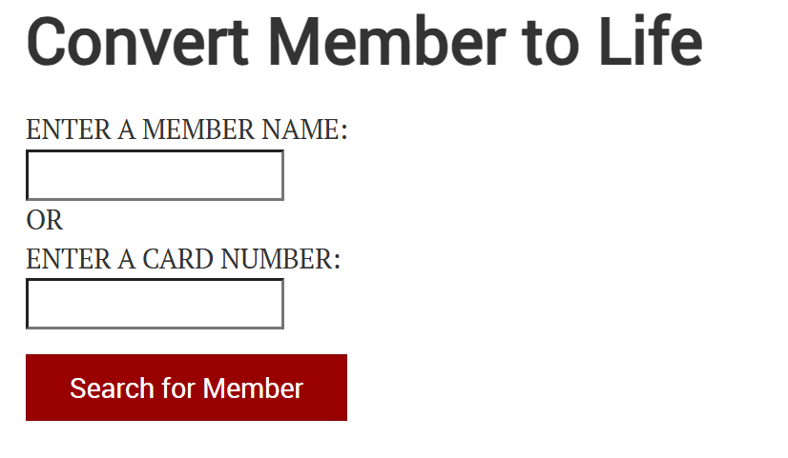

Slide 22
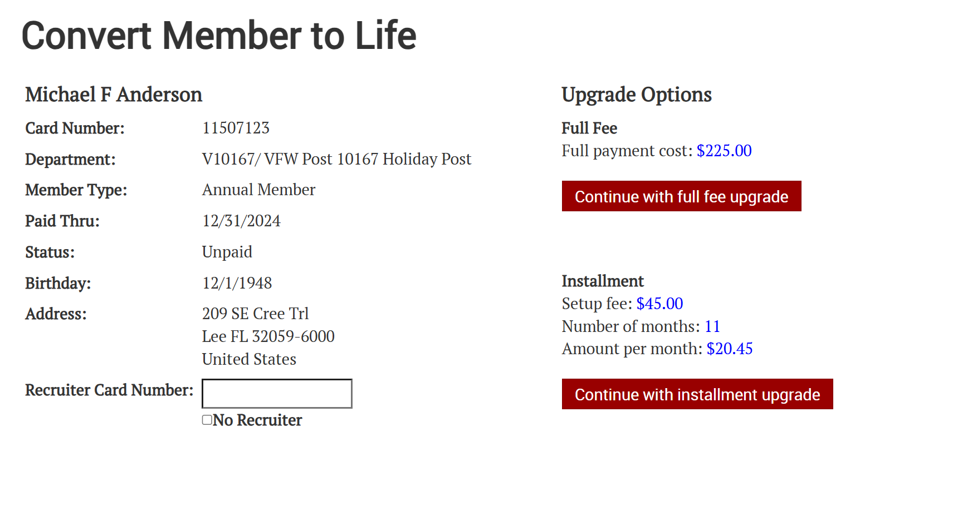

Slide 23


Slide 24
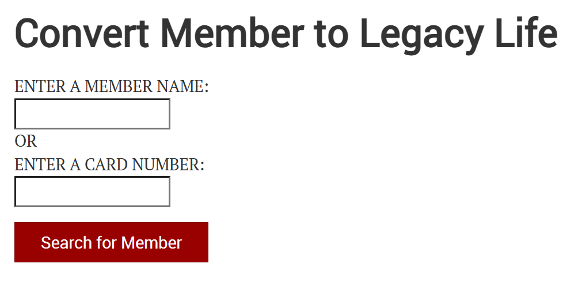

Slide 25
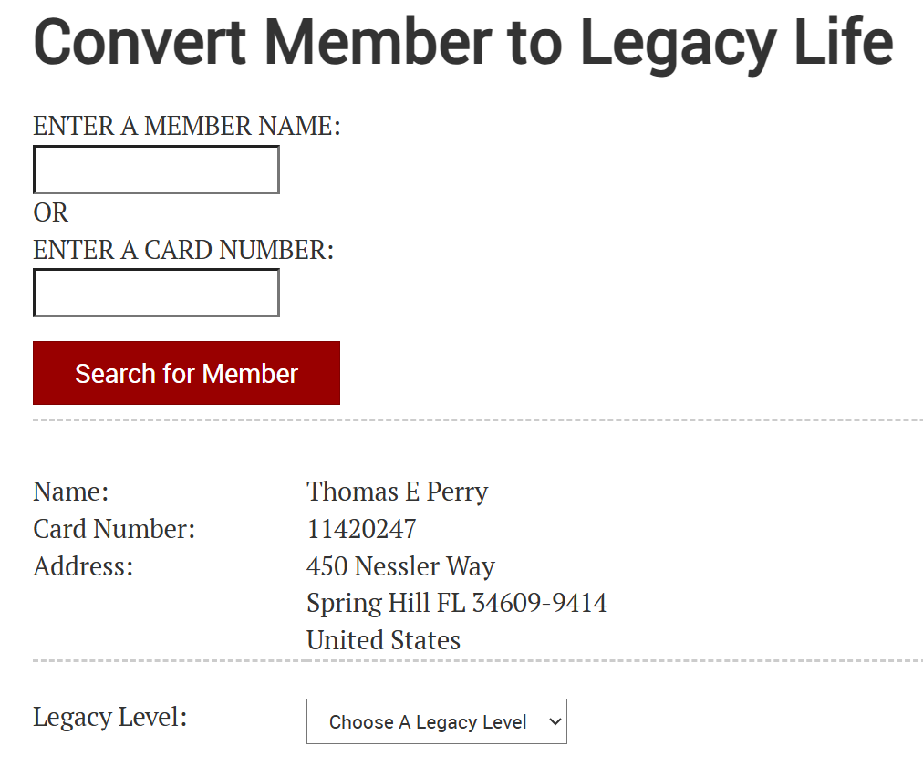
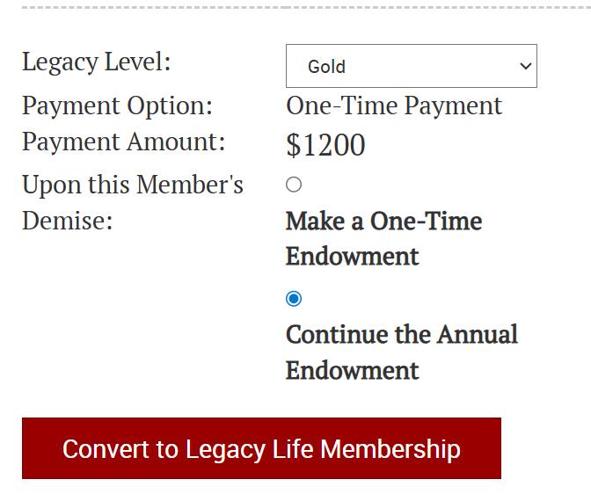


Slide 27
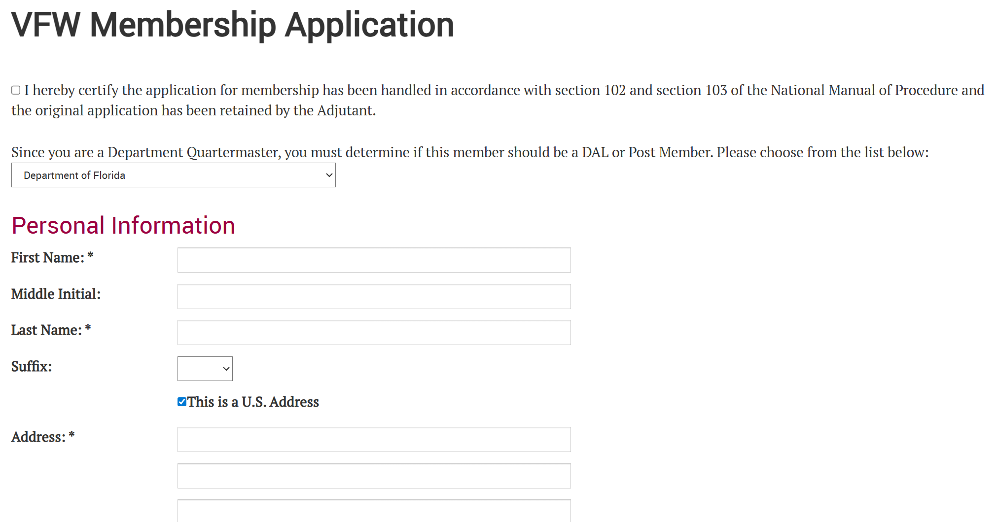

Slide 28
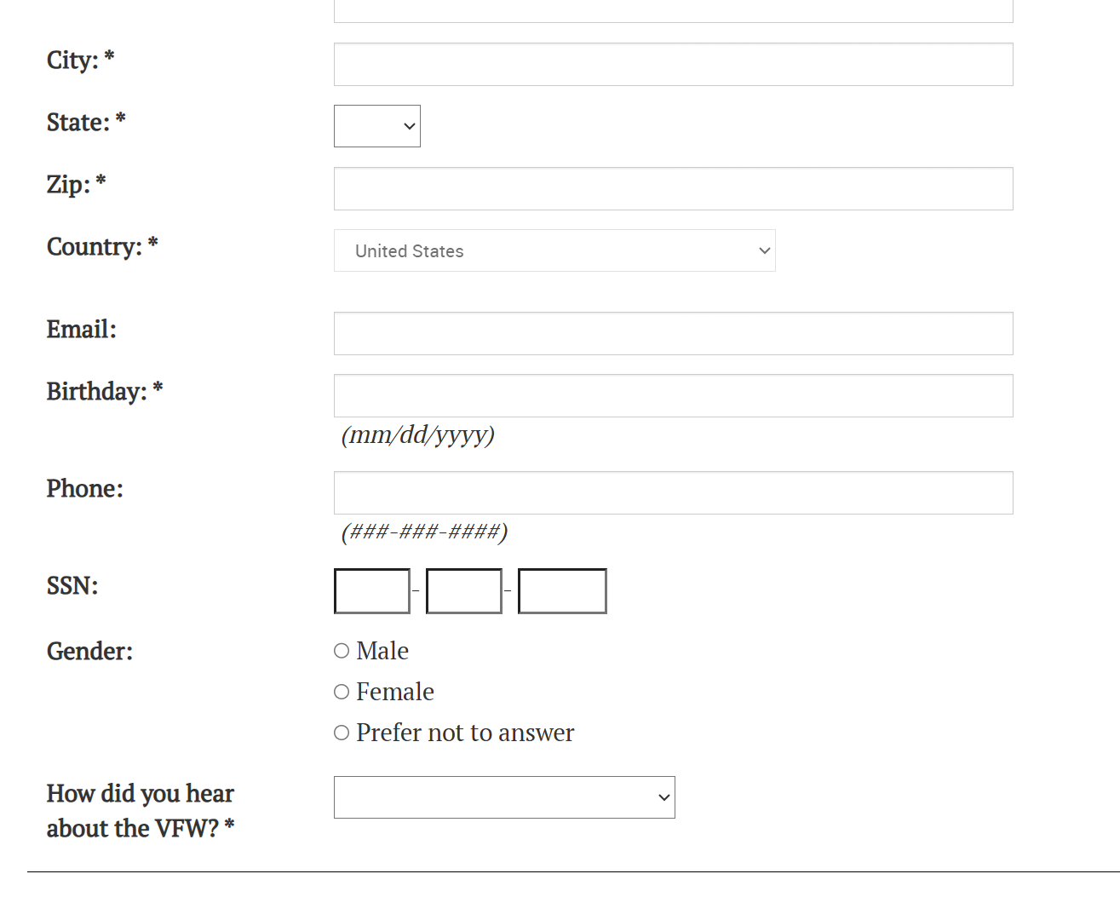
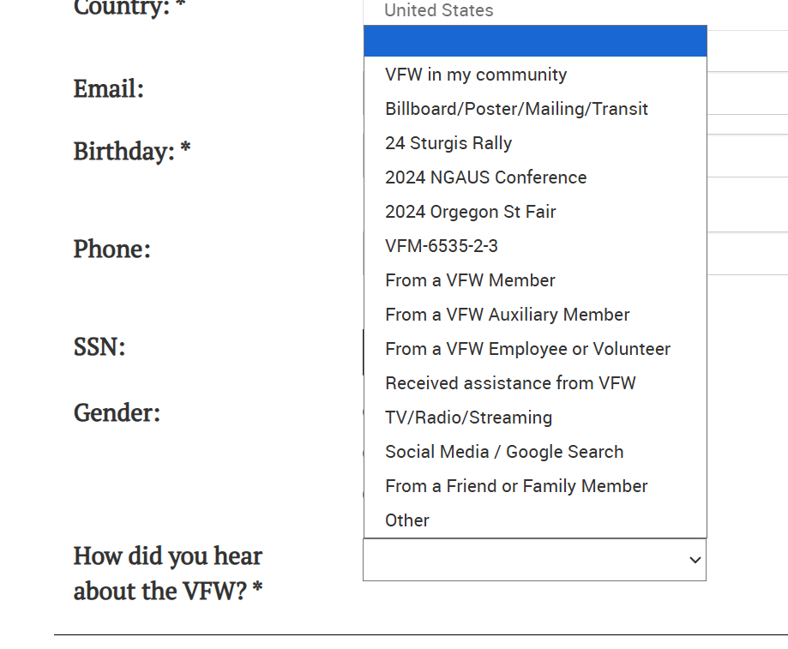
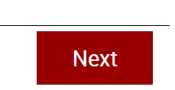

Slide 29


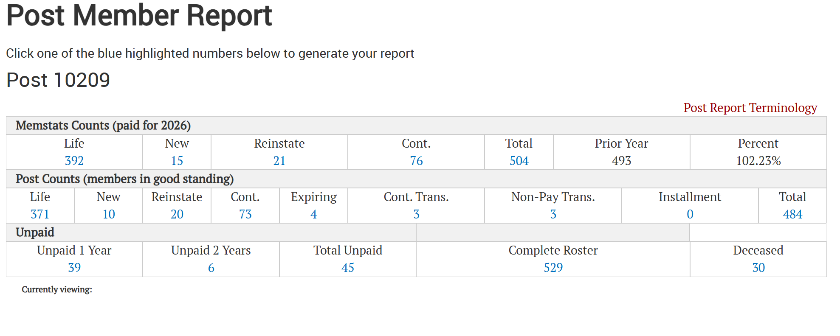

Slide 30
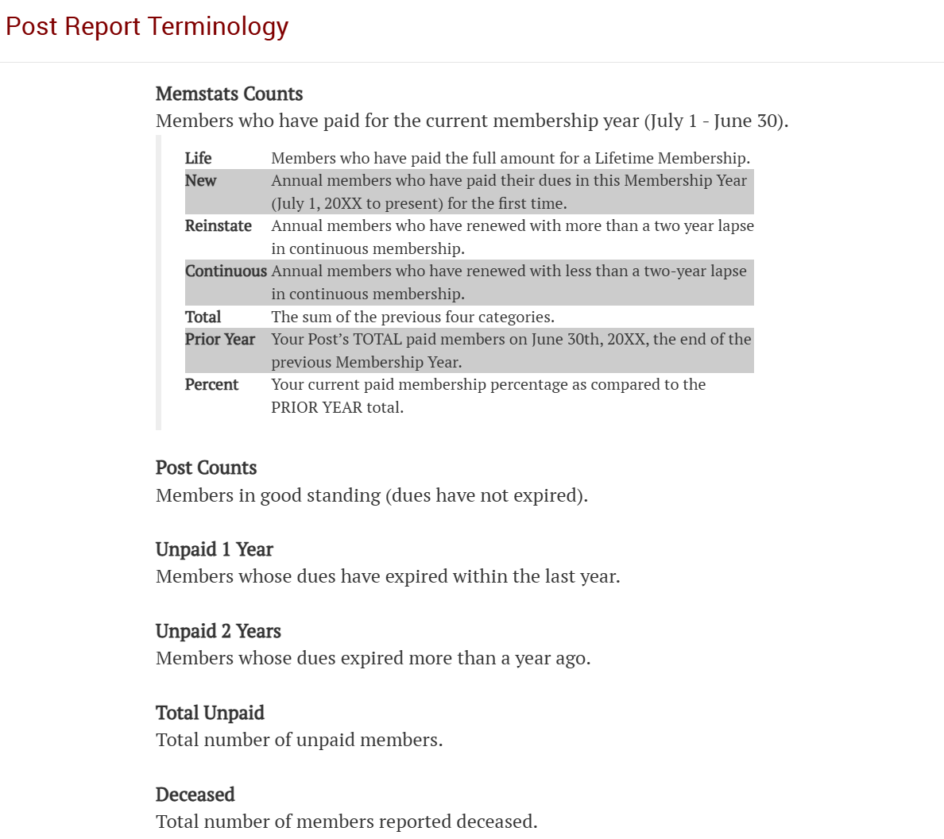

Slide 31




Slide 32
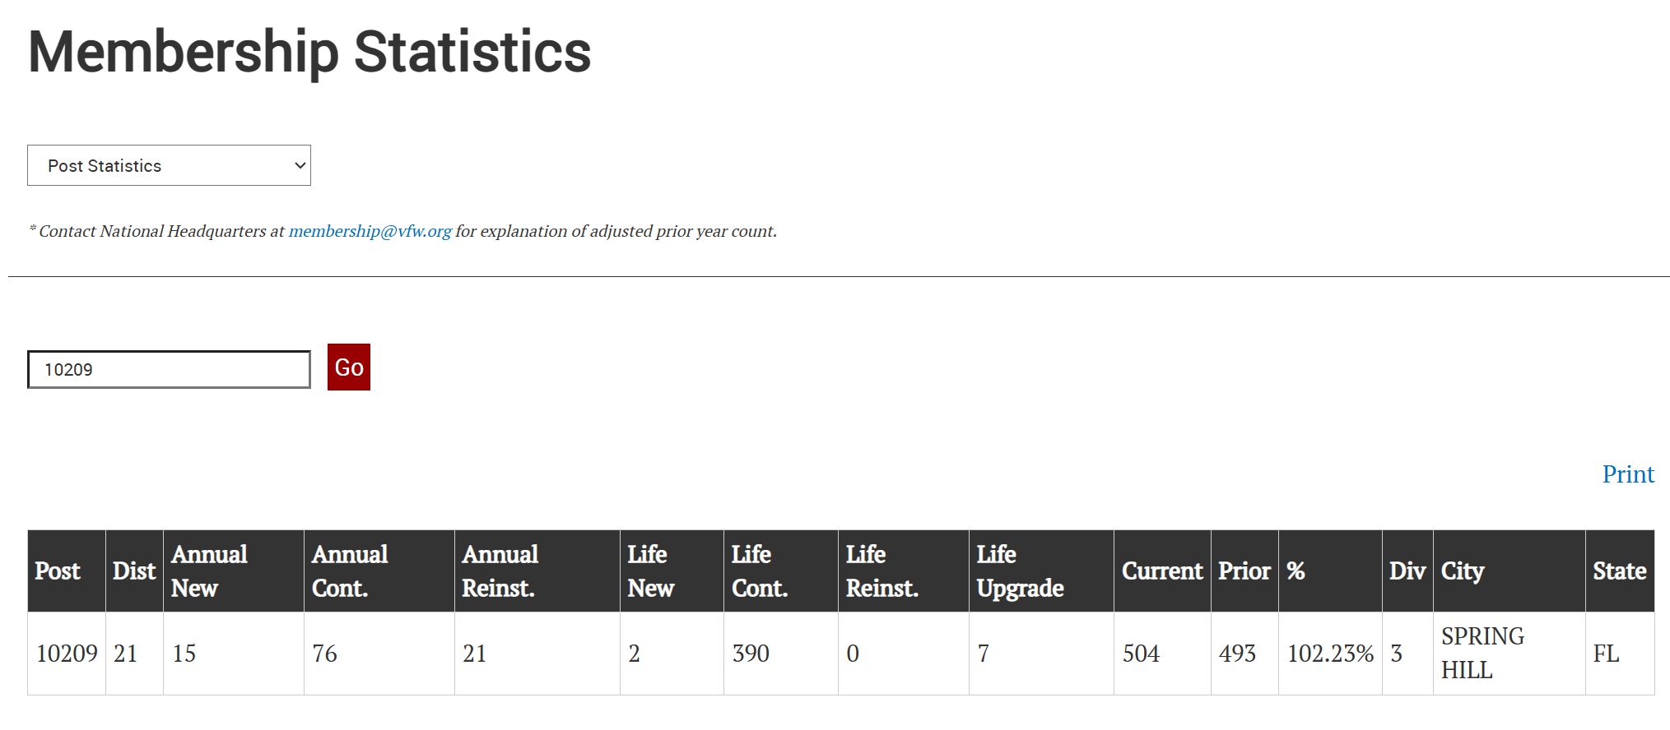



Slide 33
Questions????

