Slide 1
Programs Training
August 2026

Slide 2
Department Commander’s
Expectations

Slide 3
VFW Programs
Your VFW programs are defined under two categories:
Community Service, Youth Scholarships and Activities
Veterans & Military Support.
The Community Service, Youth Scholarships and Activities category is broken down into two Groups commonly referred to as our Core Programs and Special Projects & Activities.

Slide 4
Core Programs –
• Voice of Democracy
• Patriot’s Pen
• Smart/Maher VFW National Citizenship Education Teacher of the Year
• Scouting
• “Buddy”® Poppy.
These programs are executed by the largest number of Posts and have the greatest impact on our organization, our communities and our veterans.
Special Projects & Activities – These cover Americanism, volunteer recognition, community service, awards and recognition and other miscellaneous youth activities.

Slide 5
The Veterans & Military Support
category programs assist members of the active-duty military, National Guard and Reserves, as well as their families.
These programs consist of:
• VFW Communication Assistance
• Unmet Needs
• Military Assistance Program (MAP)
• VFW "Sport Clips Help a Hero Scholarship" program.

Slide 6
CORE PROGRAMS

Slide 7
Voice of Democracy
Program Chairperson – Heather Frank
E-mail: statevod@vfwfl.org

Slide 8
Voice of Democracy
The Voice of Democracy Audio/Essay Contest for 9th to 12th Graders.
The VFW has asked high school students to write and record a 3 to 5-minute essay, again on a patriotic theme selected by the VFW each year.
Students may record on an audio CD or flash drive.
Voice of Democracy winners receive scholarships and other incentives at the Post, District, and Department and finally to the National level where they will compete for the $35,000 first place scholarship.
The Voice of Democracy theme and additional information concerning the execution of the program can be found at vfw.org, behind the login within the VFW Training & Support hub, under Community Service and Youth Programs.

Slide 9
Voice of Democracy
This year's topic is:
“What a Veteran Taught Me About America”

Slide 10
Voice of Democracy
Promotes patriotism, civic responsibility, and an understanding of democracy
Key Deadlines:
October 31 – Student entries due to Post
November 15 – Post judging completed
December 15 – District judging completed
January 15 – Department judging completed
January 31 – Department winner due to National

Slide 11
Patriot’s Pen
Program Chairperson – Dr. Brian Frank
E-mail: statePP@vfwfl.org

Slide 12
Patriot's Pen
Asks junior high and middle school students to write a 300 to 400-word essay on a new patriotic theme each year. 6th-8th Graders.
Winners receive scholarships and begin by competing at the Post level.
Winners proceed to the District, Department and finally to the National level where they compete for the $5,000 first place scholarship.
The themes and additional information concerning program execution can be found at vfw.org, behind the login within the VFW Training & Support hub, under Community Service and Youth Programs.

Slide 13
Patriot's Pen
This year's topic is:
“What a Veteran Taught Me About America”

Slide 14
Patriot’s Pen
Purpose:
Encourages youth to think about America, citizenship, and patriotism
Key Deadlines:
October 31 – Student entries due to Post
November 15 – Post judging completed
December 15 – District judging completed
January 15 – Department judging completed
January 31 – Department winner due to National

Slide 15
Teacher of the Year
Program Chairperson – James B Holmes E-mail: statetoy@vfwfl.org

Slide 16
Teacher of the Year
(Smart/Maher Citizenship Education Award)
The VFW wants to identify and recognize America’s best educators in three (3) categories, (K-5, 6-8, 9-12), who instill a sense of national pride in students.
Teachers who promote civic responsibility, flag etiquette and patriotism are prime candidates.
It offers commemorative citations for those worthy teachers and their schools.

Slide 17
Teacher of the Year
(Smart/Maher Citizenship Education Award)
Purpose:
Recognizes elementary, middle, and high school teachers
Honors educators who promote citizenship, patriotism, and veterans’ awareness
Key Deadlines
October 31 – Nominations due to Post
December 15 – District judging completed
February 1 – Department winners due to National

Slide 18
VFW Scouting
The VFW has a long relationship with Scouting. VFW Posts need to consider providing leaders, sponsoring units, offering their facility for meetings and encouraging their involvement in service projects. Posts can benefit from Scouting by having a unit do a flag retirement ceremony, help distribute Buddy Poppies or help with clean up after events.
These are just a few that would provide a benefit and generally can serve your Post. Additional information concerning the execution of the program can be found at vfw.org, behind the login within the VFW Training and Support hub, under Community Service.

Slide 19
VFW Scouting
Program Chairperson – Ron Holladay E-mail: statescouts@vfwfl.org

Slide 20
Scout of the Year
Purpose:
Recognizes outstanding Scouts who demonstrate leadership, citizenship, and service
Key Deadlines
March 1 – Scout entries due to Post
-- Due to District
April 1 – Post entries due to Department
May 1 – Department entry due to National

Slide 21
“Buddy”® Poppy Program
Program Chairperson – Chelsey Martin
E-mail: missfoxfire3@gmail.com

Slide 22
VFW “Buddy”® Poppy Program
Our oldest and perhaps most historically significant program is the VFW “Buddy”® Poppy program.
Net proceeds from the distribution of Buddy Poppies must be credited to the Post Relief Fund as per Section 219 of the National Bylaws and Manual of Procedure. This section also mandates the purposes which funds can be disbursed from the Post Relief Fund.

Slide 23
VFW “Buddy”® Poppy Program
I’m sure you know that we never “sell” poppies. We give them away and receive donations. If someone cannot make a donation, don’t deny them a poppy. It is important that you realize that although Memorial and Veterans Days are particularly important Buddy Poppy events, you should have poppies at every event that involves your Post and the public. Poppies can and should be distributed year-round.

Slide 24
How to Use Buddy Poppy Proceeds
Your Post proceeds must be used for “the assistance of needy veterans and members of the Armed Forces and their dependents, surviving spouses and orphans.” No Buddy Poppy funds can be used for any other purpose. Net proceeds must be put in the Post Relief Fund. Adherence is mandatory as provided in Section 219, VFW, the Manual of Procedure states:
The Quartermaster of the Post will be the custodian of the relief fund and will expend monies there from, as directed by the Post, for the following purposes:

Slide 25
Special Projects
& Activities

Slide 26
Puplic Servant
(Law Enforcement, Firefighter, Emergency Services, Dispatcher, EOD)
Program Chairperson – David Bear E-mail: statelawfireems@vfwfl.org

Slide 27
Public Servant Awards
(Law Enforcement, Firefighter, Emergency Services, Dispatcher, EOD)
Each year, the Veterans of Foreign Wars selects law enforcement, firefighters, emergency medical technicians, 911 dispatchers, and explosive ordnance disposal technicians to receive the VFW’s Public Servant Awards.

Slide 28
Public Servant Awards
(Law Enforcement, Firefighter, Emergency Services, Dispatcher, EOD)
Purpose:
Honors public servants for outstanding service to their communities
Key Deadlines:
January 1 – Nominations due from Post to Department
February 1 – Department nominations due to National

Slide 29
Award Programs
Program Chairperson – Heather Frank

Slide 30
Life Saving Awards
The Safety Chairperson at Posts, Districts and Departments are encouraged to regularly identify and honor individuals throughout the year in their geographic area who have saved a life. The VFW Programs department provides the three different Life Saving citations (Regular, Line of Duty and Valor) and appropriate medal (if available), free of charge, for local presentations
Date Due: April 1

Slide 31
The Outstanding Community Service
Post Awards
are given to Posts identified by the Departments for their exceptional response to VFW Community Service Programs. Each Department determines the actual criteria for their Posts. Posts selected for this honor are invited to send a representative to the VFW National Convention for a reception with the VFW Commander-in-Chief.
Date Due: April 1

Slide 32
Outstanding Post Special Project Awards
are given each year to Posts that do a special project outside their normal VFW activities. Posts should submit their entries to their Department for review and endorsement before going to VFW National Headquarters.
Date Due: April 1

Slide 33
Outstanding Post Special Project competition.
The Post receiving the Fred C. Hall award receives a plaque at the VFW National Convention and a $1,000 service scholarship for community projects. The Post Commander (or designated representative) and a guest will receive round-trip airfare, a cash stipend and accommodations to receive the award at the VFW National Convention.
Date Due: April 1

Slide 34
Volunteer Recognition Programs
VFW Veterans in the Classroom
VFW members volunteering time with other groups such as Scouting, Civil Air Patrol, Naval Sea Cadet or JROTC units.

Slide 35
Establishment of the 'Glenn Wright Award' for Program Impact
The "Glenn Wright Award" is established to recognize Posts that prioritize community substance over administrative volume, targeting the 2026-2027 program year.
Core Objective: To recognize the Post with the largest numerical increase in verifiable program reports submitted via the electronic portal at vfwfl.org.
Qualifying Criteria for "Real Impact":
  Reports must demonstrate tangible community outreach, direct service to veterans, or legislative advocacy as defined in the Membership Mission.
  Prohibited Entries: Internal ceremonial acts, including "saluting the flag" or "religious attendance," are strictly forbidden from being counted toward this award.

Slide 36
Establishment of the 'Glenn Wright Award' for Program Impact
Documentation and Verification:
  All entries must be verifiable via the Department Dashboard and meet the benchmark of IRS 501(c)(19) standards for substance.
  Posts must provide supporting documentation (e.g., photos, receipts, or external media mentions). Reports without verifiable substance will be disqualified to prevent "paper reporting."

Slide 37
VMS Progam
Veteran and Military Support

Slide 38
Veterans & Military Support
Veterans & Military Support is a part of the VFW’s never-ending obligation to assist members of the active-duty military, National Guard and Reserves, as well as their families. These Programs were established to keep the Veterans of Foreign Wars in the forefront of patriotism as the organization and it’s members find innovate way to show support for America and her armed forces.

Slide 39

VFW Communications Support
Assisting Veteran Communication
  The VFW helps veterans connect with essential resources and benefits by improving their communication abilities.
  Technology Guidance
  Veterans receive guidance from the VFW on using technology, including emails and online forms, to access support.
  Facilitating Outreach and Advocacy
  The VFW supports effective communication between veterans and government agencies, strengthening outreach and advocacy efforts.
Notes:
Image source: Microsoft 365 content library
The VFW provides crucial communications assistance to veterans, helping them connect with resources and benefits. They offer guidance on navigating technology, from emails to online forms. VFW also facilitates outreach and advocacy by supporting effective communication between veterans and government agencies.

Slide 40
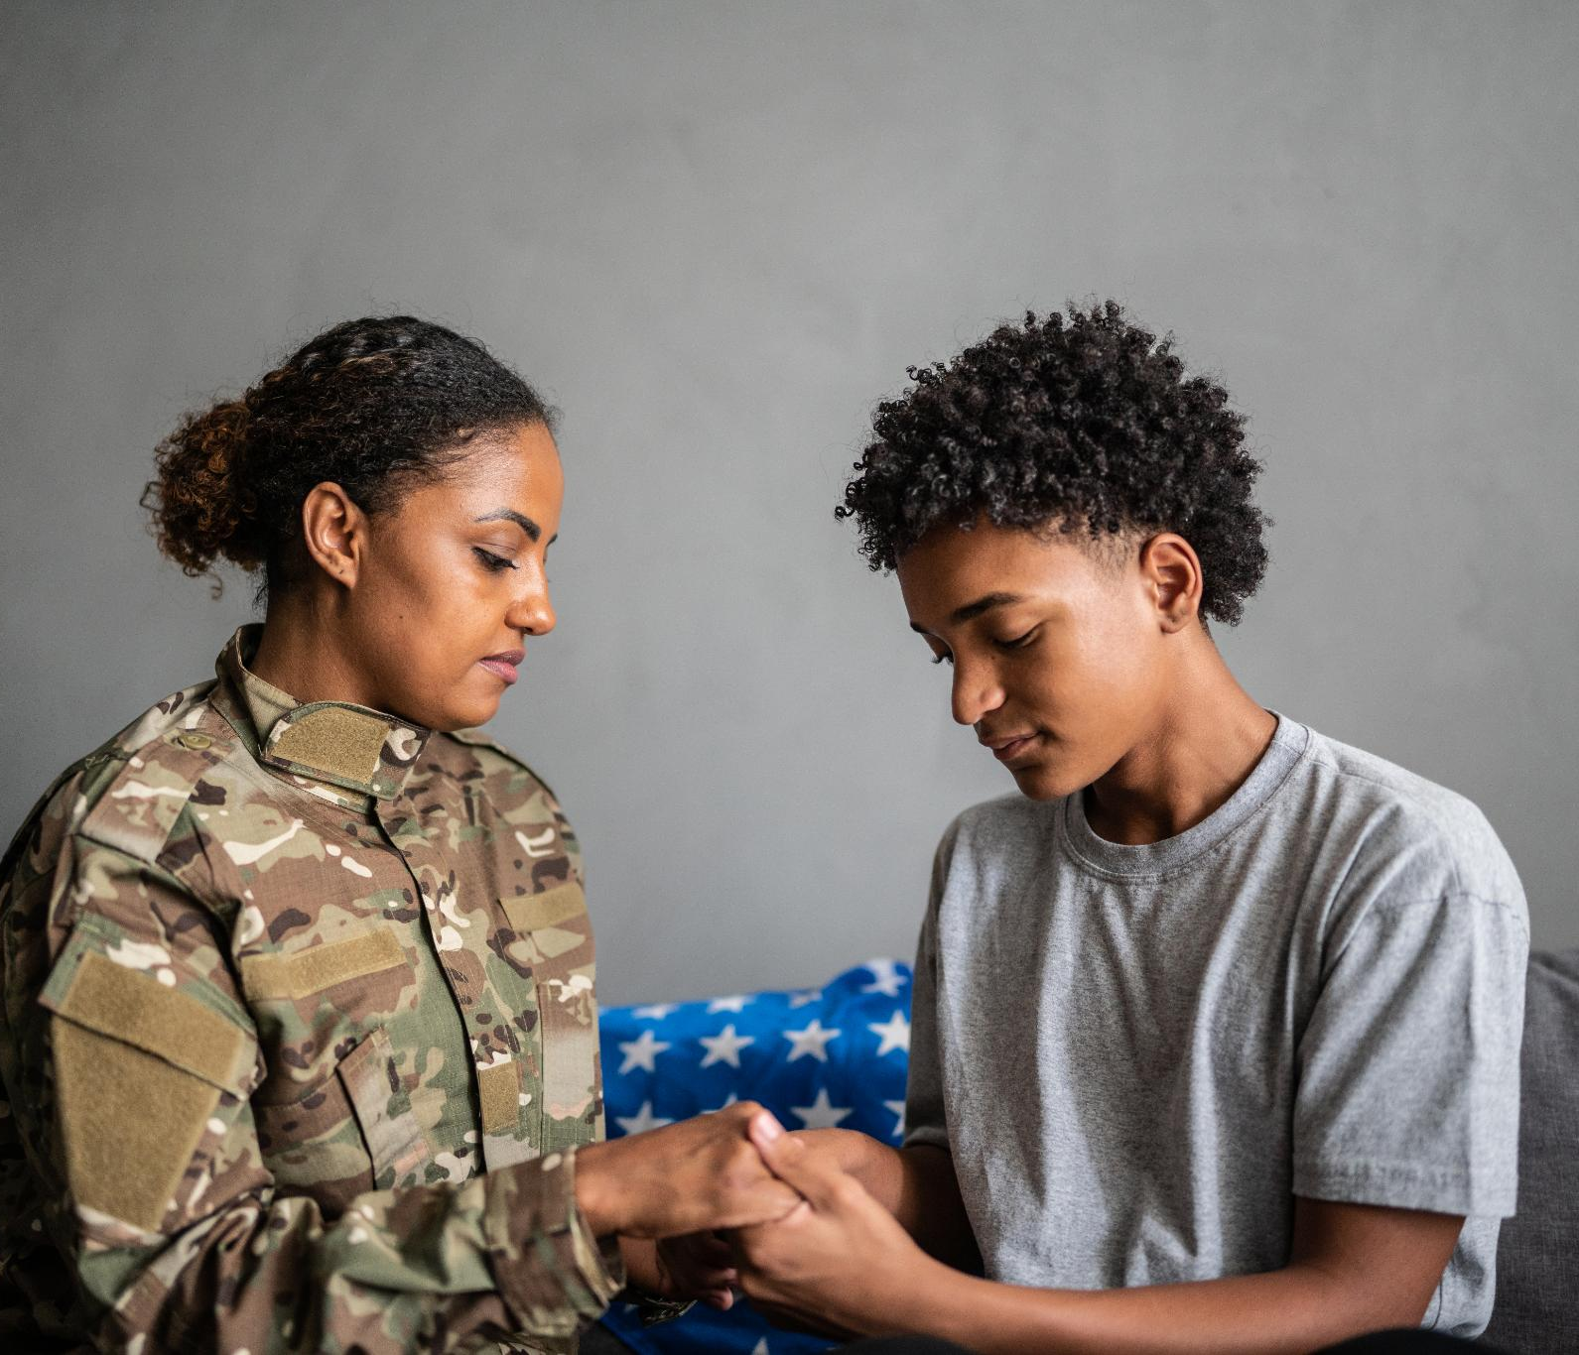
VFW Unmet Needs Program
Supporting Military Families
  The program helps military families experiencing financial stress from deployment or service by providing essential support and relief.
  Grants for Essential Needs
  Grants are offered for housing, utilities, and food, ensuring families can meet basic life necessities during tough times.
  Direct Payments to Creditors
  Funds are sent straight to creditors, minimizing stress for veterans and allowing focus on recovery and stability.
Notes:
Image source: Microsoft 365 content library
The VFW Unmet Needs program assists military families facing financial hardships due to deployment or service-related activities. It provides grants for basic life needs, such as housing, utilities, and food. The program ensures funds go directly to creditors, reducing stress and enabling veterans to focus on recovery and stability.

Slide 41
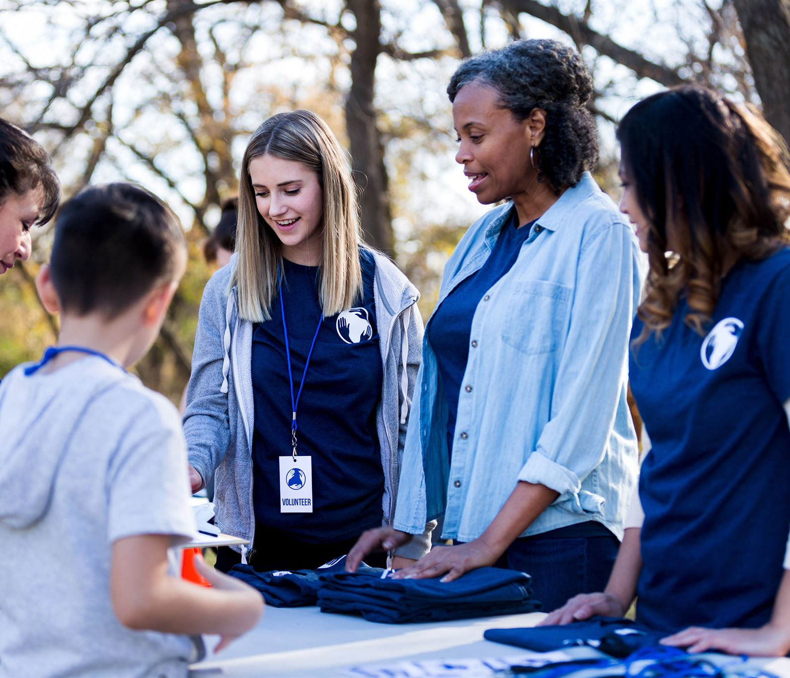
VFW Military Assistance Program
Support for Service Members
  MAP provides grants and resources to assist active-duty military personnel and their families with essential needs.
  Community Engagement
  MAP sponsors events that build strong relationships between military members and local communities, fostering mutual understanding and connection.
  Morale and Ongoing Support
  The program funds morale-boosting activities and ongoing support efforts, ensuring service members feel valued and connected.
Notes:
Image source: Microsoft 365 content library
The VFW Military Assistance Program (MAP) supports active-duty service members and their families through grants and community events. MAP strengthens relationships between military personnel and local communities. The program funds morale-boosting activities, helps address urgent needs, and fosters ongoing support for America’s military members.

Slide 42


VFW’s "Sport Clips Help A Hero Scholarship" Program
Educational Financial Support
  The program provides financial assistance to veterans and service members for post-secondary education, reducing financial barriers.
  Smooth Career Transition
  The scholarship helps ease the transition from military service to civilian careers, offering new opportunities for advancement.
  Empowering Recipients' Goals
  Recipients are empowered to reach academic and professional goals, building a strong future after service.
Notes:
Image source: Microsoft 365 content library
The VFW’s 'Sport Clips Help A Hero Scholarship' Program supports veterans and service members by providing financial assistance for post-secondary education. Since its inception, the program has awarded thousands of scholarships. Its goal is to ease the transition to civilian careers and empower recipients to achieve their academic and professional goals.

Slide 43
VFW’s "Sport Clips Help A Hero Scholarship" Program
Scholarship Details:
Scholarships of up to $5,000 will be awarded to qualified applicants.
Awarded scholarships are limited to one per family per semester.
Applications for the fall semester will be accepted Jan. 1 through April 30.
Applications for the spring semester will be accepted Aug. 1 through Nov. 15.
Fall semester scholarships will be awarded in August, and spring semester scholarships will be awarded in January.
Scholarships must be used by the end of the school semester for which the veteran is applying or they will become null and void.
Scholarships are restricted for tuition and fees only and will be paid directly to accredited schools.
Notes:
Image source: Microsoft 365 content library
The VFW’s 'Sport Clips Help A Hero Scholarship' Program supports veterans and service members by providing financial assistance for post-secondary education. Since its inception, the program has awarded thousands of scholarships. Its goal is to ease the transition to civilian careers and empower recipients to achieve their academic and professional goals.

Slide 44
VFW’s "Sport Clips Help A Hero Scholarship" Program
Eligible Applicants Must:
Be a citizen of the United States.
Be retired, honorably discharged, active duty, or a member of the National Guard or Reserve.
Have completed Basic Training and follow-on training (Advanced Individual Training, technical school, etc.).
Separated with or currently hold a military rank of E-5 or below.
Demonstrate a need for financial assistance.
Participate in, be accepted to or currently enrolled in a VA-approved program or school at an accredited post-secondary institution.
Notes:
Image source: Microsoft 365 content library
The VFW’s 'Sport Clips Help A Hero Scholarship' Program supports veterans and service members by providing financial assistance for post-secondary education. Since its inception, the program has awarded thousands of scholarships. Its goal is to ease the transition to civilian careers and empower recipients to achieve their academic and professional goals.

Slide 45



VFW-SVA Legislative Fellowship
Empowering Student Veterans
  The fellowship empowers student veterans to participate directly in shaping national policy, supporting leadership and advocacy skills.
Policy Research and Proposal
  Participants research veteran issues and prepare policy proposals, developing critical analysis and legislative writing skills.
Professional Development and Networking
  The fellowship offers valuable opportunities for professional growth, networking, and direct engagement with lawmakers on Capitol Hill.
Notes:
Image source: Microsoft 365 content library
The VFW-SVA Legislative Fellowship program empowers student veterans to influence national policy. Participants research issues affecting veterans, prepare policy proposals, and advocate on Capitol Hill. This unique fellowship offers professional development, networking opportunities, and the chance to directly engage with lawmakers, amplifying student veteran voices in Washington, D.C.

Slide 46

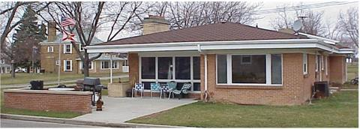

Slide 47
Department Commander Randy Cash’s
Special Project

Slide 48

VFW National Home Legacy
The VFW National Home for Children was founded in 1925 in Eaton Rapids, Michigan as a place where families left behind by war could remain together, keeping the family circle intact even when their serviceman didn't come home. The National Home is there to help veteran connected families as well who are directly related to a VFW or Auxiliary member or are eligible to become one.
The Home offers case management services to help families establish their plans for the future and set goals, education, recreational, and enrichment opportunities for parents and their children, as well as free housing and daycare. Community resources and counseling provided as needed.
Notes:
Image source: Microsoft 365 content library
Founded in 1925 in Eaton Rapids, Michigan, the VFW National Home for Children provides support to families affected by war, ensuring they stay together even when their serviceman doesn't return. It extends assistance to veteran-connected families, including those related to VFW or Auxiliary members, preserving family unity and offering vital resources.

Slide 49

The single-family homes at the National Home are maintained by many VFW Departments. VFW of FL has 2 homes that we are committed to, Florida 1 and The newly, about to be built, Florida 2.

Slide 50
Questions????

