Slide 1
Post Commander Training
May 2026

Slide 2
Information pulled from:
VFW 2025-2026 Officers Guide, VFW Parlamentary Procedures, and VFW National By-Laws

Slide 3
Being a member of the VFW means being an agent of change.
But…
To be a leader within the VFW means connecting with those around you; inspiring them with a shared sense of mission; and through education and engagement, mobilizing them in order to accomplish a common goal.

Slide 4
Department Commander’s
Expectations
Know what’s happening in the Post
Mentor Line Officers
Solve problems at the lowest level
Hold Yourself Accountable
Seek Guidance and Delegate Effectively
Understand your role as the Post Commander
Lead from the Front
Communicate Effectively

Slide 5
What is a Post Commander
The Post Commander is the key officer of the Post. They, alone, represent the judicial branch of the organization and also have some of the responsibilities of the executive branch. They preside at all meetings, enforce the rules, appoint committees not otherwise provided for, and make certain that the other officers and committeemen perform their duties. .

Slide 6
What is a Commander (Cont.)
Their authority extends to the Post Home or Club to the extent of enforcing the rules of the Post and the National and Department VFW and public laws. They represent the authority of the Post between meetings, and their voice is that of the Post membership. They see that the Post Trustees conduct their audits, that the Post Quartermaster is bonded, and that the House Committee properly supervises the activities of the Post Home.

Slide 7
What is a Commander (Cont.)
Their authority also is limited according to the rules of the organization and the bounds of common sense. They are in no sense a dictator. They cannot order nor permit the breaking of laws, nor can they supersede the recognized authority of other officers or committees. They cannot, for instance, order the Club Manager to keep the clubrooms open after hours, nor can they direct the Post Quartermaster to pay an unauthorized bill.

Slide 8
What is a Commander (Cont.)
The Commander should be familiar with all activities of the Post. They should sit in with the Trustees at their audits or, at least, have a sufficient knowledge of their procedure to know whether they are doing their job. They should attend the meetings of the House Committee, calling to their attention any discrepancies he/she may have observed or complaints they may have received. They must know that when they sign a check, it is in payment of a legitimate expenditure.
The Commander is the arbitrator of arguments and the judge in disputes. As a general rule, their decisions are considered correct until over-ruled by the Post meeting, the District, Department Commander or Commander-in-Chief.

Slide 9
Commander Duties and Obligations
Sec 218 of the VFW National ByLaws
Preside at all meetings of the Post, conducting such meetings in accordance with Article X of the Bylaws and Manual of Procedure and other applicable parliamentary rules.
Enforce strict observance of the laws and usages of this organization, including Post, County Council (if applicable), District and Department Bylaws and the Congressional Charter, National Bylaws, Manual of Procedure and Ritual and all lawful orders from proper authorities.

Slide 10
Commander Duties and Obligations (Cont.)
c. Insist that Post business and activities be conducted in such a manner that they do not violate any applicable governmental law, ordinance or regulation nor bring or tend to bring dishonor or embarrassment upon the Post, its members or the Veterans of Foreign Wars of the United States.
d. Decide all questions of law and usage in the Post, subject to appeal pursuant to the Bylaws.

Slide 11
Commander Duties and Obligations (Cont.)
e. Upon entering into office, appoint all other officers, committee chairmen and committees not otherwise provided for. The Commander may remove such appointed officers, committee chairmen and committees at their pleasure.
f. Approve all disbursements of funds properly authorized by the Post by use of voucher or payment order.

Slide 12
Commander Duties and Obligations (Cont.)
g. Assure that the office of Quartermaster is bonded according to Section 703 of the Bylaws.
h. Assure that all dues and other monies due the National Headquarters and Department are forwarded promptly together with accurate reports and returns pertaining thereto.

Slide 13
Commander Duties and Obligations (Cont.)
i. Assure that all reports are correctly prepared and promptly forwarded, that all the business of the Post is handled with dispatch and that all necessary licenses and permits are obtained for proper operation. Ensure that a properly completed Report of Election of Officers for the ensuing year is submitted to Department and National Headquarters by June 1.

Slide 14
Commander Duties and Obligations (Cont.)
j. Assure that the Post Trustees have examined the books and records of the Post and prepared the Post Trustees Quarterly Report of Audit no later than the end of the month following the last day of each quarterly period.
k. Assure that the Commander or their representative attend all properly called District Conventions or meetings and County Council meetings (if applicable).

Slide 15
Commander Duties and Obligations (Cont.)
l. Comply with and perform all of the duties required by the laws and usages of this organization, the provisions of these Bylaws, the Manual of Procedure and Ritual and Department, District, County Council (if applicable) or Post Bylaws pertaining to the duties and obligations of a Post Commander and lawful orders from proper authority and perform such other duties as are usually incident to the office.
m. Be an ex-officio member of all committees.

Slide 16
Post Quartermaster
Qualify and secure a bond in a sum at least equal to the amount of the liquid assets for which they may be accountable in accordance with Section 703.
Collect all monies due the Post, giving receipt therefore, and have charge of the funds, securities and other property of the Post, all of which shall be placed in their care. They shall be the accountable officer of the Post and the Treasurer of all committees handling funds.

Slide 17
Post Quartermaster (Cont.)
c) Disburse funds as properly authorized by the Post using accepted banking practices. Unless otherwise provided for in Post Bylaws, all disbursements of Post funds shall bear
the signature of the Quartermaster or other person(s) authorized by the Quartermaster. Such other authorized person(s) shall be bonded with an indemnity company as surety in a sum at least equal to the amount of the liquid assets for which they may be accountable in accordance with Section 703.

Slide 18
Post Quartermaster (Cont.)
d) Receive annual membership dues and Life membership fees and forward the Department and National dues and Life membership fees immediately to National Headquarters as prescribed in Section 104.
e) Provide the Post Trustees with all records, files and statements required or necessary for the preparation of the Post Trustees Quarterly Report of Audit.
.

Slide 19
Post Quartermaster (Cont.)
f) Reconcile and verify all transactions listed on all bank statements to assure the accuracy of Post records. The books and records of the Quartermaster shall be maintained in a legible and uniform format. Record keeping by electronic means may be used, provided a backup is maintained. Books and records shall be available for inspection by authorized officers and Post members at all reasonable times. Unless specifically authorized by the Post to remove such books and records from its facilities, they will be kept at the Post facilities.

Slide 20
Post Quartermaster (Cont.)
g) Provide access and transfer to their successor in office or anyone designated by higher authority, without delay, all books, records, papers, monies, securities and other property of the Post in their possession or under their control.
h) Comply with, and perform all duties required of them by the laws and usages of this organization, applicable Bylaws and orders from lawful authority and perform such otherduties as are incident to such office.

Slide 21
Post Quartermaster (Cont.)
Report on transactions concerning receipts and expenditures, for any given period, at a regular or special meeting of the Post.
File appropriate forms as required by Federal, State and Local
Statutes or regulations.

Slide 22
Adjutant
Among the duties of the Post Adjutant, the Adjutant shall:
Be the official corresponding officer for the Post and shall attest to all official communications and reports with their signature.
Under the direction of the Commander, prepare all reports and returns required of the Adjutant.

Slide 23
Adjutant (Cont.)
c. Maintain the books and records in a legible and uniform format. Record keeping by electronic means may be used, provided a back-up is maintained. Books and records shall be available for inspection by authorized officers and Post members at all reasonable times. Unless specifically authorized by the Post to remove such books and records from its facilities, they will be kept at the Post facilities.

Slide 24
Adjutant (Cont.)
d. The Post Adjutant shall maintain the following records:
1. A copy of the original application of every member admitted to the
Post.
2. Minutes of each Post meeting after correction and approval.
3. All current orders or circulars issued by the Commander-in-Chief,
the National Council of Administration, the Department
Commander, the District and/or County Council Commander (if
applicable) and the Post Commander.

Slide 25
Adjutant(Cont.)
d. The Post Adjutant shall maintain the following records: (Cont.)
4. A correspondence file.
5. A file containing a copy of the proof of eligibility
submitted by officers pursuant to Section 216.
e. Maintain a current copy of the Bylaws, Manual of
Procedure and Ritual of the Veterans of Foreign Wars of
the United States and copies of the Bylaws of the Post,
Department, District and County Council (if applicable)..

Slide 26
Adjutant(Cont.)
f. Transfer to their successor, without delay, all books, papers, records,
monies and other records and property of the Post in their possession
or under their control.
g. Comply with and perform all duties required of the Adjutant by the
laws and usages of this organization, applicable Bylaws and orders
from lawful authority and perform such other duties as are incident to
such office

Slide 27
Trustees
Trustees shall not be eligible to serve as an elected officer, Adjutant or on a committee whose books, records and accounts are audited by the Trustees. Among the duties of Post Trustees, they shall:
At least monthly, review the Monthly Report of Receipts and
Expenditures of the Post Quartermaster.

Slide 28
Trustees (Cont.)
b. Within thirty (30) days from the end of each quarter, properly audit the
books and records of the Post Quartermaster, Post Adjutant, and any
activity, club room, holding company or unit sponsored, conducted or
operated by, for or on behalf of the Post and submit a Post Trustee’s
Report of Audit to the Department Quartermaster for referral to the
Department Inspector

Slide 29
Trustees (Cont.)
c. The Report shall be in accordance with and upon such form as may be
prescribed by the Adjutant General. The audit shall be signed by the Post
Commander and Trustees, who shall, by their signatures, certify to the accuracy
of the information contained therein
d. Perform such other duties as may be incident to the office or may from time to
time be required by the laws and usages of the organization or lawful orders
from proper authority

Slide 30
The “Other Officers”
We have classes about the Commander, Quartermaster and Trustees. What about the other Officers? We will explore the usual duties and responsibilities that we can’t find in the National Bylaws.

Slide 31
Senior Vice Commander
The "Right Hand"
The Senior Vice is the second-in-command and the Commander’s primary assistant.
Membership Growth: Their #1 priority is usually membership recruitment and retention.
Succession: They preside over meetings if the Commander is absent.
Strategic Planning: Often oversees the post’s long-term goals and committee chairs.
The Goal: To learn the ropes of the Post so they are ready to step into the Commander role next year.

Slide 32
Senior Vice Commander (The Membership General)
The Senior Vice is often judged by one number: 100%. That is the goal for post membership.
Membership Chairperson: They don't just "help" with membership; they usually head the Membership Committee. They should be tracking who hasn't paid their dues and organizing "dues round-ups."
The "Shadow" Commander: They must attend every meeting. If the Commander has a family emergency, the Senior Vice takes the gavel immediately. They need to be as familiar with the Ritual and By-Laws as the Commander.
Audit Support: While the Trustees perform the audit, the Senior Vice often assists in ensuring the Post’s "Proof of Eligibility" forms are in order for all new members.

Slide 33
Monthly Officer "Battle Rhythm"
To be completed between Post meetings to ensure "All-State" eligibility.
Senior Vice Commander
[ ] Review the "Unpaid" List: Get the roster from the Quartermaster and call 5 members who haven't renewed.
[ ] Recruitment Audit: Check that all new member applications have copies of their DD-214 attached.
[ ] Command Readiness: Review the VFW Ritual for the "Opening and Closing" ceremonies in case the Commander is absent.

Slide 34
Junior Vice Commander (The Fun & Fundraising Lead)
If the Senior Vice is internal (membership), the Junior Vice is external (community).
Buddy Poppy Chairman: By tradition, the Junior Vice usually coordinates the Buddy Poppy drives (typically around Memorial Day and Veterans Day). This involves getting permits, scheduling volunteers, and ordering the poppies.
Entertainment/House Committee: They often serve on the House Committee to ensure the canteen or social hall is profitable and following rules.
Recruitment Liaison: While the Senior Vice handles the paperwork of membership, the Junior Vice is out at the street fair or the local 5k booth talking to veterans to get them interested.

Slide 35
Junior Vice Commander
The "Public Face"
The Junior Vice is third in line and focuses on the "fun" and the "fundraising."
Community Outreach: They often manage the post’s presence at local events and parades.
Social & Recreation: Usually in charge of post activities, dinners, and entertainment.
Assistance: They support the Commander and Senior Vice in all post-business.
The Goal: To build a positive reputation for the VFW within the local community.

Slide 36
Monthly Officer "Battle Rhythm"
To be completed between Post meetings to ensure "All-State" eligibility.
Junior Vice Commander
[ ] Community Calendar: Identify one local event (fair, parade, or market) for the Post to have a presence next month.
[ ] Poppy Prep: Check the inventory of Buddy Poppies; if low, coordinate with the Quartermaster to order more.
[ ] Post Social: Draft a flyer or social media post for the next Post dinner or fundraiser.

Slide 37
Post Surgeon
The "Health & Welfare Officer"
Despite the medical title, this person doesn't need to be a doctor. They are the advocate for the well-being of the members.
Health Awareness: Provides information on veterans' health issues (e.g., PTSD, exposure-related illnesses).
Hospital Visits: Coordinates visits to sick or shut-in comrades.
Community Health: Often leads the post's involvement in blood drives or health-related charity work.
The Goal: To ensure no veteran is left behind when it comes to physical or mental health

Slide 38
Post Surgeon (The Welfare Advocate)
In the modern VFW, this role has shifted from "first aid" to "Veterans Affairs & Rehabilitation (VA&R)."
Hospital Reporting: They must track and report the number of hours members spend visiting veterans in hospitals or nursing homes. This data is critical for the Post’s tax-exempt status.
Benefit Awareness: They should stay updated on VA benefit changes (like the PACT Act) and share "Health Minutes" during meetings to keep members informed.
The "VOD/PP" Support: They often assist in the Voice of Democracy and Patriot’s Pen youth scholarship programs, focusing on the health and wellness aspects of the community.

Slide 39
Monthly Officer "Battle Rhythm"
To be completed between Post meetings to ensure "All-State" eligibility.
Post Surgeon
[ ] Hospital Report: Total up all hours members spent visiting veterans or driving them to VA appointments.
[ ] Health "Minute": Find one update on VA benefits (e.g., PACT Act updates or local clinic hours) to share at the next meeting.
[ ] Wellness Check: Call at least one "shut-in" member to see if they need assistance or a home visit.

Slide 40
Post Chaplain (The Moral Compass)
The Chaplain’s job is much more than just praying; they are the Post's "Social Secretary" for life events.
The "Sick Call": At every meeting, the Chaplain reports on comrades who are ill or in distress. They are expected to actually call or visit these members between meetings.
Bereavement Coordinator: When a member passes away, the Chaplain coordinates with the family. They organize the VFW Ritual Service at the funeral home and ensure the "Taps" and flag-folding are arranged.
Charter Draping: They lead the specific ceremony at the meeting following a member’s death to drape the Post Charter in black cloth for 30 days.
Non-Sectarianism: They must ensure all prayers are inclusive of all faiths, focusing on the "Great Architect of the Universe" to respect the diversity of the veterans.

Slide 41
Post Chaplain
The "Heart of the Post"
The Chaplain provides spiritual leadership and emotional support, regardless of a member’s specific faith.
Ceremonial Duties: Delivers the opening and closing prayers at meetings and ceremonies.
Support & Comfort: Acts as the primary contact for families during illness or bereavement.
Rituals: Leads the "Draping of the Charter" and conducts funeral honors for departed comrades.
The Goal: To maintain the morale and spiritual well-being of the membership.

Slide 42
Monthly Officer "Battle Rhythm"
To be completed between Post meetings to ensure "All-State" eligibility.
Post Chaplain
[ ] Sickness & Distress: Reach out to any member reported ill at the last meeting for a status update.
[ ] Card Service: Send "Get Well" or "Sympathy" cards on behalf of the Post to members or their families.
[ ] Ceremonial Prep: Ensure the Bible, Altar cloth, and Charter drape are clean and ready for the next meeting.

Slide 43
The Judge Advocate (The "Rule Keeper")
The Mission: To interpret the VFW National By-Laws, Manual of Procedure, and Post By-Laws.
The Authority: They provide the "official opinion" on how a meeting should be run or how a rule should be applied.
The Core Responsibility: Protecting the Post from procedural errors and ensuring "Fair Play" for all members.

Slide 44
Judge Advocate Primary Duties (The "What")
By-Law Custodian: They must have a current copy of the VFW National By-Laws & Manual of Procedure and the Post By-Laws at every meeting.
Parliamentary Procedure: They advise the Commander on Robert’s Rules of Order to keep meetings professional and efficient.
By-Law Review: Every year, they should lead a committee to review the Post By-Laws to see if they need updates or amendments.
Contract Review: They should review any contracts the Post enters into (e.g., roof repairs, hall rentals) before the Commander signs them.

Slide 45
Judge Advocate During the Meeting (The "How")
Point of Order: If a member is out of line or a motion is made incorrectly, the Judge Advocate advises the Commander on how to correct it.
Voting Integrity: They ensure that all votes are conducted according to the By-Laws (e.g., ensuring only members in good standing are voting).
Neutrality: The Judge Advocate remains a neutral party during debates. They don't take sides; they take the side of the Rules.

Slide 46
Judge Advocate Monthly "Battle Rhythm" Checklist
[ ] Rule Check: Bring the current year's Manual of Procedure to the meeting (the rules change every year at National Convention!).
[ ] Order Maintenance: Assist the Commander in keeping the meeting from devolving into "parking lot talk."
[ ] By-Law Audit: Ensure the Post By-Laws on file with the Department match the ones the Post is actually following.
[ ] Disciplinary Liaison: If a member faces disciplinary action (Section 901), the Judge Advocate ensures the exact legal process is followed to protect the Post from appeals.

Slide 47
Pro-Tip for the Judge Advocate:
The most important phrase a Judge Advocate can learn is: "Commander, according to Section [Number] of the National By-Laws..." Never give an opinion based on "how we've always done it." Always give an opinion based on what is written in the book.

Slide 48
Article IX – The Judge Advocate’s Critical Role
The "Due Process" Guardian: The JA does not decide if someone is guilty; they ensure the process is followed exactly as written in the National By-Laws.
Neutral Advisor: The JA should not be the one "digging for dirt." They advise the Commander and the Investigating Committee on how to gather evidence legally.
The Safety Net: Their goal is to prevent the Post from being sued or having a disciplinary action overturned by the Department or National.

Slide 49
Judge Advocate Pre-Trial Duties (The Investigation)
Section 903 Compliance: Ensure the Commander appoints an "Investigating Committee" before any charges are officially preferred.
Reviewing the Report: Once the investigation is done, the JA reviews the written report to see if "reasonable grounds" exist.
Drafting Charges: The JA assists in drafting the Charges and Specifications.
  Charge: The specific rule violated (e.g., "Section 902, Sub-section 4").
  Specification: A concise statement of who, what, when, and where.
Materials Relied Upon: Ensure all evidence (emails, photos, statements) is gathered and ready to be served to the accused.

Slide 50
Judge Advocate During the Proceedings (The Hearing)
Procedural Advisor: If a Disciplinary Hearing is requested, the JA advises the Hearing Panel President on rules of evidence and member rights.
Ensuring Rights of the Accused: The JA verifies the accused was given their 15-day notice and has the right to "Lay Counsel" (someone to represent them).
Maintaining the Record: The JA ensures that a proper record of the hearing is kept. This is vital if the case goes to an appeal.
Avoid the "Prosecutor" Trap: In many Posts, the JA is mistakenly asked to be the prosecutor. Ideally, the Commander should appoint a different member as the "Prosecutor" so the JA can remain the neutral procedural expert.

Slide 51
Post-Hearing & Appeals
Reviewing the Penalty: Ensure the penalty recommended by the panel (e.g., suspension or expulsion) matches the offense and follows Section 907.
The Appeal Package: If the member appeals to the Department Commander, the JA ensures all documents, the Special Order, and the evidence are packaged correctly and sent up the chain.
Confidentiality: The JA must remind all members that Article IX proceedings are confidential. Divulging details to the general membership before the process is complete is itself a punishable offense.

Slide 52
The Judge Advocate’s "Golden Rule" for Article IX
"When in doubt, don't guess—call the Department Judge Advocate."
Most disciplinary actions fail because of "Administrative Errors." A 5-minute phone call to the Department (State) level can save the Post months of legal headaches.

Slide 53
The Sergeant-at-Arms (The "Sentinel")
The Mission: To maintain order, dignity, and security during all Post meetings.
The Authority: They act as the "strong arm" of the Commander. If the Commander says "remove that person," the Sgt-at-Arms carries it out.
The Presence: They are the first person a member sees when entering the meeting room.

Slide 54
Sergeant-at-Arms Primary Duties (The "What")
Guard the Door: Ensure that only members in good standing (current dues paid) enter the meeting room.
The Password: In many Posts, they are responsible for "taking the word"—checking membership cards and receiving the current VFW password from attendees.
Setup & Teardown: They are responsible for placing the Altar cloth, the Bible, the Colors (flags), and the Charter in their proper positions before the meeting starts.
The Gavel: They assist the Commander in enforcing "Silence" when the gavel drops.

Slide 55
Sergeant-at-Arms During the Meeting (The "How")
Escort Duty: When a guest speaker or a distinguished visitor (like the District or Department Commander) arrives, the Sgt-at-Arms escorts them to the front to be introduced.
Managing the Floor: If a member wants to speak, the Sgt-at-Arms ensures they are recognized by the Commander and are standing at the proper location (usually near the Altar or a microphone).
Handling Disruptions: If a meeting becomes heated, the Sgt-at-Arms moves to a position between the disputing parties to de-escalate the situation physically.
Ballot Box: During elections, they prepare the ballot box and supervise the distribution and collection of physical ballots.

Slide 56
Sergeant-at-Arms Role in Article IX (The "Enforcer")
Security of the Hearing: During a Disciplinary Hearing, the Sgt-at-Arms is the only person authorized to stay at the door to ensure no unauthorized persons enter and that the "secrecy" of the proceeding is maintained.
Evidence Custodian: They may be tasked with physically securing any documents or items presented as evidence during a hearing, so they aren't tampered with.
Removal of the Accused: If a member is suspended or expelled via an Article IX proceeding, the Sgt-at-Arms is responsible for ensuring that person physically leaves the Post premises and does not return during their suspension.

Slide 57
Monthly "Battle Rhythm" Checklist
Sergeant-at-Arms
[ ] Equipment Check: Ensure the Post flags are clean, not frayed, and stored properly.
[ ] Meeting Prep: Arrive 30 minutes early to set up the "Station" chairs and the Altar.
[ ] Membership Check: Have a "Dues Spotter" list from the Quartermaster to quickly verify members at the door.
[ ] Ritual Mastery: Memorize the "Order of Business" so you know exactly when to present colors or escort guests without being told.

Slide 58
Pro-Tip for the Sgt-at-Arms:
A good Sergeant-at-Arms is seen but not heard. You shouldn't be the one arguing; you should be the one standing calmly in the back of the room, letting everyone know that the meeting is a professional environment.

Slide 59
The Officer of the Day (The "Master of Ceremony")
The Mission: To ensure the meeting follows the VFW Ritual with precision and military dignity.
The Authority: They are the expert on the floor. While the Judge Advocate knows the Laws, the OD knows the Movements.
The Presence: They oversee the "floor work"—how people move, salute, and stand during the meeting.

Slide 60
Who is the Officer of the Day usually?
In most VFW Posts, the Officer of the Day is:
The Sergeant-at-Arms: In many smaller or "working" Posts, the Commander appoints the same person to hold both titles (Sgt-at-Arms/OD). This is because their duties—guarding the door and managing the ritual—overlap naturally.
A Past Post Commander: Because the OD needs to know the Ritual (the floor movements, the prayers, the manual of procedure) by heart, a "Past Postie" is often asked to do it. They have the experience to keep the meeting running smoothly without looking at the book.
A "Rising Star": A Commander might appoint a newer member who is sharp, shows leadership potential, and wants to learn the inner workings of the Post before running for an elected office like Junior Vice.

Slide 61
Officer of the Day -- Who can it be? (The Rules)
According to the VFW National By-Laws (Section 216):
Any Member in Good Standing: Any active member whose dues are current can be appointed as the Officer of the Day.
Appointed by the Commander: The Post Commander has the sole authority to choose the OD. They do not need a vote from the membership to fill this spot.
Not the Commander or Quartermaster: While not strictly forbidden in every scenario, the OD should be a separate person because their duties (examining the room, handling the Bible, leading the Color Guard) happen while the Commander and Quartermaster are stationary at their desks.

Slide 62
Can one person hold multiple roles?
Yes, with some "Common Sense" exceptions:
The "Rule of One": A member can only hold one elective Post office (e.g., you can't be the Senior Vice and the Quartermaster at the same time).
Appointed Roles are Different: Since the OD is an appointed role, an elected officer (like the Surgeon or even the Junior Vice) could technically be appointed as the OD if the Post is short-staffed.
  Note: It is usually better to have a separate OD so more members are involved in the leadership of the Post.

Slide 63
"The Commander's Appointment"
Title: Appointing the Officer of the Day
Points:
  Appointed annually by the Post Commander.
  Serves at the "pleasure of the Commander" (can be replaced if they aren't performing).
  Should be someone with a "Command Presence" and a deep respect for VFW Ritual.
  Often paired with the Sergeant-at-Arms role in smaller Posts.

Slide 64
Officer of the Day Primary Duties (The "What")
The Password & Grip: It is the OD’s specific duty to examine every person in the room to ensure they have the "Password" and the "Grip" (the VFW handshake) before the meeting is officially opened.
Custodian of Properties: They are responsible for the Post’s ritual equipment: the Bible, the Altar cloth, the Gavel, and the Charter.
Ballot Management: During elections, the OD prepares the ballot box, ensures it is empty before voting begins, and carries it to the Commander and officers for the first votes.
Dignified Entry: They announce and introduce all visiting officers and guests at the Altar.

Slide 65
Officer of the Day During the Meeting (The "Flow")
Advancement of Colors: The OD leads the Color Guard. They give the commands for "Present Arms" and "Order Arms" during the National Anthem and the Pledge.
The Altar: The OD is the only person who officially opens and closes the Bible at the start and end of the meeting.
Member Initiation: They lead new recruits through the "Obligation" (the oath) at the Altar, ensuring the ceremony is solemn and impressive.
Retiring the Colors: They ensure the flags are properly furled and stored at the conclusion of the meeting.

Slide 66
Officer of the Day Role in Article IX (The "Witness")
Integrity of the Room: During a Disciplinary Hearing, the OD works with the Sgt-at-Arms to ensure the room is "tiled" (secured).
The Oath: If witnesses are called during an Article IX hearing, the OD may be asked to administer the VFW "Obligation of a Witness" to ensure everyone tells the truth.
Evidence Handling: Along with the Judge Advocate, the OD ensures that any physical evidence brought before a hearing is handled with respect and kept in the proper "custody" of the Post.

Slide 67
Monthly "Battle Rhythm" Checklist
Officer of the Day
[ ] Ritual Rehearsal: Practice the "Opening and Closing" ceremonies so you don't have to read from the book.
[ ] Equipment Audit: Check that the Bible is in good repair and the Altar cloth is clean and pressed.
[ ] Password Update: Obtain the new semi-annual password from the Commander/Quartermaster to test members at the door.
[ ] New Member Prep: Have a stack of "Member Pins" and "Cross of Malta" decals ready for anyone being initiated that night.

Slide 68
Benefits Advisor
The Post Benefits Advisor shall advise members of the Post, their family members and survivors of benefits and services that are available in the local community such as homeless services, employment opportunities, and companies that offer discounted goods or services to veterans. The Post Benefits Advisor shall direct individuals seeking Federal benefits assistance to the Department Service Officer. The work of a Post Benefits Advisor shall be performed in accordance with the instructions contained in the VFW Guide for Post Benefits Advisor under the general supervision of the Post Commander. The Post Benefits Advisor shall perform such other duties as may be incident to the office and as may from time to time be required by the laws and usages of this organization or lawful orders from proper authority

Slide 69
VFW National By-Laws
The master set of rules for the guidance of all Post activities is the VFW National Bylaws and Manual of Procedure. The Bylaws are the basic rules, and the Manual of Procedure goes into further detail. These govern all activities of the Veterans of Foreign Wars and are inflexible. They are worded very clearly, and they mean just what they say. The Bylaws and Manual of Procedure, along with the VFW Ritual are combined into one document referred to as the Podium Editions which is available to download for free behind the login at vfw.org or a hard copy can be purchased from the VFW Store (Item #4108) at vfwstore.org or 833.VFW.VETS (833.839.8387)

Slide 70
VFW Department By-Laws
Because of the fact that state laws differ and there is a wide variance between Departments in their organizational make-up, most Departments have adopted Department Bylaws which apply only to Posts within that Department’s jurisdiction. These must not conflict with the National Bylaws, nor can they permit anything which is prohibited by the National Bylaws.
In most cases, Department Bylaws deal with policies to be followed at the Department or District level and do not attempt to go into detail in the operation of the Post. They can impose more restrictions on Posts but never less than are provided in the National Bylaws.

Slide 71
VFW Post By-Laws
Every Post operating any type of activity -- particularly a Club or Post Home -- should adopt Post Bylaws. Section 202 of the National Manual of Procedure requires that such Bylaws be submitted to the Department Commander and Commander-in-Chief for review and approval.
The Post Bylaws can cover the gaps left in the National Bylaws and Department Bylaws and Rules. Where the former are the building code, the Post Bylaws are the house plan. They show just what you are trying to accomplish.

Slide 72
VFW Post By-Laws (Cont.)
The National or the Department Organizations can furnish you with a Post Bylaw template. However, they are the responsibility of the Post and may be set up in the way best suited to the type of operation contemplated by the Post. They cannot permit anything prohibited by National or Department rules, nor can they take away any of the responsibilities or authority of Post Officers. They can set up general procedures and policies within the Post.

Slide 73
VFW Post By-Laws (Cont.)
Post Bylaws may provide for the establishment of certain standing committees within the Post, state how they are to be selected and the limits of their powers and duties; they may give authority for the sponsorship of recurring activities; limit the expenditures of funds; establish the procedure for carrying out certain objectives; and provide for their own amendment.

Slide 74
VFW Post By-Laws (Cont.)
Generally speaking, they set up the policies of the Post and provide for carrying them out. They protect the member against ill-conceived or hasty actions since they generally provide for prior notice and a 2/3 vote for amendment, and they promote a clearer understanding of operating procedures.
Matters of policy are covered in the Bylaws; details of management of a Post Home or Club are left to the Post Club or Home regulations.

Slide 75
Club Regulations A.K.A “Canteen Rules”
These, again, are left to the Post for adoption although they must not conflict with the National Bylaws, Department Post Home Rules or Post Bylaws. Suggested forms are available although they are not designed for adoption in their entirety. The variance between Posts makes it impossible to adopt a standard form for all Posts. Some operate entire buildings with activities scheduled every day of the week; others may own or rent very modest quarters and only be open occasionally. Some have a full-time paid staff of employees while others may operate entirely on volunteer help.

Slide 76
Club Regulations A.K.A “Canteen Rules” (Cont.)
The Club regulations cover the details of operation. They outline the responsibilities and limits of authority of the Post membership, the House Committee, the Club Manager, and the guests. They cover opening and closing hours, decorum, enforcement of rules, hiring of paid help, financial authority and keeping of records.
For any Post operating a Club or Post Home, local regulations are a must. They will save many hours of argument and remove most causes for misunderstanding and dissension.

Slide 77
Insurance
Any Post owning and/or operating, directly or by reason of a holding company or other entity substantially controlled by the Post or its members, a canteen, clubroom or other facility available to members or guests must maintain general liability insurance, including, if necessary or appropriate, liquor liability insurance.
Such insurance must be of a type and amount sufficient to protect the Post and must name, as additional insureds, the Veterans of Foreign Wars of the United States and the Department in which such Post is located.

Slide 78
Regular Meetings
Posts shall hold at least one regular meeting each month. Failure to comply can result in immediate revocation of the Post Charter notwithstanding the provisions of Section 211 of the Manual of Procedure. Read Section 205 Paragraph 3

Slide 79
Special Meetings
Special meetings will be called in accordance with the procedures set forth in the Manual of Procedure. Read Section 203 of the National Bylaws.

Slide 80
Committee Meetings
Meetings called by Post Committee Chairmen, or as authorized by the Post Bylaws, for the purpose of conducting the business of that committee

Slide 81
Quorum
The Post Bylaws may specify the minimum number of members required to constitute a quorum for the transaction of business at a regular or special meeting, provided that in no case shall the quorum be less than five (5) members.

Slide 82
Electronic Attendance
Any of the above stated meetings may be conducted or attended electronically that allows participating members to communicate with each other simultaneously

Slide 83
Authorized Attendees
Any member of the Post and those on official business shall be recognized by the Post Commander for the conduct of business.

Slide 84
Guests
With the approval of the Post Commander/Committee Chairman, any visiting member or guest may attend a Post/Committee meeting. Such visiting member or guest shall have no voice unless recognized by the Post Commander/Committee Chairman, and shall have no voting privileges.

Slide 85
Parliamentary Procedure
Helps an organization achieve its purpose.
Provides equal treatment for all.
Expedites business and saves time.
Maintains order.
Protects the right of the majority to decide.

Slide 86
Parliamentary Procedure (Cont.)
Protects the right of the minority to be heard.
Protects the rights of members.
Protects the rights of absentees.
Helps members understand the universal rules that are useful in any organization.
Makes for meetings that members want to attend.

Slide 87
Parliamentary Procedure (Cont.)
Presiding officers who are ignorant of parliamentary law or who defy the body’s will or deny to the members the proper exercise of their rights are a sad spectacle before intelligent assemblies and frequently cause discontent and disunity.
Capable presiding officers make good meetings.

Slide 88
Parliamentary Procedure (Cont.)
Incompetent, abusive or obnoxious presiding officers can be censured; and their tenure of office can be shortened or abolished altogether by a 2/3 vote, and thus they may be legislated out of office at any meeting with prior notice.
You are not expected to know all the law, but you are expected to be able to at least match the members’ combined basic knowledge of it.

Slide 89
Parliamentary Procedure (Cont.)
Parliamentary procedure is the body of ethics, rules, and customs governing meetings and other operations of clubs, organizations, legislative bodies, and other deliberative assemblies.
Our bylaws govern our proceedings and Section 1001 of our Manual of Procedure define our “Rules of Order Governing All Meetings.”

Slide 90
Parliamentary Procedure (Cont.)
Any procedural matter not provided for within our bylaws are governed by Robert’s Rules of Order Newly Revised.
Our bylaws always take precedence.

Slide 91
Conducting Opening Ceremonies

Slide 92
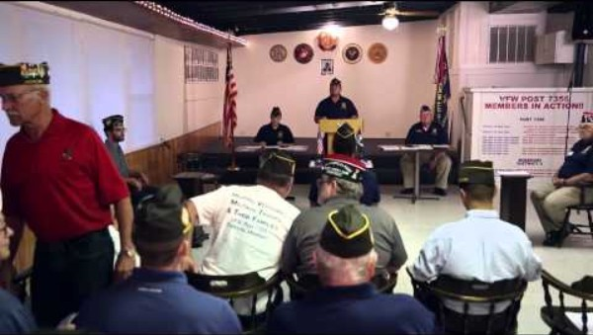

Slide 93
Conducting the Post Meeting

Slide 94
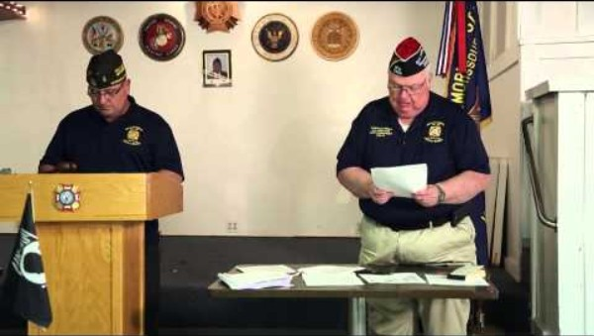

Slide 95
Closing Ceremony

Slide 96
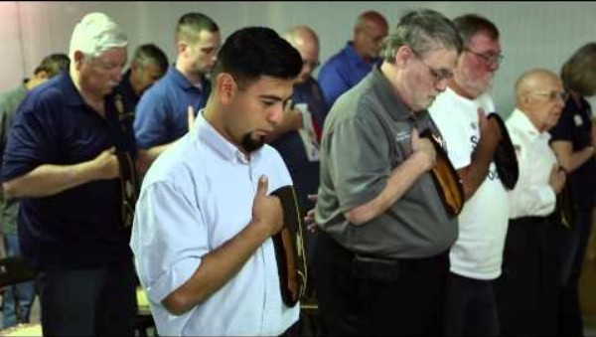

Slide 97
How to Make and Handle Motions (Cont.)
Once properly recognized by the Chair, a motion may be made. It is important the proposed motion is made in a clear and concise manner. The motion should be repeated and clarified by the Chair before being seconded.
Correct: “I move that (clear and plain language that is specific and limiting with a time constraint if necessary).”
Incorrect: “(long drawn out explanation with no clear indication of where the motion starts and ends)… I so move.”

Slide 98
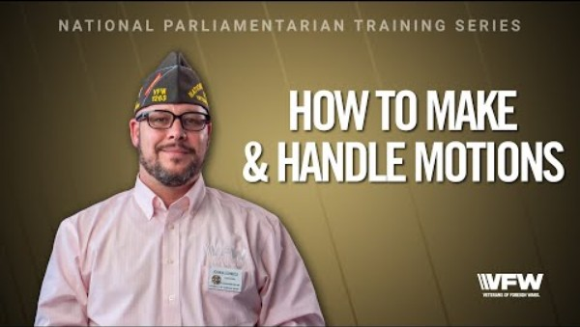

Slide 99
Misconceptions of the Second

Slide 100
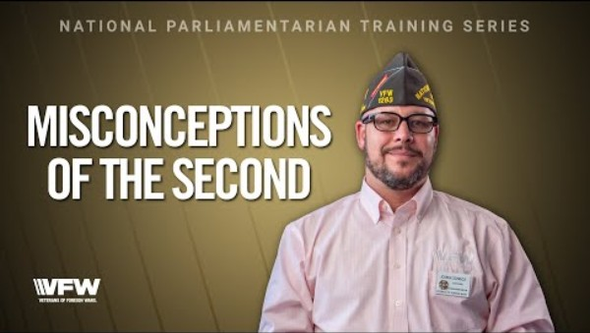

Slide 101
Nominations and Elections
Nominating speeches shall not exceed 5 minutes each, nor exceed two seconding speeches of two minutes each.

Slide 102
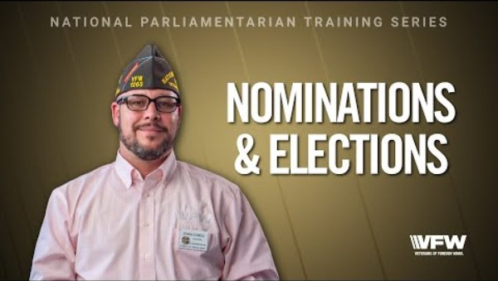

Slide 103
How to Close Debate
Once a motion has been proposed, clarified by the Chair, and seconded, the motion may be debated or amended.
While debating a motion, no member shall speak more than twice on the same question, nor longer than 10 minutes each time. No member shall speak a second time on the same question if any member who has not spoken on that question arises to claim the floor to speak thereon.

Slide 104
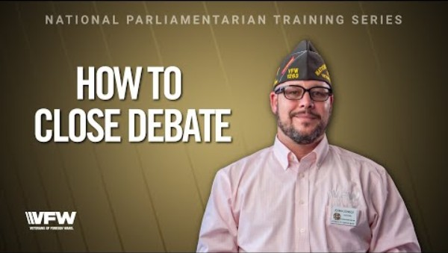

Slide 105
Amending Motions
Once a motion has been proposed, clarified by the Chair, and seconded, the motion may be debated or amended.
The object of an amendment is to change or modify the original motion, without destroying the sense of it. For instance, if there was a motion on the floor to hold a picnic, it could be amended to add a date or a place, but it could not be amended to change the affair from a picnic to a bowling match.

Slide 106
Amending Motions (Cont.)
Amendments should take the form of: inserting or adding words to the motion; striking out words; substituting words or sentences. The chair is obliged to rule out of order any proposed amendment which would do more than the above and change the sense of the motion entirely.

Slide 107
Amending Motions (Cont.)
Amendments to motions are debatable (that is, can be discussed). Like motions, amendments also require seconding. Discussion on an amendment must be confined to the amendment itself.

Slide 108
Amending Motions (Cont.)
In taking the vote, after debate, the amendment is first voted upon, and then the motion itself is voted upon. Sometimes, the nature of the amendment is such that passing or defeating the amendment carries or defeats the motion also. In that event, it is not necessary to take a vote on the motion.

Slide 109
Taking a Vote

Slide 110
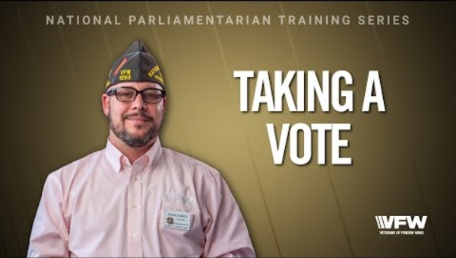

Slide 111
Presiding Officer Vote

Slide 112
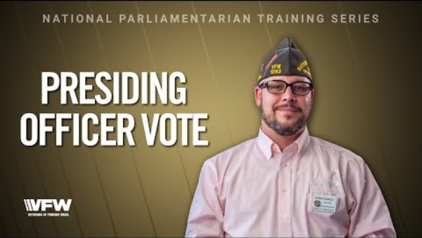

Slide 113
Challenging Voice Vote Results
The Chairman of a meeting or the “Chair” has certain rights, but they do not include engineering the meeting, or “railroading” certain matters through. A decision of the chair can always be subjected to change through appeal.
When a member rises to appeal a decision of the chair, their motion can be either to appeal the decision, or to overrule the chair—they both have the same meaning.
Under such circumstances, the member should state carefully and in understandable language why he/she is making the motion. The motion requires a second.

Slide 114
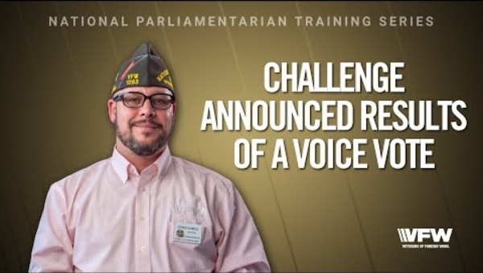

Slide 115
Tabling a Motion
A motion to table is a motion to lay aside business in such a manner that it can be renewed at a later time—either at the same meeting or a later one. A motion to table requires a second. Once seconded, the motion to table cannot be either debated or amended but must be put to immediate vote without discussion.

Slide 116
Tabling a Motion (Cont.)
Tabling a motion or matter does not carry a time limit. That kind of postponement is handled as follows:
Postpone to a Set Time: When the object is to set a future time at which a matter or motion must be considered, do not move to table. Instead, move to postpone to a set time, date, or meeting. A motion to so postpone consideration requires a second. It can be debated before being voted on and can be amended as to the time.

Slide 117
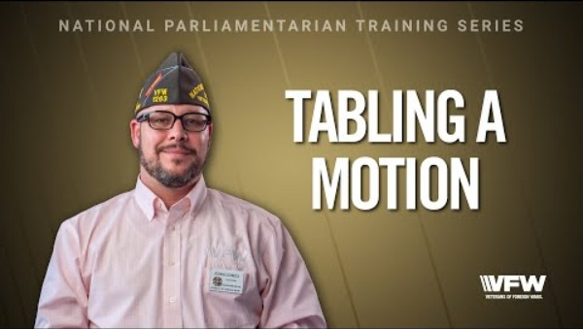

Slide 118
Motion to Take From the Table
When it is desired to resume the matter which was tabled, the correct motion is to “take from the table.” This motion must be seconded and is also not subject to debate or amendment. When a matter is taken from the table, it is taken with all previous actions, amendments, etc., and resumed just as it was when tabled

Slide 119
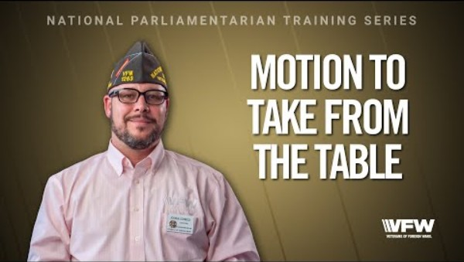

Slide 120
Motion to Commit
Place in Committee: When it is desired to let a few handle a given matter, instead of tying up the whole meeting needlessly, this is done by committing or placing in committee through a properly worded motion.

Slide 121
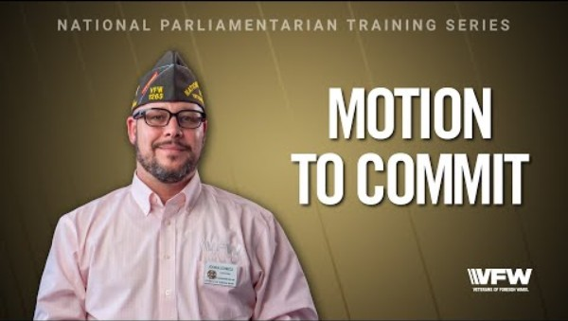

Slide 122
Dealing with Disruptive Members

Slide 123
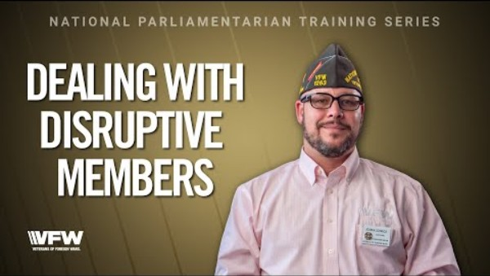

Slide 124
Meeting Minutes
The minutes of a meeting are simply a record of the proceedings of that particular meeting. As such, they can only be accepted by the body. In short, the general membership can only accept minutes of the membership meetings, the executive board can only accept its own minutes, etc. Upon reading of the minutes of a given meeting, they are subject to a motion to accept. Sometimes, corrections are raised, and then the minutes are accepted as corrected.

Slide 125
Meeting Minutes (Cont.)
Being simply the record of proceedings, minutes may be corrected at any time, including subsequent meetings.
Minutes shall record all main motions which were not withdrawn, all points of order, all appeals and whether lost or sustained. The makers of motions should be recorded, but not necessarily the seconders.
The date, time, and place of the meeting, as well as the time of adjournment should be in the minutes. Also, the results of any roll call votes, and full report of tellers who tally ballots.

Slide 126
Your Department Membership Team
Director – Scott Hice
Asst. Director – Ken Michael
Legacy Life Coordinator – Dave Bear

Slide 127
Membership Goals
This years Membership Goals are a little different than what you are used to. National has changed our focus of building membership every year to focusing on Retention. That is a word you will hear a lot this year. It’s not enough to go find new members each year. What are we doing to keep the annual members we put into the post?

Slide 128
National Membership Goals
National Division | Membership Size | National Quota | Retention
Division 1 | 501 – UP | 103% | 80%
Division 2 | 351 – 500 | 104% | 80%
Division 3 | 246 – 350 | 105% | 80%
Division 4 | 190 – 245 | 106% | 80%
Division 5 | 150 – 189 | 107% | 80%
Division 6 | 125 – 149 | 108% | 80%
Division 7 | 105 – 124 | 109% | 80%
Division 8 | 90 – 104 | 110% | 80%
Division 9 | 70 – 89 | 111% | 80%
Division 10 | 50 – 69 | 112% | 80%
Division 11 | 10 – 49 | 113% | 80%

Slide 129
Department Commander’s
Expectations
Division | Membership Size | Quota Required
Divisions 1 – 3 | 246 – 750+ Members | 101%
Divisions 4 – 6 | 112 – 245 Members | 102%
Divisions 7 – 8 | 68 – 111 Members | 103%
Divisions 9 – 10 | 1 – 67 Members | 104%
Plus 1 New Legacy Life member or Legacy Life Upgrade
And 80% Retention

Slide 130
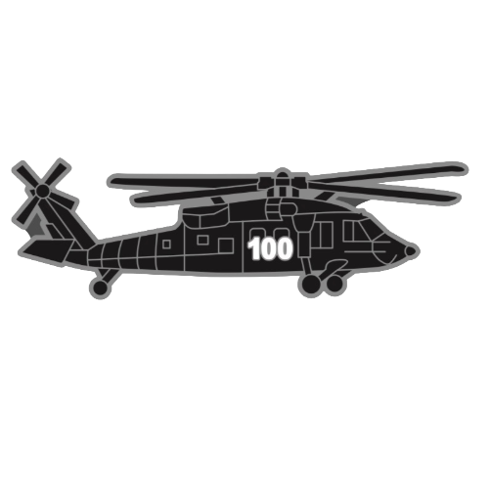
Department Commander’s Centurion Club
Posts who reach 101% will receive a special hat pin and 101% Banner

Slide 131


Department Commander’s Elite Centurion Club
Posts who reach 101% by December 31st will receive a special hat pin, a Special 101% Banner and a gift Card

Slide 132
Trustees’ Report of Audit Form
It is the responsibility of the Trustees to ensure the Trustees’ Report of Audit form is properly completed. To prepare for the audit, the following documents should be made available:
Previous quarterly audit
Ledger/voucher maintained by the Quartermaster
Banking statements for all accounts for the quarter being audited and Post Meeting minutes maintained by the Adjutant for the quarter being audited to ensure expenditures voted on by Post Members are being completed.

Slide 133
Trustees’ Report of Audit Form (cont.)
In addition, it is important to maintain a copy of the Post ByLaws with the financial documents if there is guidance on how monies are to be expended between Post meetings, e.g., a $ dollar limit on expenditures to maintain post operations or to assist a Veteran in need.

Slide 134
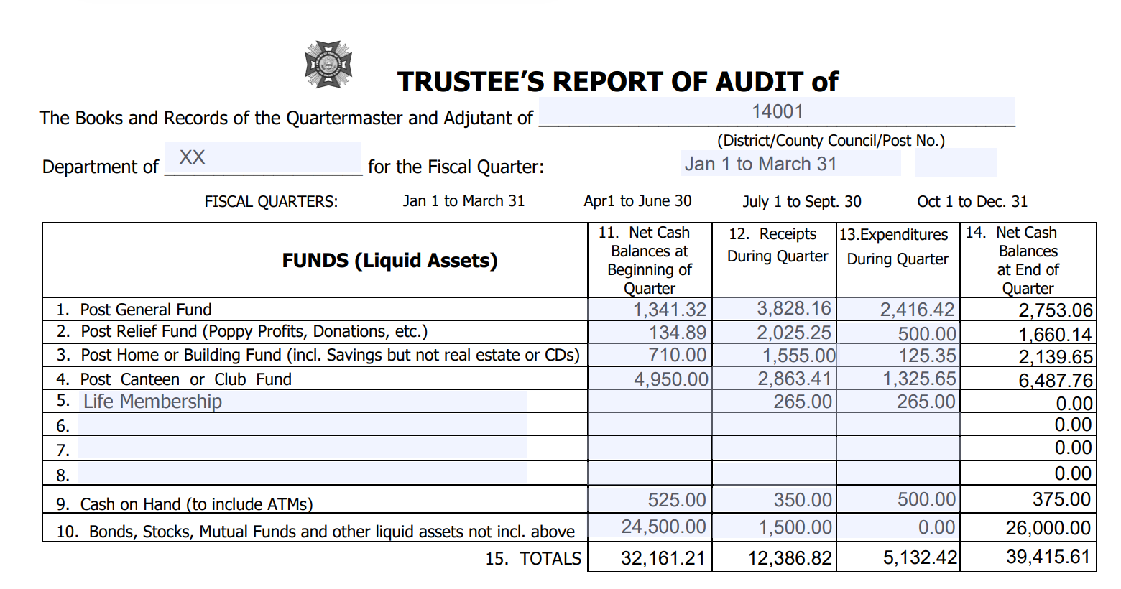

Slide 135
Lines #1-8 FUNDS (Liquid Assets) Listed are those funds most likely to be carried by a VFW Post and District. Any special funds may be added in the blank spaces. A “fund” is an account which normally has both income and expenditures. In most cases, just about all of your miscellaneous expenditures (community service, youth activities, expenses, etc.) are chargeable to your general fund and most miscellaneous income (proceeds from fundraising activities, dues, etc.) are credited to your general fund. Item

Slide 136
Line #9 CASH ON HAND (TO INCLUDE ATMS): Some posts own/operate ATMs, jukeboxes, gaming machines or other cash machines that that are not included in Item #4 above that require cash on hand to operate daily.
Line #10 BONDS, STOCKS, MUTUAL FUNDS AND OTHER LIQUID ASSETS NOT INCLUDED ABOVE This includes any financial instruments not previously included in any funds listed in Item #1-8 that can be liquidated without penalty by the financial institution. A loss in value of the account or processing fee charged by the financial institution to process the transaction does not equate to a penalty.

Slide 137
Column #11 NET CASH BALANCES AT BEGINNING OF QUARTER The figures in this column are obtained from different funds as listed in your ledger. The individual items in this column as well as the total at the bottom of the column should be the same as the ending balances of the previous quarterly audit.
Column #12 RECEIPTS DURING QUARTER The figures in this column are obtained by adding the amount shown in your ledger for the three months. This should include items transferred into a fund from another fund during the quarter.

Slide 138
Column #13 EXPENDITURES DURING QUARTER The figures in this column are obtained by adding the expenditures for the three months. Include items transferred out of another fund during the quarter.
Column #14 NET CASH BALANCE AT END OF QUARTER The figures in this column are obtained by adding items 11 & 12 and subtracting items 13.
Line #15 TOTALS The figures in this line are obtained by adding the totals of items 11& 12 and subtracting item 13 – you should arrive at the same by adding item 14.

Slide 140
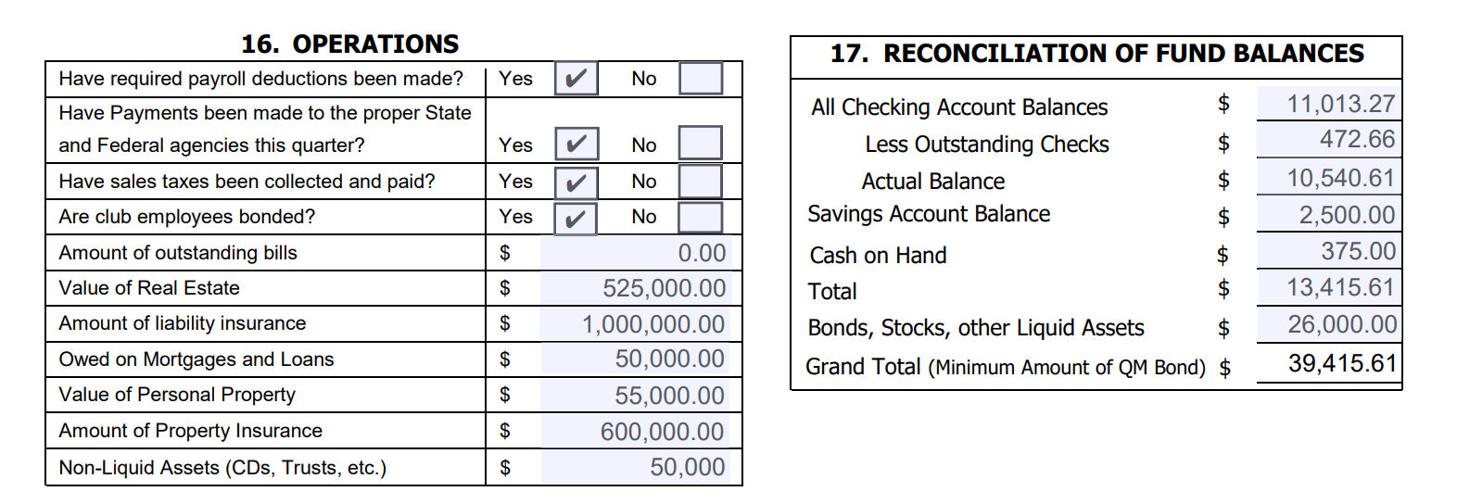

Slide 141
Section #16 OPERATIONS Answer questions as applicable. Non-liquid assets are types of assets that cannot be easily converted into cash within a short period without harsh penalties for early withdrawals. Trusts are a typical example. However, Certificate of Deposits less than $65,000 in value are typically non-liquid assets. Certificate of Deposits greater than $65,000 can be liquid assets. It is best to check with your banking institution on the type of CD and retain the information with the Post Financial Documents.

Slide 142
#17 RECONCILIATION OF FUND BALANCES:
All Checking Account Balances
Enter ending balance shown on bank statement. If more than one checking account, total ending balances for all accounts.
Less Outstanding Checks
Total checks written on or before the date of the last bank statement of the quarter that do not appear on the statement. If more than one checking account, total all outstanding checks.

Slide 143
#17 RECONCILIATION OF FUND BALANCES:
Account Balance
Subtract " Less Outstanding Checks" from "All Checking Account Balances. Add any deposits in transit that do not appear on bank statements. This should agree with the balance in your checkbook/ledger.
Savings Account Balance
Enter balances of any savings accounts.

Slide 144
#17 RECONCILIATION OF FUND BALANCES:
Cash on Hand
Amount of money on hand that has not been included in “Outstanding Deposits” above.
Total
Add "Account Balance" line, "Savings Account Balance", and"Cash on Hand" Line.
Bonds, Stocks and Other Liquid Assets
Enter current value of all bonds, stocks, and other liquid assets.

Slide 145
#17 RECONCILIATION OF FUND BALANCES:
Grand Total (Minimum Amount of QM Bond)
Add "Total Cash" line to "Bonds & Other Liquid Assets" line. Total in Item #15 Net Cash Balance at end of Quarter should equal Grand Total in Item #17. This is the minimum amount of QM Bond. Verify in #18, QM bond equal to or above this amount.

Slide 147
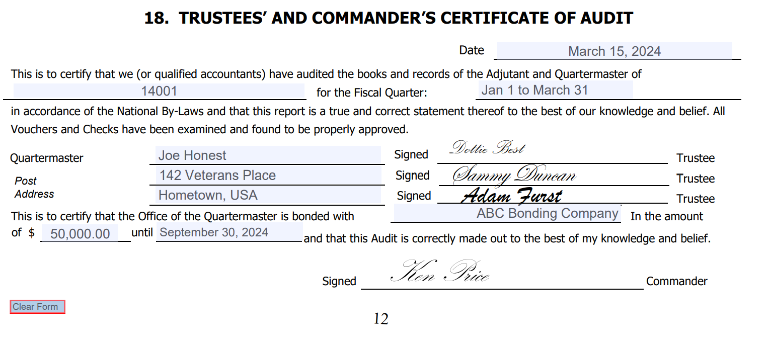

Slide 148
#18 TRUSTEES’ AND COMMANDER’S CERTIFICATE OF AUDIT:
Enter the date the audit is prepared, the Post name and number and the quarter for which the audit is prepared. The Post Commander and Trustees must sign the audit prior to submittal to the Department.
Enter the name of the Post Quartermaster, the name of the bonding company, the amount of the bond (verify in #17 Total that amount equal to or exceeds Total and the expiration date of the bond.
Remember, it is the duty of the Post Trustees to conduct the quarterly audits. It is the duty of the Commander to see that audits are made.

Slide 149
#18 TRUSTEES’ AND COMMANDER’S CERTIFICATE OF AUDIT: (Cont.)
The completed form, with the signature of the Post Trustees to attest to its accuracy, together with the signature of the Post Commander, should be forwarded to the Department Quartermaster. The Post Trustees should also sign the General Ledger at the ending point of the current audit period.

Slide 150
Read the VFW 2025-2026 Officers Guide, VFW Parliamentary Procedures, and VFW National By-Laws

Slide 151
Questions????

