Slide 1
Parliamentary Procedure

Slide 2
Parliamentary Procedure
Helps an organization achieve its purpose.
Provides equal treatment for all.
Expedites business and saves time.
Maintains order.
Protects the right of the majority to decide.

Slide 3
Parliamentary Procedure (Cont.)
Protects the right of the minority to be heard.
Protects the rights of members.
Protects the rights of absentees.
Helps members understand the universal rules that are useful in any organization.
Makes for meetings that members want to attend.

Slide 4
Parliamentary Procedure (Cont.)
Presiding officers who are ignorant of parliamentary law or who defy the body’s will or deny to the members the proper exercise of their rights are a sad spectacle before intelligent assemblies and frequently cause discontent and disunity.
Capable presiding officers make good meetings.

Slide 5
Parliamentary Procedure (Cont.)
Incompetent, abusive or obnoxious presiding officers can be censured; and their tenure of office can be shortened or abolished altogether by a 2/3 vote, and thus they may be legislated out of office at any meeting with prior notice.
You are not expected to know all the law, but you are expected to be able to at least match the members’ combined basic knowledge of it.

Slide 6
Parliamentary Procedure (Cont.)
Parliamentary procedure is the body of ethics, rules, and customs governing meetings and other operations of clubs, organizations, legislative bodies, and other deliberative assemblies.
Our bylaws govern our proceedings and Section 1001 of our Manual of Procedure define our “Rules of Order Governing All Meetings.”

Slide 7
Parliamentary Procedure (Cont.)
Any procedural matter not provided for within our bylaws are governed by Robert’s Rules of Order Newly Revised.
Our bylaws always take precedence.

Slide 8
Conducting Opening Ceremonies

Slide 9
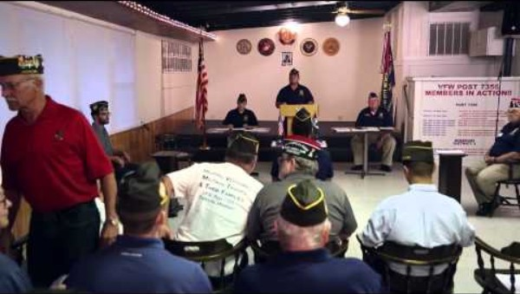

Slide 10
Conducting the Post Meeting

Slide 11
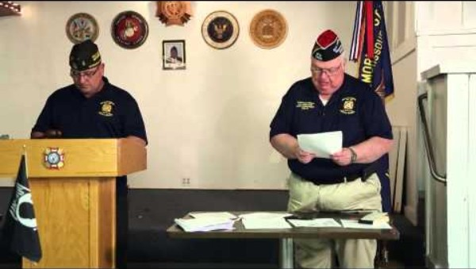

Slide 12
Closing Ceremony

Slide 13
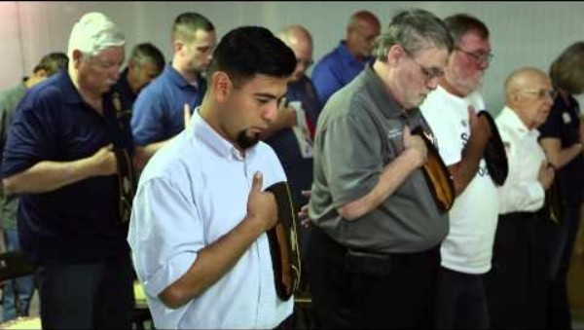

Slide 14
How to Make and Handle Motions (Cont.)
Once properly recognized by the Chair, a motion may be made. It is important the proposed motion is made in a clear and concise manner. The motion should be repeated and clarified by the Chair before being seconded.
Correct: “I move that (clear and plain language that is specific and limiting with a time constraint if necessary).”
Incorrect: “(long drawn out explanation with no clear indication of where the motion starts and ends)… I so move.”

Slide 15
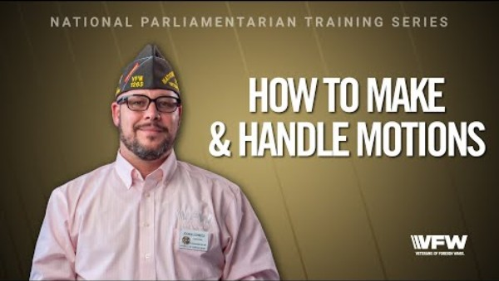

Slide 16
Misconceptions of the Second

Slide 17
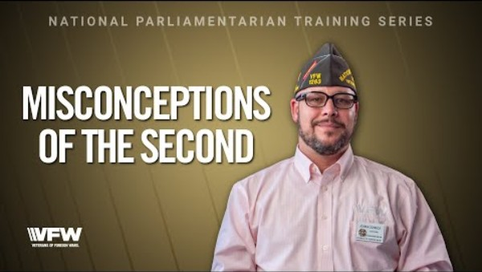

Slide 18
Nominations and Elections
Nominating speeches shall not exceed 5 minutes each, nor exceed two seconding speeches of two minutes each.

Slide 19


Slide 20
How to Close Debate
Once a motion has been proposed, clarified by the Chair, and seconded, the motion may be debated or amended.
While debating a motion, no member shall speak more than twice on the same question, nor longer than 10 minutes each time. No member shall speak a second time on the same question if any member who has not spoken on that question arises to claim the floor to speak thereon.

Slide 21
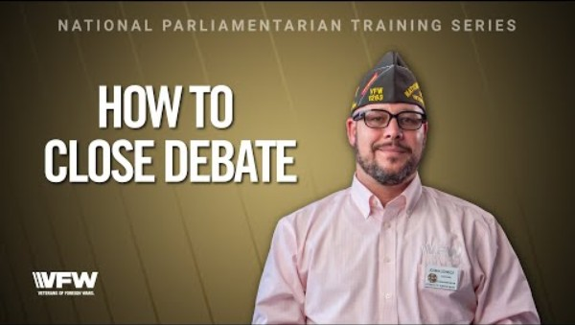

Slide 22
Amending Motions
Once a motion has been proposed, clarified by the Chair, and seconded, the motion may be debated or amended.
The object of an amendment is to change or modify the original motion, without destroying the sense of it. For instance, if there was a motion on the floor to hold a picnic, it could be amended to add a date or a place, but it could not be amended to change the affair from a picnic to a bowling match.

Slide 23
Amending Motions (Cont.)
Amendments should take the form of: inserting or adding words to the motion; striking out words; substituting words or sentences. The chair is obliged to rule out of order any proposed amendment which would do more than the above and change the sense of the motion entirely.

Slide 24
Amending Motions (Cont.)
Amendments to motions are debatable (that is, can be discussed). Like motions, amendments also require seconding. Discussion on an amendment must be confined to the amendment itself.

Slide 25
Amending Motions (Cont.)
In taking the vote, after debate, the amendment is first voted upon, and then the motion itself is voted upon. Sometimes, the nature of the amendment is such that passing or defeating the amendment carries or defeats the motion also. In that event, it is not necessary to take a vote on the motion.

Slide 26
Taking a Vote

Slide 27
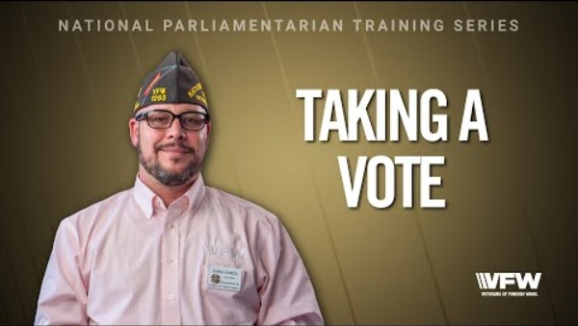

Slide 28
Presiding Officer Vote

Slide 29
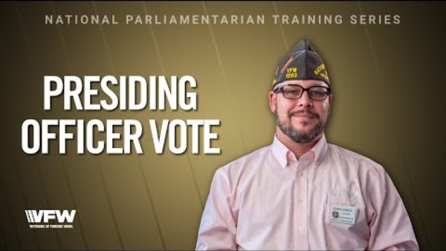

Slide 30
Challenging Voice Vote Results
The Chairman of a meeting or the “Chair” has certain rights, but they do not include engineering the meeting, or “railroading” certain matters through. A decision of the chair can always be subjected to change through appeal.
When a member rises to appeal a decision of the chair, their motion can be either to appeal the decision, or to overrule the chair—they both have the same meaning.
Under such circumstances, the member should state carefully and in understandable language why he/she is making the motion. The motion requires a second.

Slide 31
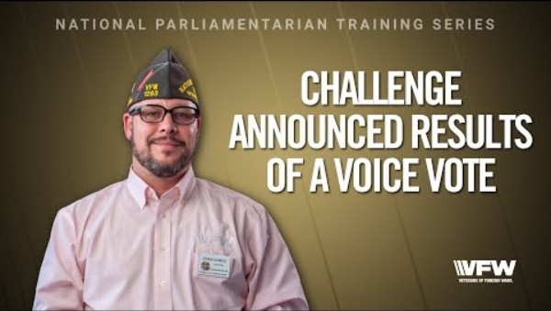

Slide 32
Tabling a Motion
A motion to table is a motion to lay aside business in such a manner that it can be renewed at a later time—either at the same meeting or a later one. A motion to table requires a second. Once seconded, the motion to table cannot be either debated or amended but must be put to immediate vote without discussion.

Slide 33
Tabling a Motion (Cont.)
Tabling a motion or matter does not carry a time limit. That kind of postponement is handled as follows:
Postpone to a Set Time: When the object is to set a future time at which a matter or motion must be considered, do not move to table. Instead, move to postpone to a set time, date, or meeting. A motion to so postpone consideration requires a second. It can be debated before being voted on and can be amended as to the time.

Slide 34
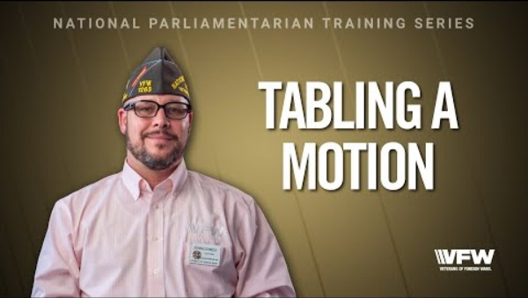

Slide 35
Motion to Take From the Table
When it is desired to resume the matter which was tabled, the correct motion is to “take from the table.” This motion must be seconded and is also not subject to debate or amendment. When a matter is taken from the table, it is taken with all previous actions, amendments, etc., and resumed just as it was when tabled

Slide 36
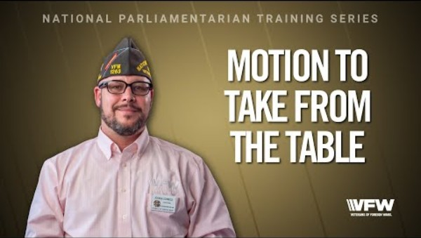

Slide 37
Motion to Commit
Place in Committee: When it is desired to let a few handle a given matter, instead of tying up the whole meeting needlessly, this is done by committing or placing in committee through a properly worded motion.

Slide 38
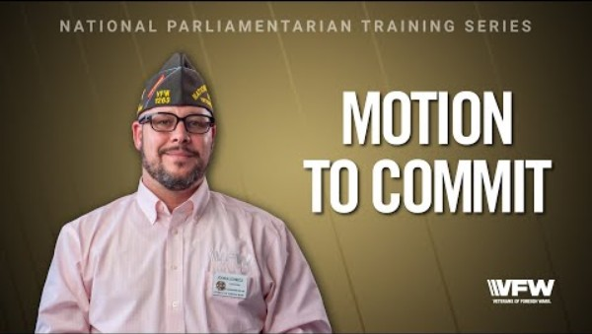

Slide 39
Dealing with Disruptive Members

Slide 40
