Slide 1
2026-2027
Training

Slide 2
Membership Training

Slide 3
Your Department Membership Team
Director – Scott Hice
Asst. Director – Ken Michael
Membership Committee – Heather Frank
Legacy Life Coordinator – Dave Bear
MAL Director – Dr. Brian Frank

Slide 4
Membership Goals
This years Membership Goals are a little different than what you are used to. National has changed our focus of building membership every year to focusing on Retention. That is a word you will hear a lot this year. It’s not enough to go find new members each year. What are we doing to keep the annual members we put into the post?

Slide 5
National Membership Goals
National Division | Membership Size | National Quota | Retention
Division 1 | 501 – UP | 103% | 80%
Division 2 | 351 – 500 | 104% | 80%
Division 3 | 246 – 350 | 105% | 80%
Division 4 | 190 – 245 | 106% | 80%
Division 5 | 150 – 189 | 107% | 80%
Division 6 | 125 – 149 | 108% | 80%
Division 7 | 105 – 124 | 109% | 80%
Division 8 | 90 – 104 | 110% | 80%
Division 9 | 70 – 89 | 111% | 80%
Division 10 | 50 – 69 | 112% | 80%
Division 11 | 10 – 49 | 113% | 80%

Slide 6
Department Commander’s Expectations
Division | Division Size (2026-2027) | Proposed All-State Quota
Division 1 | 501 – UP | 102%
Division 2 | 351 – 500 | 102%
Division 3 | 246 – 350 | 102%
Division 4 | 190 – 245 | 103%
Division 5 | 150 – 189 | 104%
Division 6 | 125 – 149 | 105%
Division 7 | 105 – 124 | 106%
Division 8 | 90 – 104 | 107%
Division 9 | 70 – 89 | 107.5%
Division 10 | 10-69 | 108%
Plus 1 New Legacy Life member or Legacy Life Upgrade
And 80% Retention

Slide 7
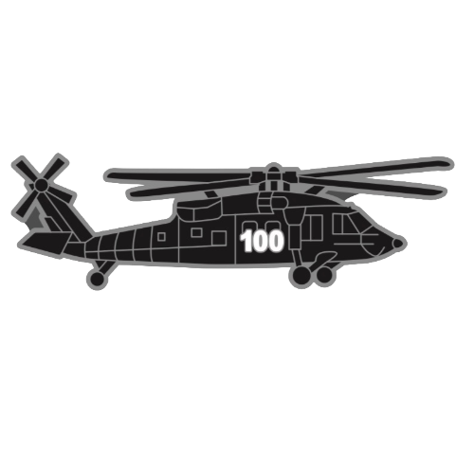
Department Commander’s Centurion Club
Posts who reach 101% will receive a special hat pin and 101% Banner

Slide 8


Department Commander’s Elite Centurion Club
Posts who reach 101% by December 31st will receive a special hat pin, a Special 101% Banner and a $100 gift Card

Slide 9
2026-2027 Membership Goals
Month | Membership Percentage | Retention Percentage
June 2026 | 65% | 0%
July 2026 | 69.5% | 10%
August 2026 | 74% | 20%
September 2026 | 78.5% | 30%
October 2026 | 83% | 40%
November 2026 | 87.5% | 50%
December 2026 | 92% | 60%
January 2027 | 96.5% | 70%
February 2027 | 100% +1 | 80%

Slide 10
50% off of Life Membership Program

Slide 11
50% off of Life Membership Program
Starts around October 1st
Member pays half
Post pays full
Post fills out Form and submits it to HQs
HQs sends Post Half back for each one on the form.

Slide 12
50% off of Life Membership Program
This is a First Come, First Served Program
Don’t wait, as soon as the money is gone….The Program Closes
This is a no-Brainer. Take advantage of this.
This only helps posts in RETAINING!!!
Push this program as much as you can!!

Slide 13
TRANSFERS

Slide 14
Question:
What must we always do when accepting a Transfer Request?

Slide 15
Answer:
See a copy of their DD Form 214 or Qualifying document

Slide 16
Members-at-Large
MAL

Slide 17
Members-at-Large
Members-at-Large are members of the VFW who do not have a post home. Whether they joined online, got frustrated with another post, got remanded to the MAL or were members of a post who closed.

Slide 18
Members-at-Large
It becomes our duty and responsibility to get our local MAL list from the membership team and find worthy comrades from that list and offer them a home. Always remember to check their DD form 214 or Qualifying documentation before processing their transfer form.
It is the Department Membership’s goal to reduce the MAL by 20% every year. We want those people who qualify in our posts. We want them to help local post programs and mission.

Slide 19
Membership Form and How to Fill it out.

Slide 20
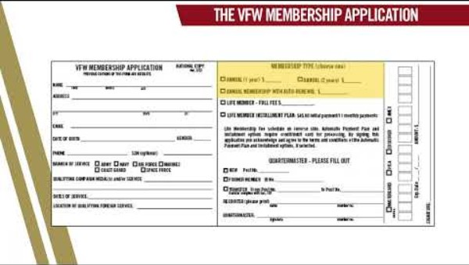

Slide 21
LEGACY LIFE MEMBERSHIP PROGRAM

Slide 22


Slide 23
The VFW Legacy Life Membership Program
is a prestigious tier of membership designed for current Life Members who wish to leave a lasting financial impact on the organization. By participating, members create an annual endowment that supports their local Post, Department, and the National VFW in perpetuity.

Slide 24
Legacy Life Membership Program
Membership Levels & Costs
The program is divided into three distinct levels, each offering increasing benefits and endowment amounts:
Level | One-Time Cost | Annual Endowment (to Post/Dept/Natl)
Bronze | $400 | $6
Silver | $800 | $12
Gold | $1,200 | $18

Slide 25
Legacy Life Membership Program
Key Benefits
Members receive exclusive recognition items and financial perks based on their tier:
Recognition: Personally engraved membership card, lapel pin, hat pin, and a framed certificate.
Discounts: Tiered discounts at the VFW Store (5% for Bronze, 10% for Silver, 15% for Gold).
Insurance: Increased levels of no-cost Accidental Death and Dismemberment (AD&D) insurance.
Permanent Legacy: Recognition at the VFW National Headquarters Museum and the Memorial Building kiosk in Washington, D.C..

Slide 26
Legacy Life Membership Program
Endowment Options
When enrolling, members choose how their legacy continues after their passing:
Annual Endowment: The annual payment to the Post, Department, and National continues forever in the member's name.
One-Time Endowment: Upon the member's death, the principal amount of the legacy is paid out in equal shares to the Post, Department, and National organization.

Slide 27
Legacy Life Membership Program
Memorial Legacy
The program also allows individuals to purchase a Memorial Legacy in the name of a deceased VFW member. This ensures the veteran's name remains on the Post rolls and continues to provide financial support to the organization in their honor.

Slide 28



New Florida Legacy Life Pin Program
New Legacy Life Members and those who upgrade will be recognized at the Department awards ceremony. They will receive a special Florida Legacy Life Pin.
This pin will be controlled and will only be issued at the Conferences/Convention.
It will Come in Bronze, Silver, Gold variations based on the level of Legacy Life.
Existing Legacy Life Members will be able to purchase their pin at the Conference/Convention.
These pins have been approved at National and will be another way of showing the world the members decision to leave their legacy with VFW.

Slide 29
Recruiting Awards

Slide 30
Question
Who usually wins recruiting awards across the Department?

Slide 31
Answer
The Quartermaster.
Unfortunately, they are the only person that can put new members in the system, and the recruiting member field is usually left blank, so they put their name in it.

Slide 32
Question
Is it fair that the QM is usually the person who wins recruiting awards?

Slide 33
Answer
No, it is not.
While QMs work hard. They are not usually the people out there working hard to bring new members in. Props to the QM who do but they are the exception, not the rule.

Slide 34
Moral of the Story
Take credit for your work!!

Slide 35
Recruiting Awards
Individual Recruiting Awards
Individual members are rewarded based on the number of new or reinstated members they sign up:
5, 10, or 15 Members: Corresponding recruiter pins.
25 Members: Commander-in-Chief’s Coin.
50 Members: Recruiter’s Medical Bag.
75 Members: Commander-in-Chief’s Medallion Set.
100 Members (Century Club): Century Cap and Citation (or a $50 VFW Store credit).

Slide 36
Recruiting Awards
Post, District, and Department Awards
The program features several "prestige" awards for leadership and unit performance:
award | Criteria
All-American Status | Achieving Percentage goal in membership, submitting election reports, and participating in core programs (Voice of Democracy, Patriot’s Pen, Buddy Poppy purchase).
All-State Status | State-specific criteria (e.g., in California or Pennsylvania) usually involving percentage goal in membership and community service reporting.
Triple Crown | Awarded to an individual named as an All-American Commander at the Post, District, and Department levels.
Commander’s Challenge | Quarterly contests awarding points: 1 pt for Annual, 5 pts for Life conversion, 10 pts for New Life members.

Slide 37
Recruiting Awards
Special Incentives & Benchmarks National
Early Bird Award: The top two Posts in each division as of January 1, 2027, receive a $1,000 VFW Store gift certificate.
Legacy Life Membership: Posts hitting benchmarks of 25, 50, or 75 Legacy Life members receive a Legacy Society Post Proclamation. Commanders of Posts reaching 100+ Legacy members can receive up to $1,000 in travel/lodging for the National Convention.
Divisional Recruiting Grant: The top two Posts in each division (based on new/reinstated members) receive a $1,000 membership grant deposited directly into their Post account.

Slide 38
David G. Snyder Award
Recognizes the first Post to reach its designated membership percentage by the November 30, 2026 hard deadline.
Divisions 1-3 (Large): Must reach 101%.
Divisions 4-6: Must reach 102%.
Divisions 7-9: Must reach 103%.
Division 10: Must reach 105%.
Life Membership Requirement: Posts that are 101% Life Membership must obtain at least 10 new members to qualify.
Exclusion: Post mergers are not eligible for this award.

Slide 39
Emerson Lee Award
Recognizes the first Post to reach its designated membership percentage by the November 30, 2026 hard deadline.
Minimum Eligibility: Posts must have a minimum of 50 members to qualify.
Divisions 1-3 (Large): Must reach 105%.
Divisions 4-6: Must reach 106%.
Divisions 7-9: Must reach 107%.
Division 10: Must reach 108%.
Exclusion: Post mergers are not eligible for this award.

Slide 40
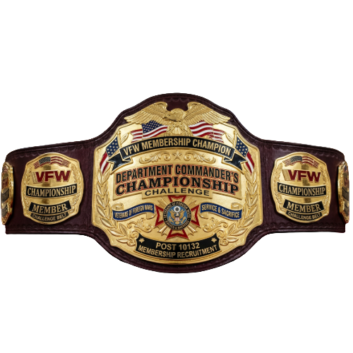

The Florida "Title Circuit"
Department of Florida: Championship Belt Class Structure (2026-2027)
Florida Title Class | National Divisions Included | Post Size (Total Members) | Competitive Focus
Heavyweight | Division 1 | 501+ Members | "Titans" with large rosters and high community visibility.
Cruiserweight | Divisions 2 – 3 | 246 – 500 Members | Established Posts focused on high-volume recruitment to hit 104-105% quotas.
Welterweight | Divisions 4 – 7 | 105 – 245 Members | The "Mega-Bracket" focused on high engagement and aggressive MAL transfers.
Lightweight | Divisions 8 – 11 | 10 – 104 Members | Grassroots growth requiring 110%+ quotas and high 80% retention.

Slide 41
The Department Commander’s
Championship Belt

Slide 42
The Department Commander’s
Championship Belt
Commander-in-Chief’s Challenge Scoring
New Annual Member: 1 point
MAL Transfer: 5 points
Annual/Lapsed Member Conversion to Life: 5 points
New Life Member: 10 points
MAL Transfer + Life Membership: 10 points
Legacy Upgrade: 10 points (per level: Bronze, Silver, or Gold)
New Legacy Life Member: 15 points
1 Belt per Weight Class
Changes hand Quarterly. You must keep putting them in to keep the belt.
Post who ends up with it at the end of the year, keeps the title
Gets awarded at the Fall Conference, Mid-winter, and Convention.
District Commander of the Belt holder must bring the belt to the Conference/Convention.

Slide 43
The MAL Slayer Championship Belt

Slide 44
The MAL Slayer Championship Belt
1 Belt only
Awarded to the Post with the highest volume of Members-at-Large (MAL) transfers. This honors the "hunters" who actively bring unassigned veterans back into the active fold. Awarded quarterly and Conferences and Convention.
1pt per MAL Life member who transfers in.
1pt per MAL Annual who transfers in.
5pts per MAL Annual who transfers in and converts to life while transferring.

Slide 45
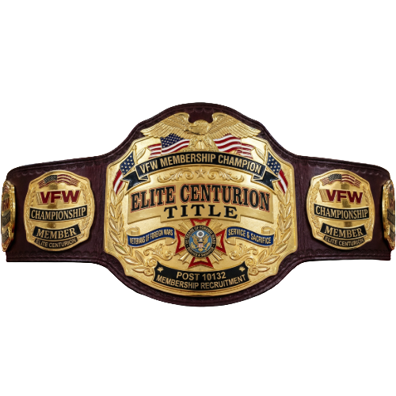
The Elite Centurion Championship Belt

Slide 46
The Elite Centurion Championship Belt
1 Belt per Weight Class
Awarded to the Post in each class that maintains the highest overall membership percentage. This title specifically celebrates the "100% Sprint" and those who hit their quotas early.
Changes each Quarter at Conferences/Convention. District Commander must bring the belt to Conferences/Convention.
Winner at Convention keeps the belt.

Slide 47

The Legacy Life Championship Belt

Slide 48
The Legacy Life Championship Belt
1 Belt
Awarded to the Post that gets the most New Legacy Life and Legacy Upgrades.
Awarded at Convention.
Scoring:
New Legacy Life 15pts
Legacy Life Upgrade 10pts

Slide 49
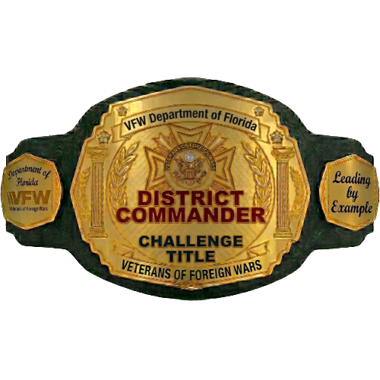
The District Commander Challenge Title

Slide 50
The District Commander Challenge Title
1 Belt
Awarded to the District Commander that has the highest percentage of posts who do the right things.
Changes each Quarter at Conferences/Convention. District Commander must bring the belt to Conferences/Convention.
Winner at Convention keeps the belt.
Scoring:
Points are awarded for milestones from the dashboard. Scores will be averaged.

Slide 51
Recruiting 101
We have a separate training slides on Recruiting ideas, DOs/Donts etc. Please go to vfwfl.org then resources and then training to find it.

Slide 52
Read the VFW 2026-2027 VFW Membership Guide

Slide 53
Questions????

