Slide 1
DEPARTMENT OF FLORIDA
LEADERSHIP SOI DEPARTMENT MEMBERSHIP 2024 - 2025

Slide 2
STATE COMMANDER
Glenn Wright
gwright@vfwfl.org
STATE ADJUTANT/QUARTERMASTER
Eugene “Gene” Perrino, SR.
gperrino@vfwfl.org
(352) 622-5126

Slide 3
Contact Information
Membership Director:
Scott Hice - 850 305-0064
shice@vfwfl.org

Slide 4
Assistant Membership Director:
Ron Holladay – 850-602-6395
rholladay1960@hotmail.com
Members At Large Director
Wayne Tuttle – 810-610-9361
warvet1976@gmail.com
Assistant Member At Large Director
TOM RANDALL - (954) 790-5739 trandall@vfwfl.org

Slide 5
Membership
Online Membership Services (OMS)
Memstats versus Roster
Common Issues
National Membership Program
Training Resources
Questions

Slide 6
OMS
ONLINE MEMBERSHIP
SYSTEM

Slide 7
Create Your Account For National Website
** Every Member SHOULD create an account for themselves !!
Notes:
Ask how many have an account

Slide 8
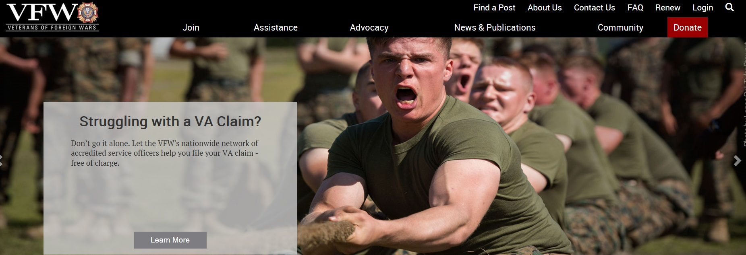
Create An Account https://www.vfw.org

Slide 9
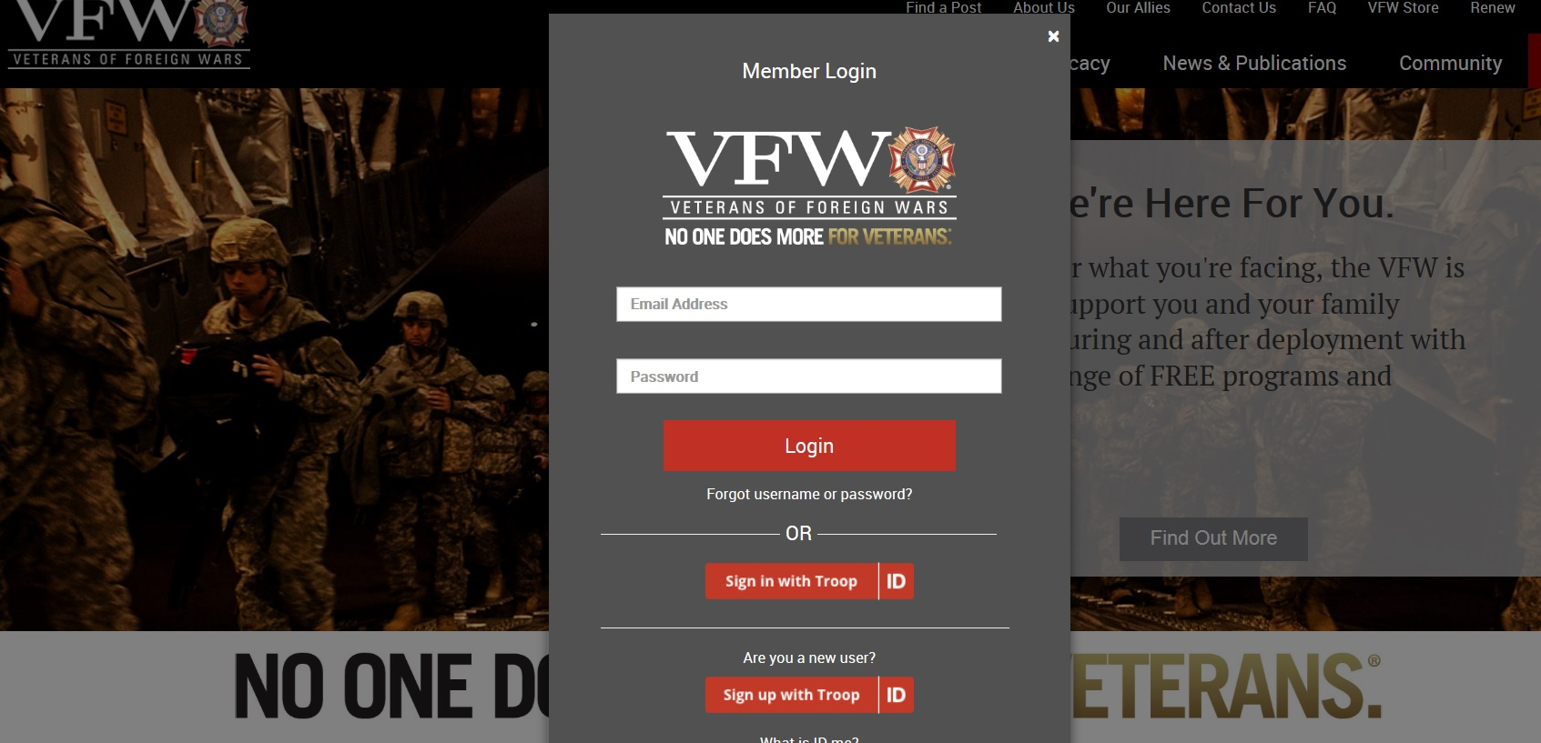

Slide 10
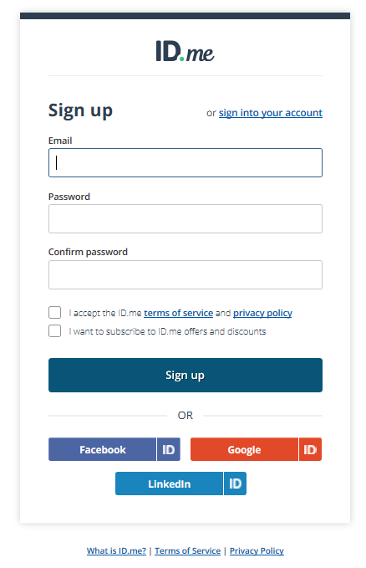

Slide 11
LOGIN TO YOUR ACCOUNT

Slide 12
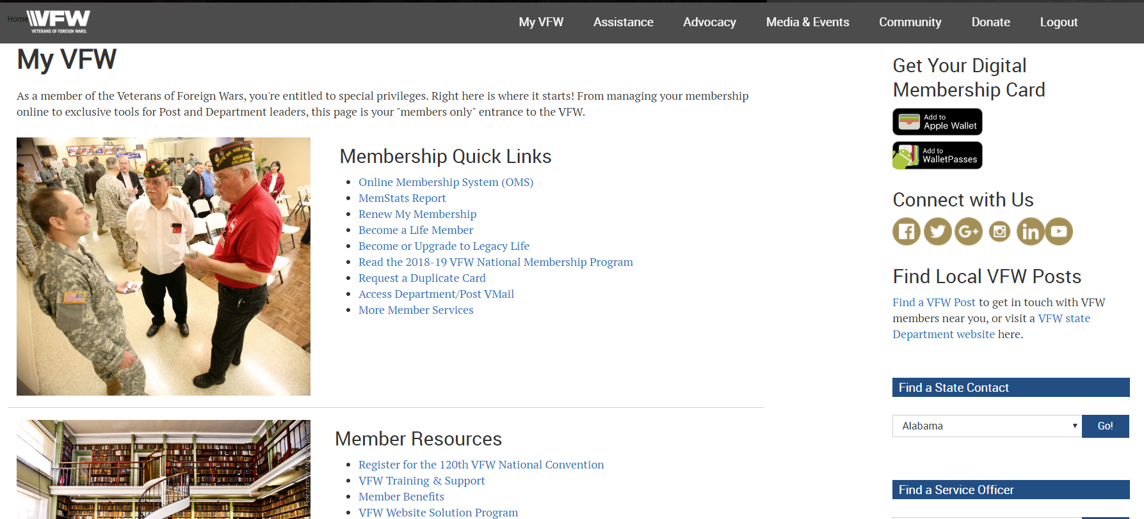
QUARTERMASTER TOOLS

Slide 13
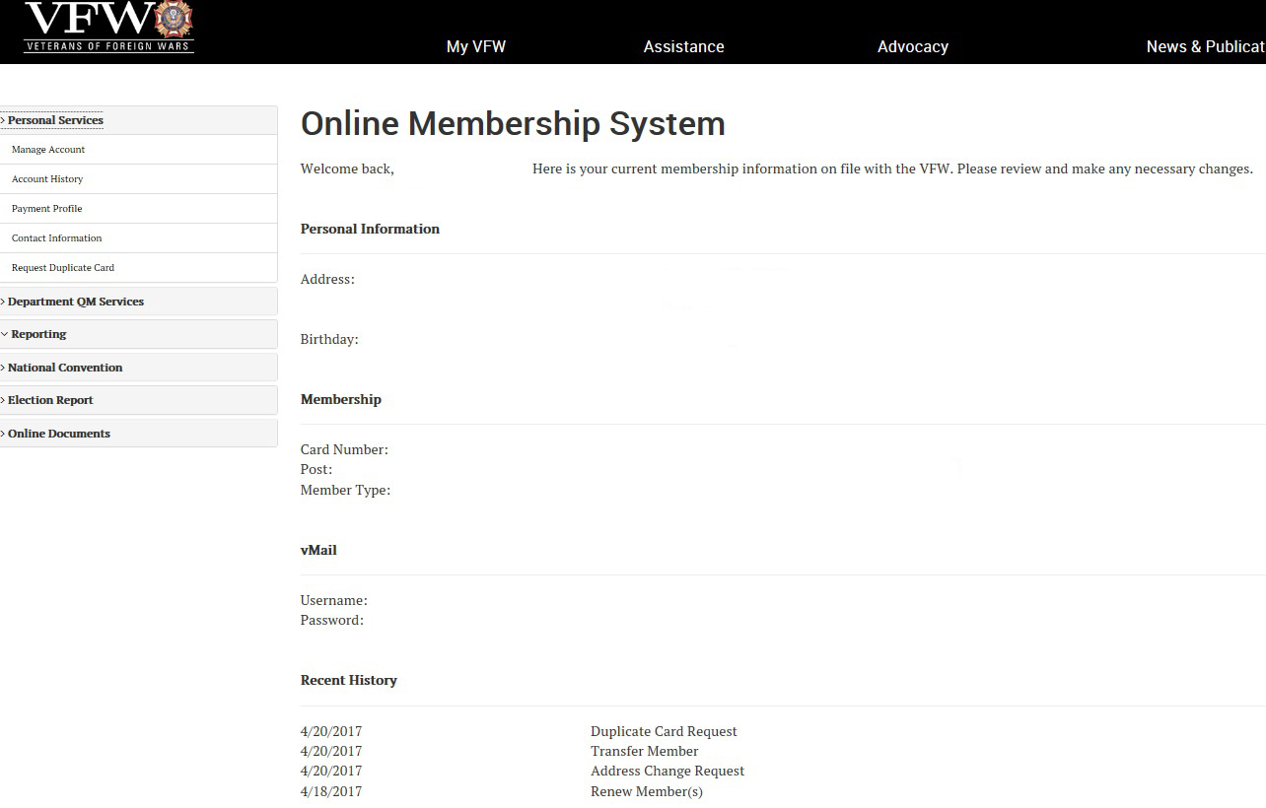
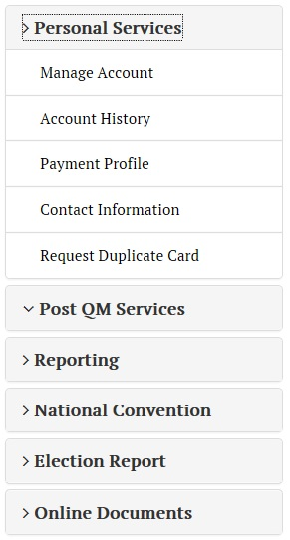
Notes:
DO NOT SHARE QM PASSWORD
Can reek havoc

Slide 14
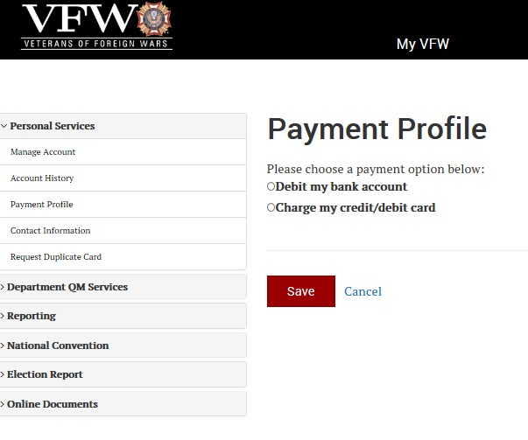
Notes:
Setup Payment Profile to Debit Bank or Charge cc/ debit card (Info goes to National)
Used when submitting a new or renewal member (National debits your account)
If member renews online sends the post their portion of the dues
Notify National if your bank acct info changes
QM signing on for the first time will receive a one-time pin via snail mail from National

Slide 15
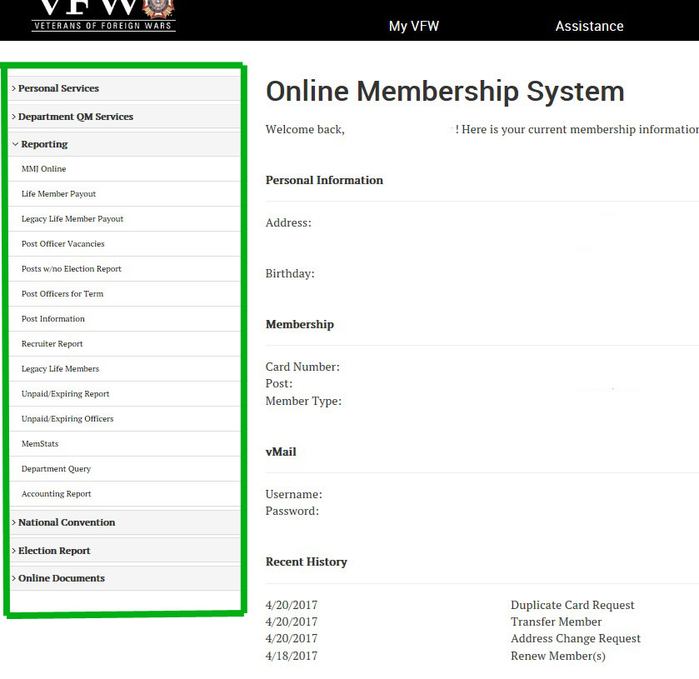
GET FAMILIAR
Notes:
Get Familiar with MENU ITEMS

Slide 16
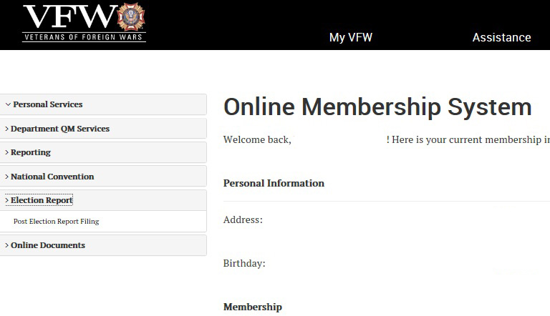
Notes:
Election Reports are submitted
1. After and Election
2. Anytime an Officer changes
3. Anytime Status of the Post Changes (Meeting Change, Dues change or address etc

Slide 17
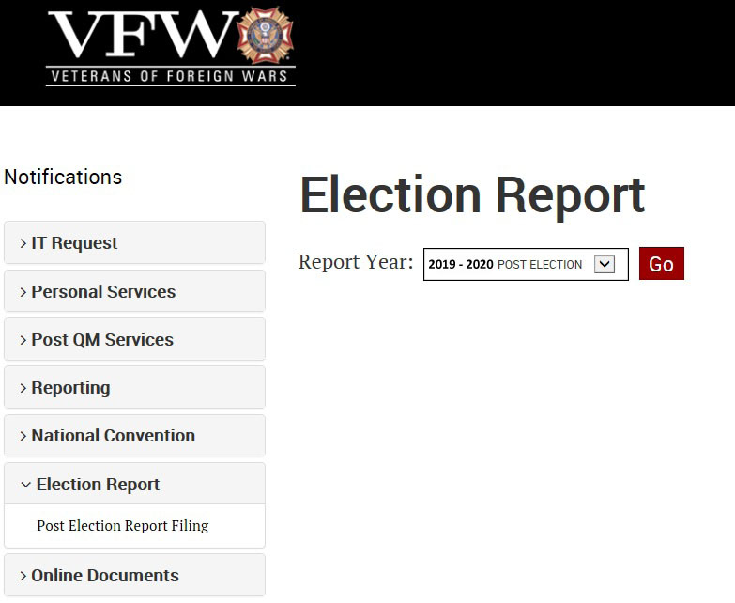
Notes:
When are Election Reports filed?

Slide 18
Important:
If at any time during the year you have an elected Officer change –
YOU MUST SUBMIT AN ELECTION REPORT
If the Quartermaster changes, you must notify Dept. HQ with the member number of the new Quartermaster. It may take HQ assistance to get the Quartermaster Tools up and running.

Slide 19
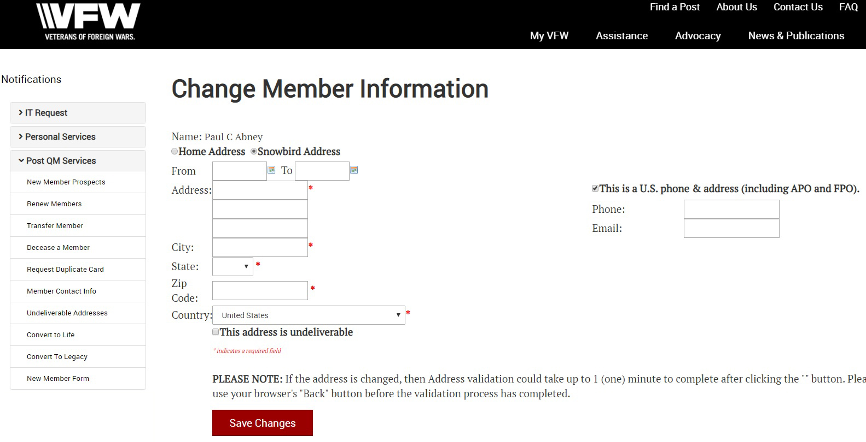

Slide 20
Understanding
Memstats
and the Roster

Slide 21
MEMSTATS
MemStats can be summed up in one concept:
“What will the status of my Post be on June 30th if no further dues are collected?”
MemStats does not count Unpaid or Expired Members, only Paid Members. This is because Memstats reflects what your Post’s year-end counts will be. It is not intended to be a running total of your Post’s active members (Members in Good Standing).
The reason for this is simple – there are no administrative functions that rely on a Post’s number of Members in Good Standing, and MemStats is solely an administrative tool. All Membership contests rely solely on Paid Members, which is what MemStats tracks.
In short, MemStats follows the money for the membership year.

Slide 22
Post Query
Notes:
Example

Slide 23
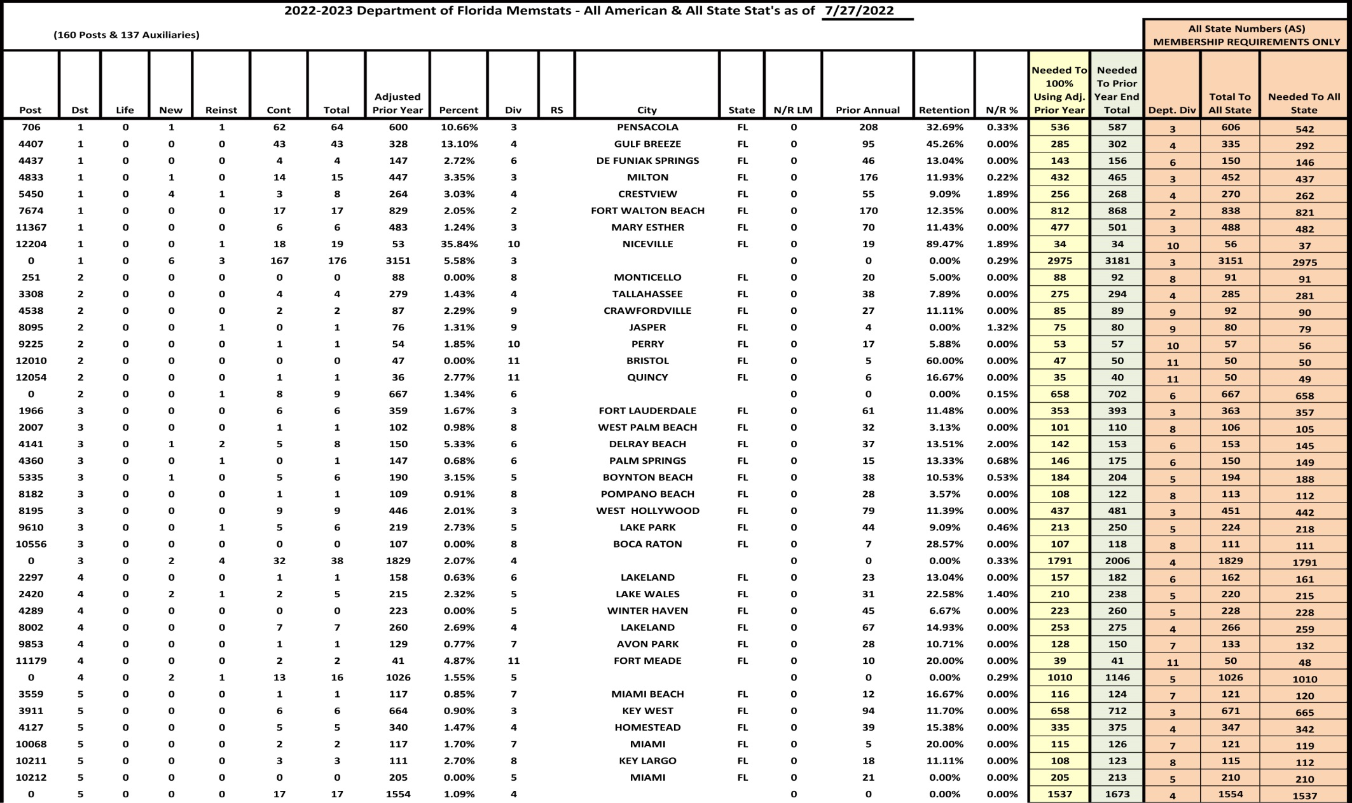
Memstats From FL Membership Director
Notes:
19 Districts,156 Post & 137 Auxiliaries
Spin numbers to give total to 102% and total to reach All State requirement by Division

Slide 24
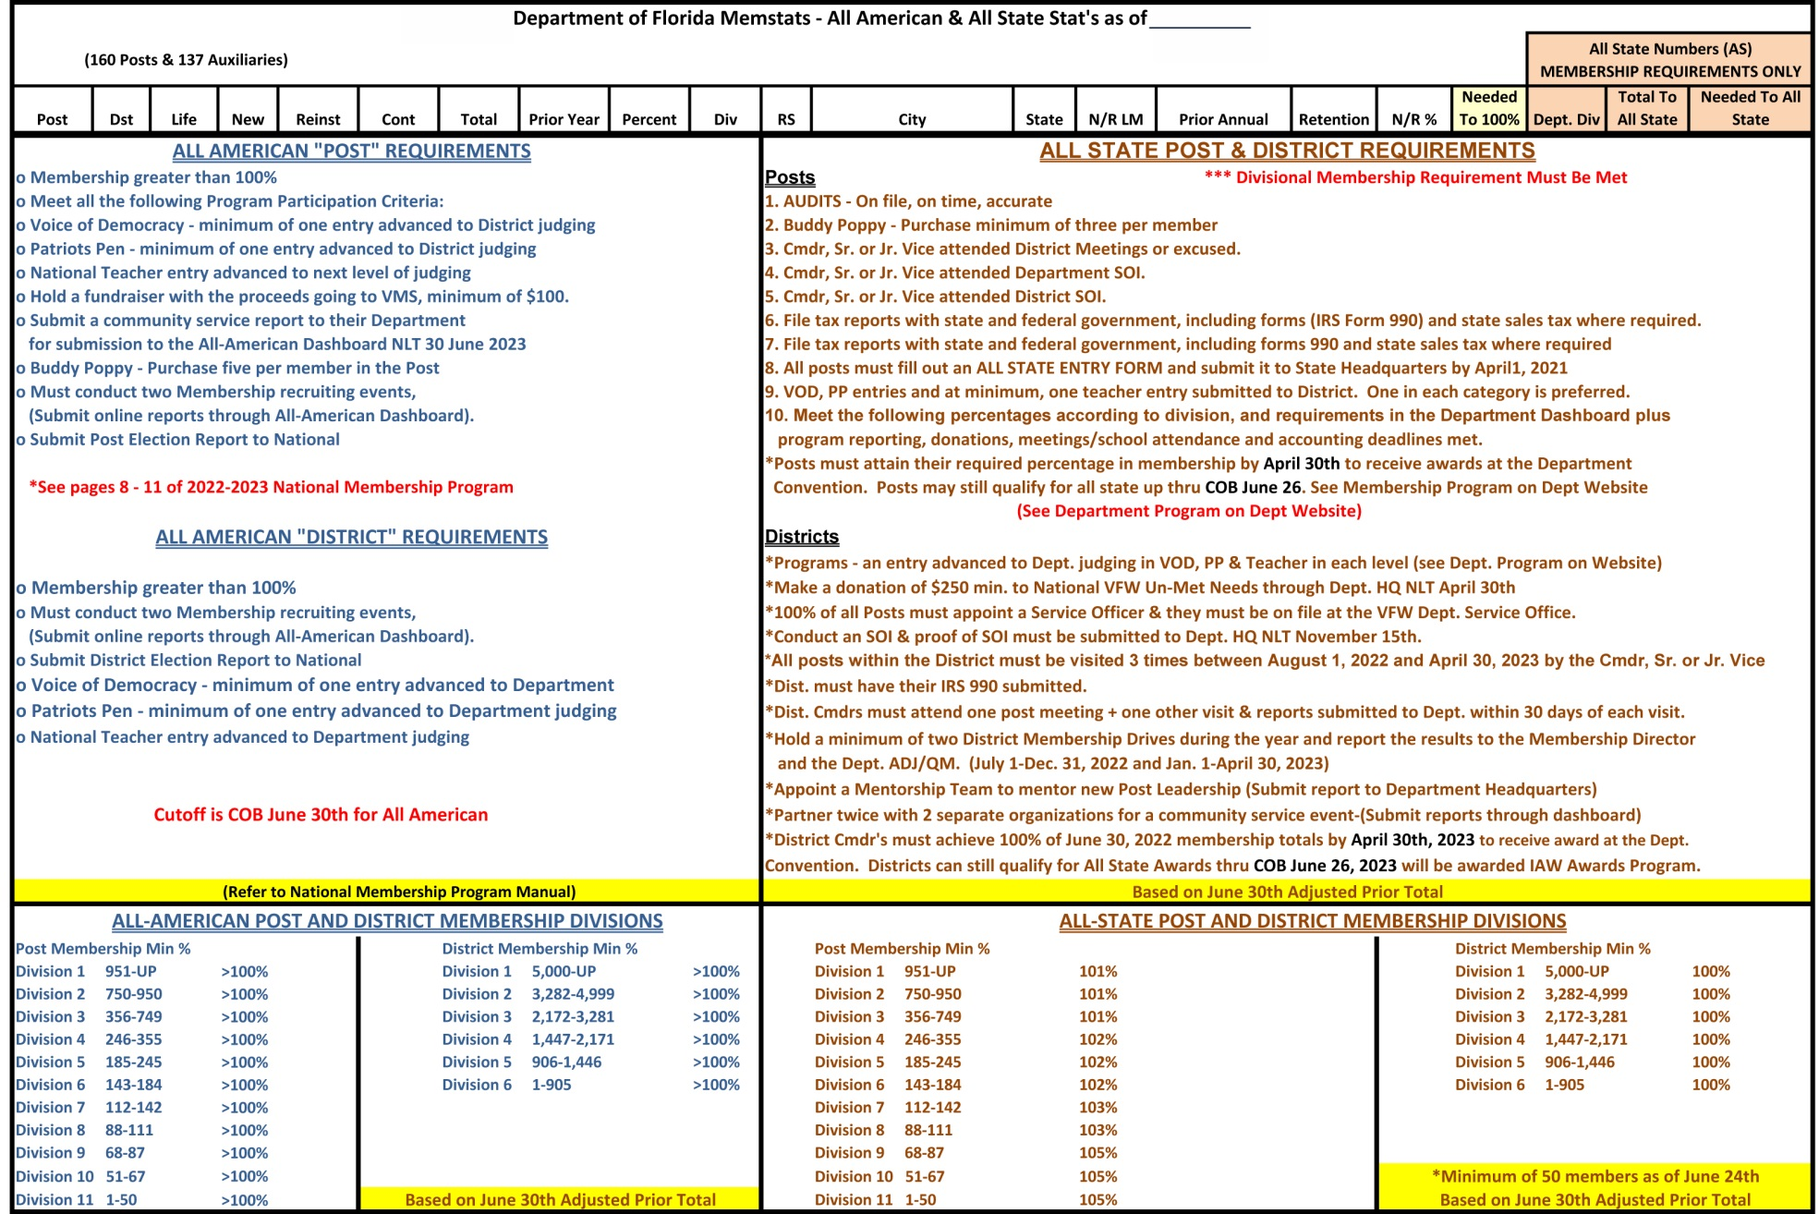
All American & All State Membership Requirements For 2024 - 2025
Notes:
Page list all Criteria for All State & All American (Taken directly from the National & State Membership Programs)

Slide 25
Post Membership Divisions and Minimum Qualifying Percentages
Division | Total Membership |  |  | Qualifying Percentage
1 | 951+ |  |  | 102%
2 | 750 | 950 |  | 102%
3 | 356 | 749 |  | 102%
4 | 246 | 355 |  | 102%
5 | 185 | 245 |  | 102%
6 | 143 | 184 |  | 102%
7 | 112 | 142 |  | 102%
8 | 88 | 111 |  | 102%
9 | 68 | 87 |  | 102%
10 | 51 | 67 |  | 102%
11 | 10 | 50 |  | 102%
Notes:
Membership Scale ---All Divisions must reach 102% to qualify

Slide 26
COMMANDER’s REPORTING MENU:
Unpaid/Expiring Report (MAL, Relocated & Prior).
Unpaid/Expiring Officers.
Find Unpaid/Relocated.
Find Unpaid Members.
MemStats.
NOTE: Extremely important to work the Unpaids/Expiring Lists. Retention is key!
Shows our members we care; strength are in our numbers when fighting for our benefits we earned & deserve.

Slide 27
RETENTION DEFINED:
Your Post retention is derived from six types of payment components based on your prior year total of annual members:
A prior year annual member pays his or her annual membership dues.
A prior year annual member pays the life membership installment fee.
A prior year annual member pays for life membership dues.
A prior year annual member transfers to another Post and pays his or her annual membership dues to your Post prior to transfer.
A prior year annual member transfers to another Post and pays the life membership installment fee to your Post prior to transfer.
A prior year annual member transfers to another Post and pays life membership dues to your Post prior to transfer.

Slide 28
COMMON
RECURRING ISSUES

Slide 29
OFFICERS
DUES RENEWAL
*
Renew Them ASAP
Notes:
Annual Pay Officers…. If they expire you lose them for the year.
Pay for them…they are doing a job for the post

Slide 30
Department Email
Do NOT Auto-Forward or Use Auto-Response
Share
Check Often
Important Info
Notices
Invoices
Audits
Due Dates
Notes:
Commanders share email with QM, Adjutant Membership Chairperson/Director
Will only use VFW email postXXXX@vfwfl.org
DO NOT DELETE Right away….maybe for your QM….Work together as a TEAM

Slide 31
ADP Contingency Planning
Natural Disasters
Fire, Flood, Etc.
Man-made
Theft, Vandalism,
Sabotage, Etc.
Equipment Failure
Computer, Hard Drive, Etc.
Backup
Computer, External Hard Drive, Thumb Drive
Keep it secure!
Notes:
Have a Disaster Plan –
Backup Info Daily or at least a couple times a week (do not want to rebuild your data)
Offsite Storage for –your data—Ensure its kept Secure!

Slide 32
MEMBERSHIP CHANGES – 2024-25

Slide 33
OPERATION: ALL IN
VFW National Membership Program
2024-2025
Al Lipphardt Commander-in-Chief
“Believe in what you do, do what you believe in.”
VERSION DATE: May 6, 2024

Slide 34
All-American Post Leadership Criteria
• Membership must be at least 102%
• Post-Election Report must be submitted to National Headquarters
• Meet all the following Program Participation Criteria by Jan 31st, 2025.
o Voice of Democracy - minimum of one entry advanced to District judging (Overseas Post donate $125 to National in lieu of entry)
o Patriots Pen - minimum of one entry advanced to District judging (Overseas Post donate $125 to National in lieu of entry)
o Donate to Veterans & Military Support Programs
Services, minimum of $125.

Slide 35
All-American Post Leadership Criteria
o A Post must submit a community service report quarterly to their department for submission to the All-American Dashboard. Quarters: Jul-Sep, Oct-Dec, Jan-Mar & Apr-Jun. One of these community service activities must be for the VFW Day of Service. Learn more at https://todaysvfw.org/vfw-day-of-service/
o Must purchase a minimum of 500 Buddy Poppies

Slide 36
All-American District Award
• Membership must be at least 102%
• District-Election Report must be submitted to National Headquarters.
• Meet all the following Program Participation criteria by Jan 31st, 2025.
o Voice of Democracy - minimum of one entry advanced to Department judging (Overseas District donate $125 to National in lieu of entry)
o Patriots Pen - minimum of one entry advanced to Department judging (Overseas District donate $125 to National in lieu of entry)

Slide 37
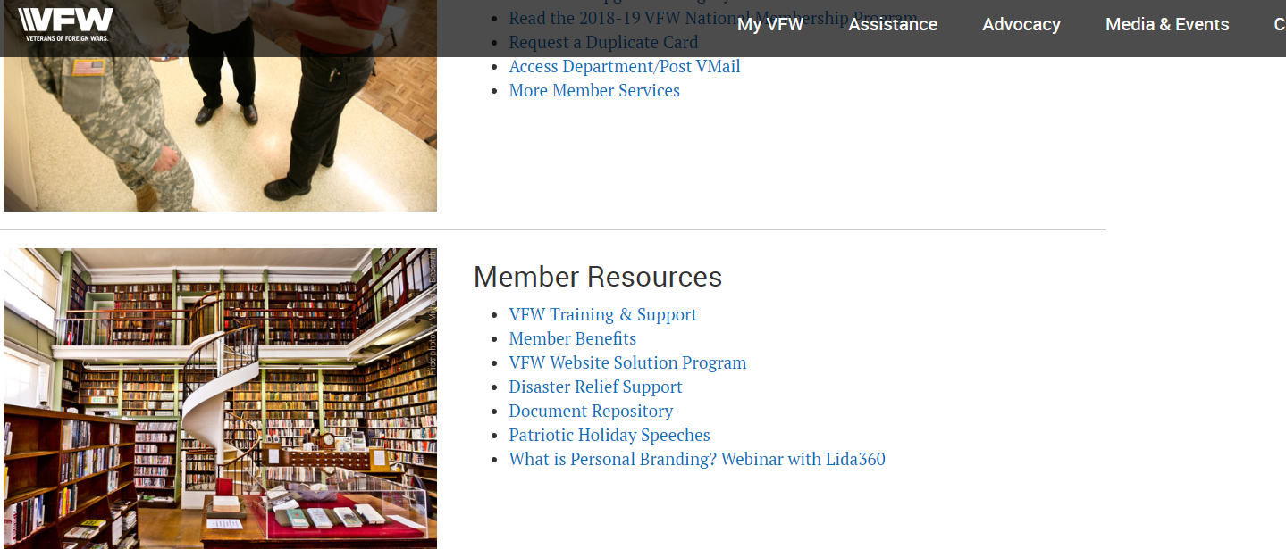
Training Resources

Slide 38
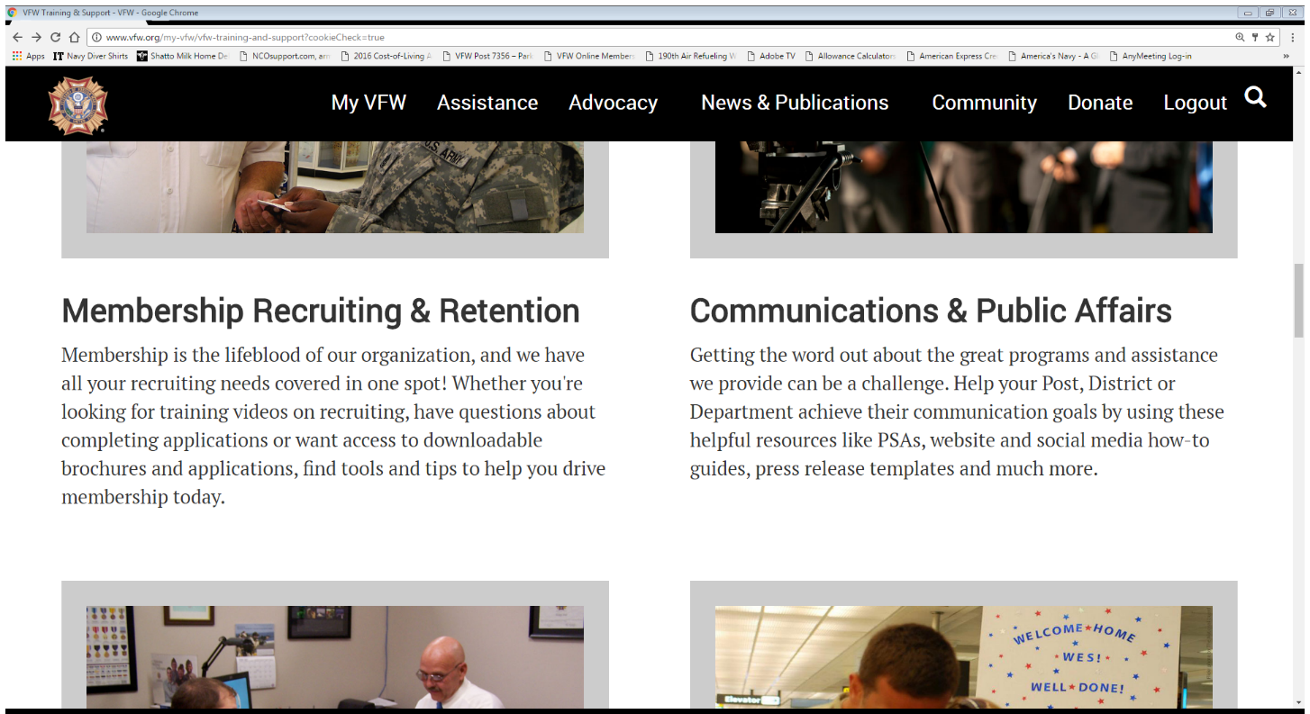
Training Resources

Slide 39
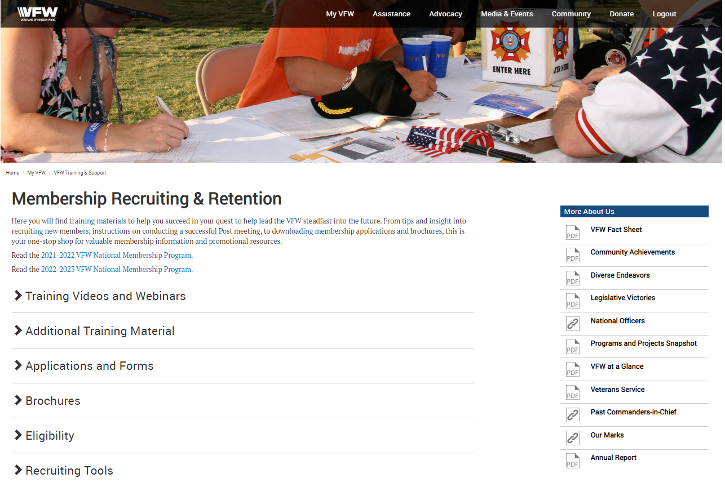

Slide 40
Membership Monday Webinars

Slide 41
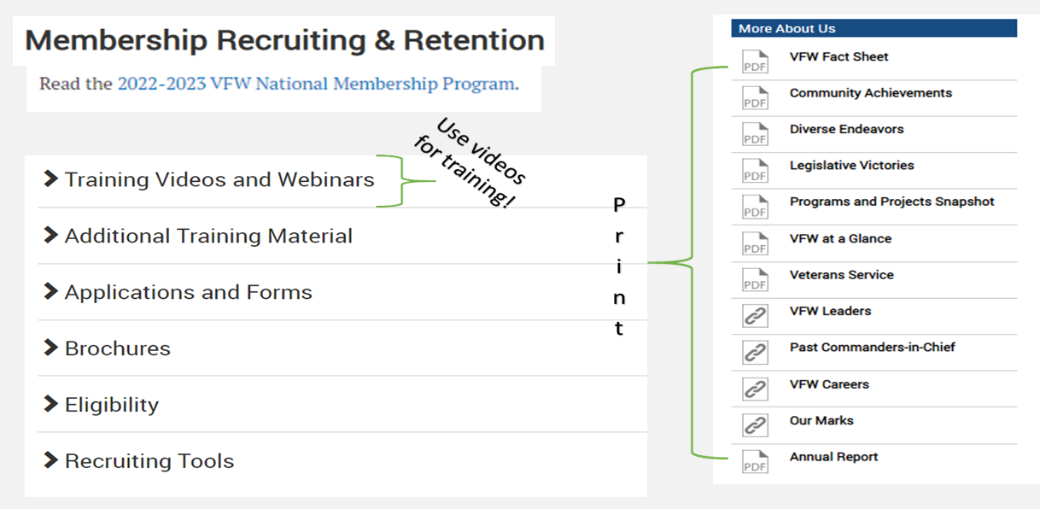

Slide 42
NATIONAL’S ONLINE DOCUMENT
TRAINING & SUPPORT
“More About Us”
VFW Fact Sheet
Community Achievements
Diverse Endeavors
Legislative Victories
Programs and Projects Snapshot
VFW at a Glance
Veterans Service
“Promotional Material”
VFW Priority Goals VFW Fact Sheet Got Your Back Poster New Post Forming Poster Join Now Poster Take Pride Flyers Women Marines Poster Stand With Us Poster

Slide 43
Contact Information
Membership Director:
Scott Hice - 850 305-0064
shice@vfwfl.org

Slide 44
QUESTIONS?
DEPARTMENT OF FLORIDA VFW
Website - https://www.myfloridavfw.org/
Phone – (352) 622-5126 Fax – (352) 622-3869
VFW NATIONAL HEADQUARTERS
Website - https://www.vfw.org/
National Headquarters – (816)-756-3390

Slide 45
DEPARTMENT OF FLORIDA
LEADERSHIP DEPARTMENT SOI MEMBERSHIP 2024 - 2025

