Slide 1
Leadership Presentation

Slide 2
Which Leader Are You?
Leadership isn’t defined by your title. Taking time to reflect on the kind of leader you are isn’t just self-awareness—it’s a strategic advantage. It exposes gaps, reinforces strengths, and clarifies the impact you have on your team and organization.
Are you leading with purpose, or just reacting to problems?
Are you developing others, or simply directing them?
Are you accountable to the standard, or comfortable with the status quo?
The most effective leaders don’t assume—they assess, adjust, and evolve.
Call to Action:
Take an honest look at which leader you are and identify where you stand today, decide who you need to become tomorrow, and commit to leading with intention.

Slide 3
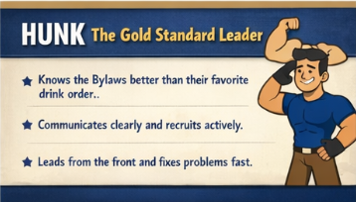
The Hunk

Slide 4
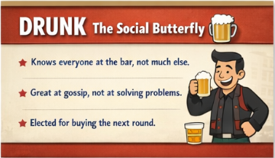
The Drunk

Slide 5
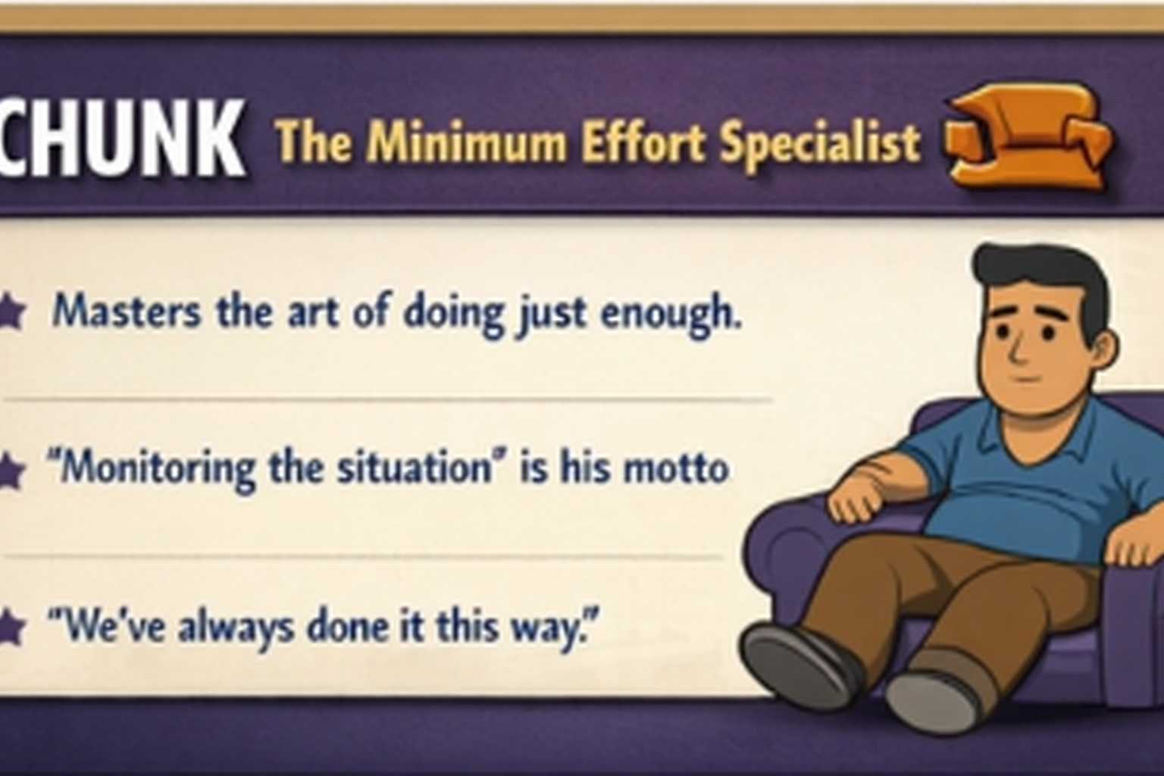
The Chunk

Slide 6
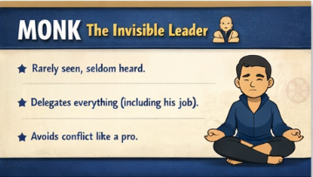
The Monk

Slide 7
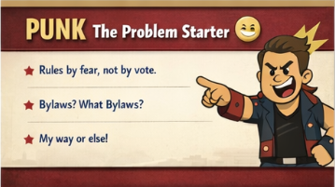
The Punk

Slide 8
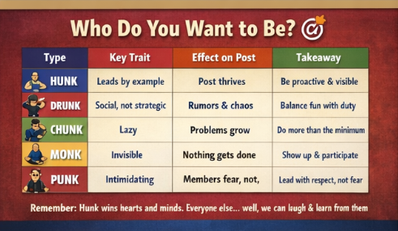
Who Do You Want to Be?

Slide 9

Which Leader Are You Going to Be?

Slide 10

Mirror Moment
This Photo by Unknown Author is licensed under CC BY-SA

Slide 11
Leadership Framework
Reality of VFW Leadership
The 3 Pillars of Effective Leadership
  Respect Earns Influence
  Visibility Builds Trust
  Consistency Creates Credibility
  The Leadership Traps
    Trap 1: Title ≠ Leadership
    Trap 2: Trying to Please Everyone
    Trap 3: Ignoring the Quiet Ones

Slide 12
True Story
We’ve talked about leadership—what it looks like… what it requires.
But I want to leave you with something more important than anything I’ve said so far…
a story that captures what humility and leadership really is.

Slide 13
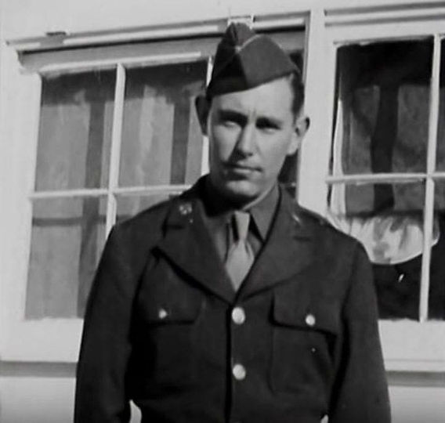
William Crawford

Slide 14
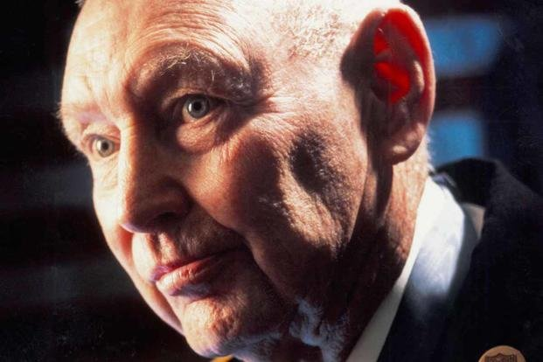
William J Crawford - MOH
When the cadets finally learned the truth, everything changed.
Not because he changed—
but because they did.

Slide 15
Be careful with labels.
We’re quick to say, “just a Post member”… “just a volunteer”… “just someone in the background.”
Don’t make that mistake.

Slide 16
Everyone deserves respect.
Not because of position… but because they are part of your team.

Slide 17
Take time to know your people.
A hero walked among them for years… and they never knew it.
Who is walking among you right now?

Slide 18
Leaders should be humble.
This role isn’t about recognition.
It’s about service.

Slide 19
Don’t chase glory—chase excellence.
Do the job the right way… and let the results speak for themselves.

Slide 20
No job is beneath a leader.
If a Medal of Honor recipient can clean floors and toilets with pride… there is nothing in your Department that should be beneath you.

Slide 21
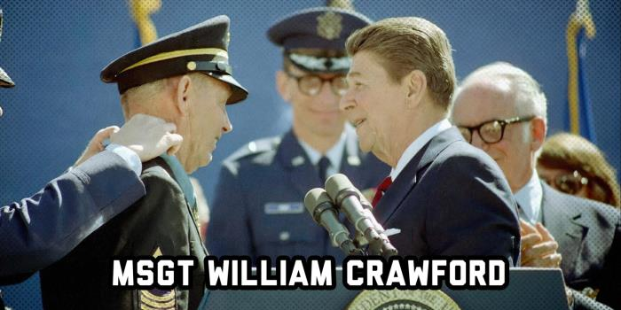
Receiving The MOH

Slide 22
QUESTIONS?

