Slide 1
STATE INSPECTOR
Don Bult
inspector@vfwfl.org
(904) 529-8869

Slide 2
AUDITS
ARE DUE END OF MONTH
JUL, OCT, JAN, APR

Slide 3
IF LATE
POST CAN NOT
MAKE
ALL STATE!!!!!!

Slide 4
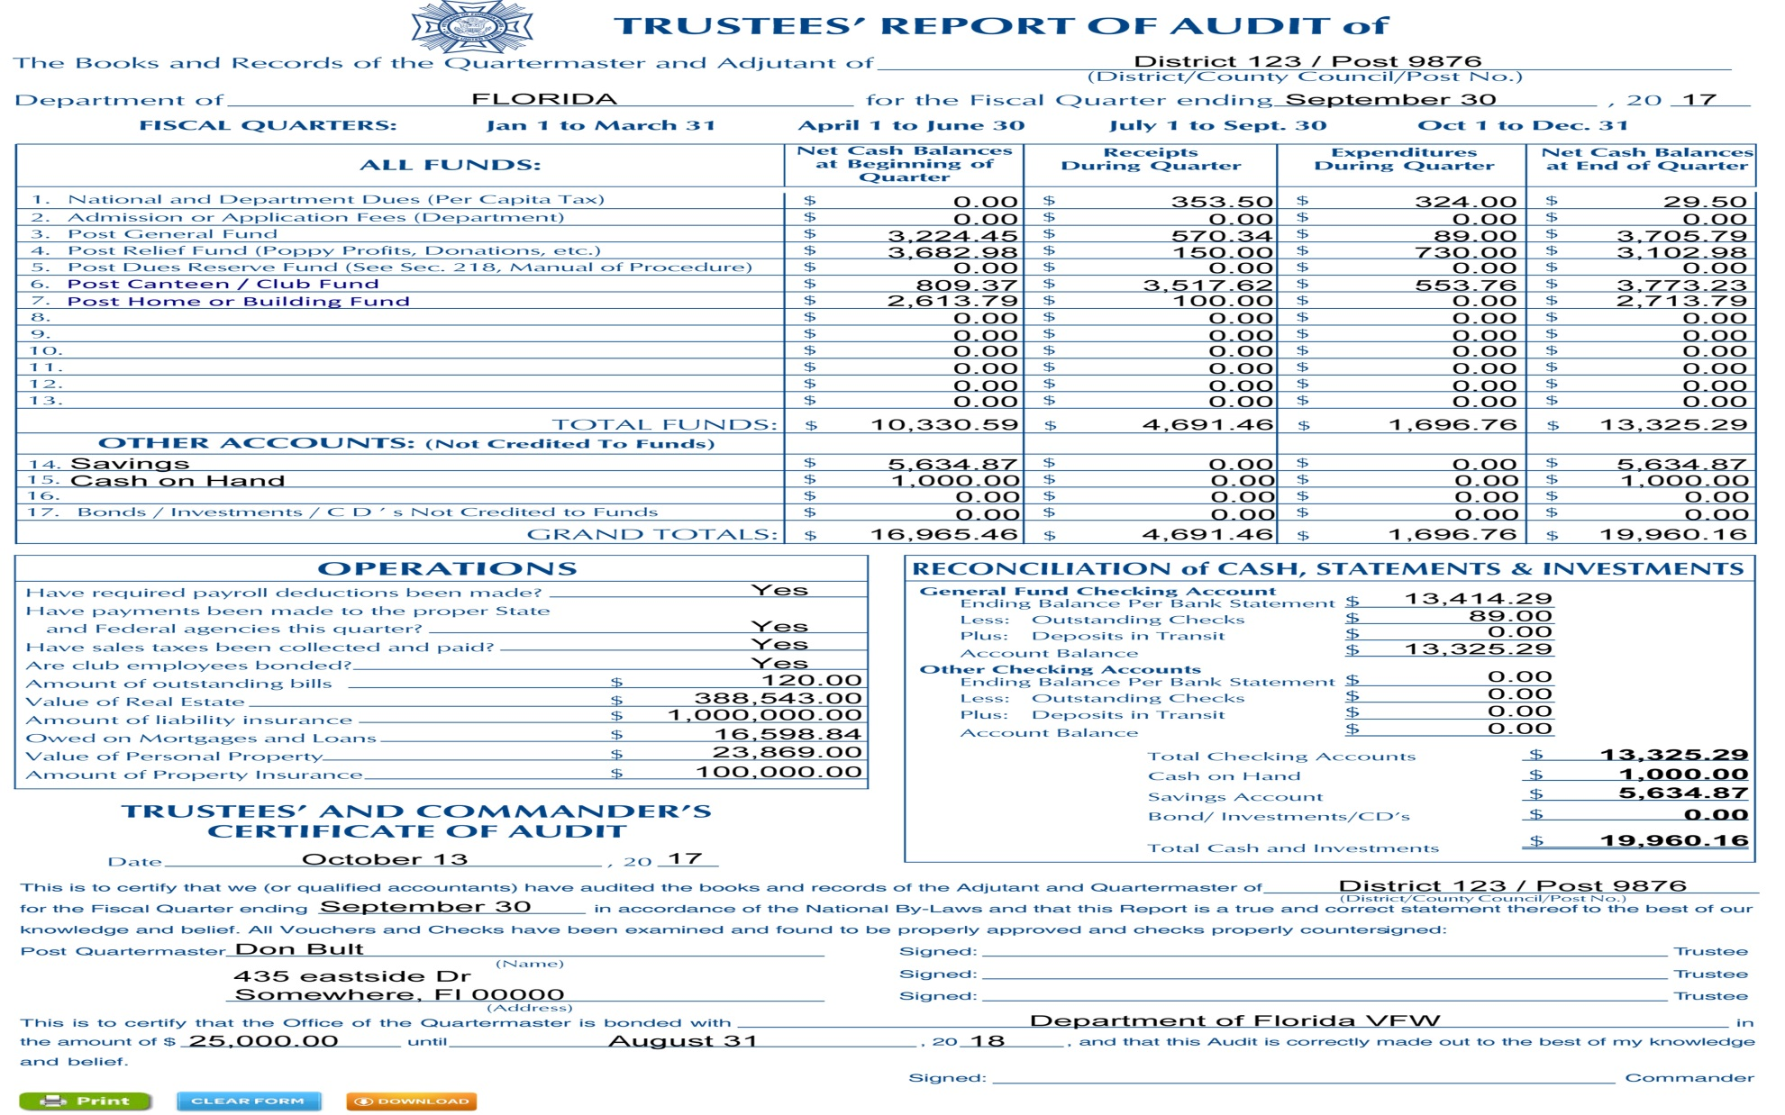

Slide 5
Inspections
To be done between
December 1 2024 and February 28 2025

Slide 6
All Discrepancies
need to be
corrected by
March 30 2025

Slide 7
The District Inspector will schedule when inspections are done
Be prepared

Slide 8
990’s, Insurance, Audits, Bonds, Inspections
Must provide a copy to Department as follows
990’s, Bonds,
All State Forms, Donations
statecg@vfwfl.org
Audits, Inspections, Insurance
cgates@vfwfl.org

Slide 9
CANTEEN RULES
Canteen is governed by the State Rules
Applies to both
VFW and VFWA members
The post membership sets the
Conduct standards

Slide 10
House Committee runs the canteen
And makes recommendations to post membership for all changes/purchases that are not routine operation items
i.e new cooler, bar stool, tables

Slide 11
Florida does NOT have
Associate Members

