Slide 1
Florida Dashboard Training

Slide 2
The Florida Department Dashboard
Visual Tool using color
Helps the Department track all the important things a post/district is doing
Post Commander/District Commander can track what still needs to be done
Can help foster competition between posts/districts

Slide 3

Go to www.vfwfl.org
Click on Login then Members Only

Slide 4
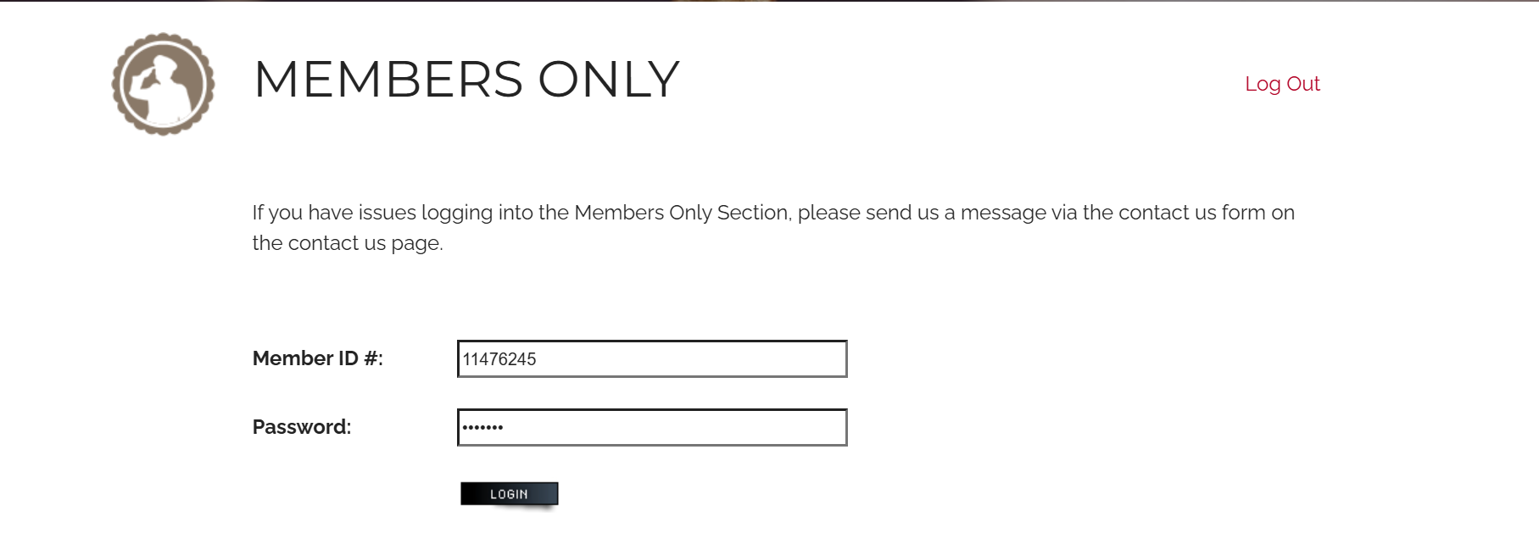
Enter your VFW Member ID #
The Password is your last name
Then Click Login

Slide 5
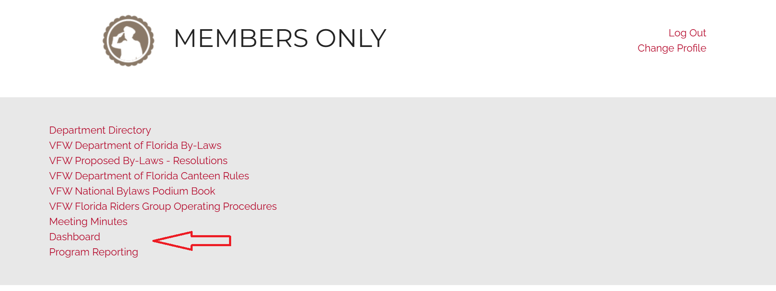
Once you have logged in,
Click on Dashboard

Slide 6
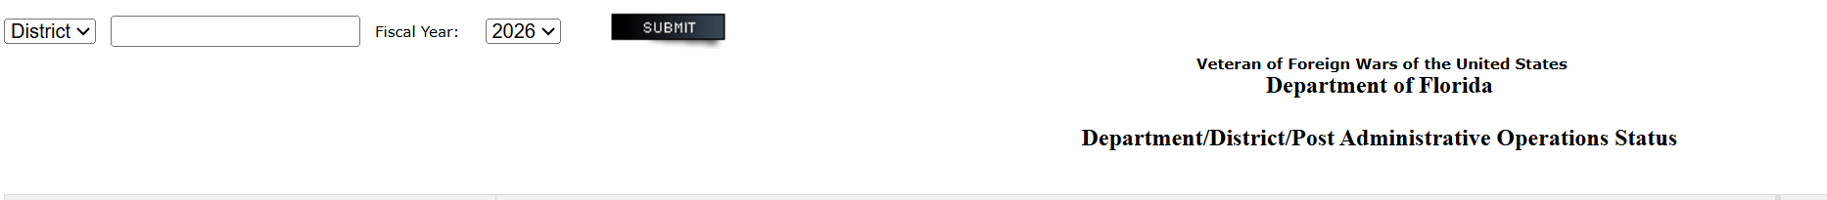
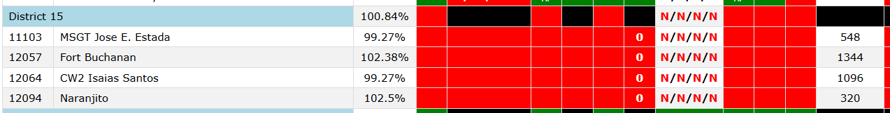
In the upper left of the Dashboard, you can sort by district and post.

Slide 7
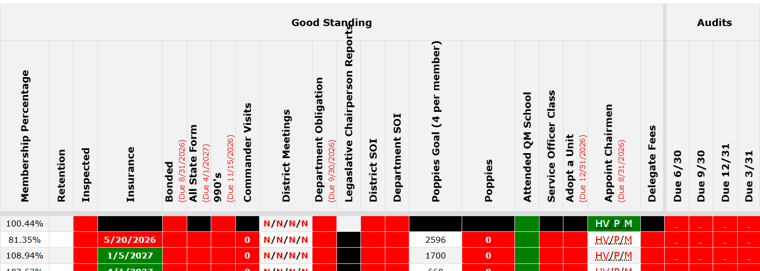

Slide 8
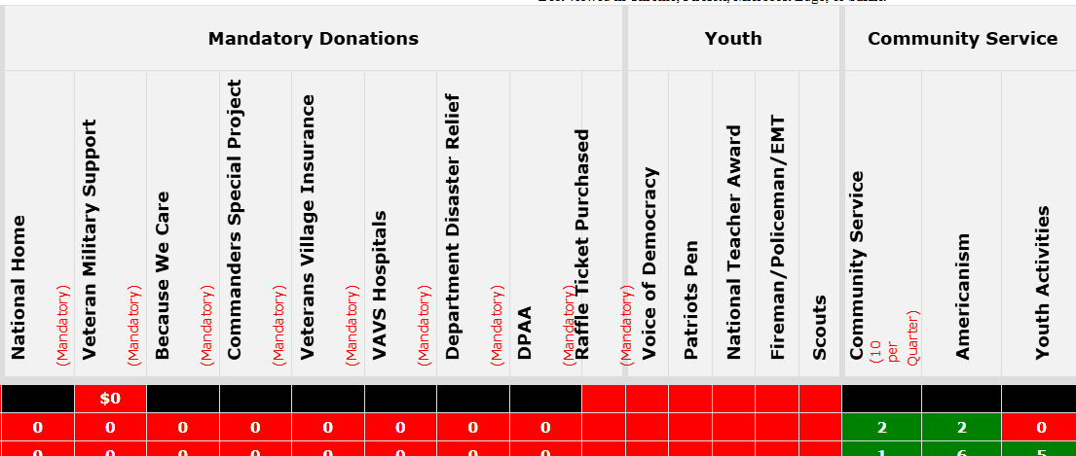

Slide 9
Remember
The Dashboard is a tool
As an officer of the Post/District, it is your tool. Use It!!
Make sure you visit it often.

