Slide 1
Quarterly Audit

Slide 2
Why the Audit Matters (The "So What?")
The Legal Shield: Protects the Post from fraud, theft, and mismanagement.
National Requirement: Per Section 218 of the Manual of Procedure, audits must be submitted quarterly.
Bonding Protection: If a Post is not audited correctly and money goes missing, the Bonding Company may refuse to pay the claim.
"All-State" Requirement: You cannot achieve All-State or All-American status without four consecutive, on-time audits.

Slide 3
Who Performs the Audit?
The Trustees: The three elected Trustees are the only ones responsible for the audit.
The Commander’s Role: The Commander must ensure the audit happens, but they do not perform it.
The Quartermaster’s Role: The Quartermaster must provide all books and records but cannot participate in the actual auditing process (to avoid a conflict of interest).
The Adjutant’s Role: The Adjutant should provide the minutes to verify that expenditures were actually approved by the Post.

Slide 4
How to Prepare (The "Quartermaster’s Homework")
The Quartermaster should have these items organized in a binder before the Trustees arrive:
Bank Statements: All pages for every account (Checking, Savings, Post Relief, Canteen).
Canceled Checks/Digital Images: To verify who the money went to.
Receipts & Invoices: Every dime spent must have a paper trail.
Meeting Minutes: To prove the membership voted to spend the money.
The Previous Audit: To ensure the "Ending Balance" of the last audit matches the "Beginning Balance" of this one.

Slide 5
The Step-by-Step Process
Verify the "Beginning Balance": Does it match the last audit exactly?
Total the Income: Add up all dues, donations, hall rentals, and fundraisers.
Total the Expenses: Subtract all checks written and electronic debits.
The "Checkbook vs. Bank" Test: Does the Quartermaster’s ledger match the Bank Statement exactly (after accounting for outstanding checks)?
Inspect the "Relief Fund": Ensure that money in the Relief Fund was only spent on veterans in need, not Post utility bills (this is a common failure point).

Slide 6
How to Pass (The "Trustee’s Checklist")
The "Penny" Rule: If the books are off by even $0.01, the audit is not finished. Find the error.
Actual Cash on Hand: Physically count any "Petty Cash" or "Canteen Till" money.
Signatures: All three Trustees and the Commander must sign the report.
The Vote: The audit must be read at the next Post meeting and approved by a vote of the membership.
Submission: The Quartermaster must mail or upload the audit to the Department (State) Quartermaster by the deadline (usually the end of the month following the quarter).

Slide 7
Common Red Flags to Watch For
Missing Receipts: "I lost the receipt, but I remember buying the paint" is not acceptable.
Checks Made to "Cash": This is a major violation of VFW policy.
Borrowing from Relief: Using the Relief Fund to pay the electric bill is a "misappropriation of funds."
One-Person Show: If only one Trustee shows up to do the audit, it is invalid. You need a quorum of Trustees.

Slide 8
Important Dates:
1st Qtr: Due Oct 31 (covers July–Sept)
2nd Qtr: Due Jan 31 (covers Oct–Dec)
3rd Qtr: Due April 30 (covers Jan–March)
4th Qtr: Due July 31 (covers April–June)

Slide 9
Pro-Tip:
"An audit is not an accusation." It is a tool to prove that the Quartermaster is doing a great job and that the Post's money is safe. A clean audit is the best sleep aid a Commander can have.

Slide 10
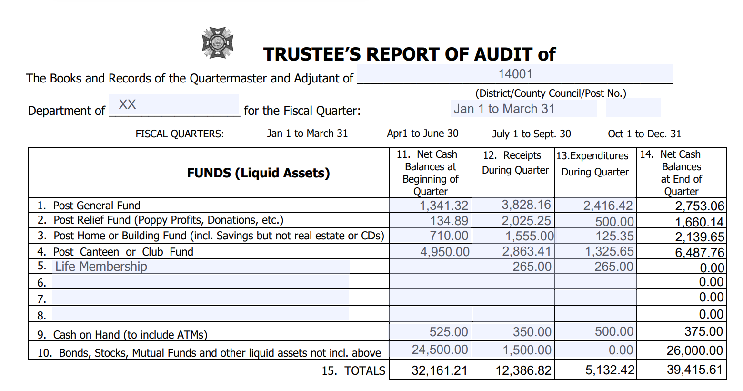

Slide 11
Lines #1-8 FUNDS (Liquid Assets) Listed are those funds most likely to be carried by a VFW Post and District. Any special funds may be added in the blank spaces. A “fund” is an account which normally has both income and expenditures. In most cases, just about all of your miscellaneous expenditures (community service, youth activities, expenses, etc.) are chargeable to your general fund and most miscellaneous income (proceeds from fundraising activities, dues, etc.) are credited to your general fund. Item

Slide 12
Line #9 CASH ON HAND (TO INCLUDE ATMS): Some posts own/operate ATMs, jukeboxes, gaming machines or other cash machines that that are not included in Item #4 above that require cash on hand to operate daily.
Line #10 BONDS, STOCKS, MUTUAL FUNDS AND OTHER LIQUID ASSETS NOT INCLUDED ABOVE This includes any financial instruments not previously included in any funds listed in Item #1-8 that can be liquidated without penalty by the financial institution. A loss in value of the account or processing fee charged by the financial institution to process the transaction does not equate to a penalty.

Slide 13
Column #11 NET CASH BALANCES AT BEGINNING OF QUARTER The figures in this column are obtained from different funds as listed in your ledger. The individual items in this column as well as the total at the bottom of the column should be the same as the ending balances of the previous quarterly audit.
Column #12 RECEIPTS DURING QUARTER The figures in this column are obtained by adding the amount shown in your ledger for the three months. This should include items transferred into a fund from another fund during the quarter.

Slide 14
Column #13 EXPENDITURES DURING QUARTER The figures in this column are obtained by adding the expenditures for the three months. Include items transferred out of another fund during the quarter.
Column #14 NET CASH BALANCE AT END OF QUARTER The figures in this column are obtained by adding items 11 & 12 and subtracting items 13.
Line #15 TOTALS The figures in this line are obtained by adding the totals of items 11& 12 and subtracting item 13 – you should arrive at the same by adding item 14.

Slide 16
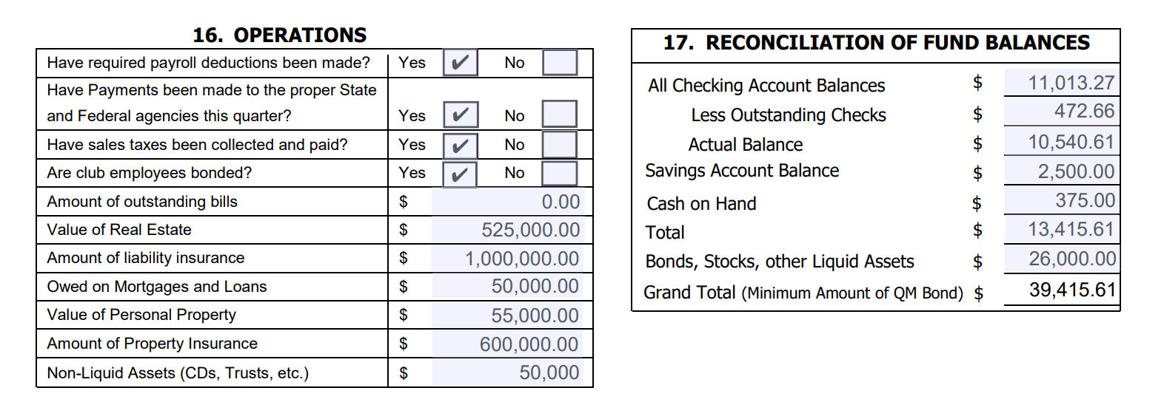

Slide 17
Section #16 OPERATIONS Answer questions as applicable. Non-liquid assets are types of assets that cannot be easily converted into cash within a short period without harsh penalties for early withdrawals. Trusts are a typical example. However, Certificate of Deposits less than $65,000 in value are typically non-liquid assets. Certificate of Deposits greater than $65,000 can be liquid assets. It is best to check with your banking institution on the type of CD and retain the information with the Post Financial Documents.

Slide 18
#17 RECONCILIATION OF FUND BALANCES:
All Checking Account Balances
Enter ending balance shown on bank statement. If more than one checking account, total ending balances for all accounts.
Less Outstanding Checks
Total checks written on or before the date of the last bank statement of the quarter that do not appear on the statement. If more than one checking account, total all outstanding checks.

Slide 19
#17 RECONCILIATION OF FUND BALANCES: (Cont.)
Account Balance
Subtract " Less Outstanding Checks" from "All Checking Account Balances. Add any deposits in transit that do not appear on bank statements. This should agree with the balance in your checkbook/ledger.
Savings Account Balance
Enter balances of any savings accounts.

Slide 20
#17 RECONCILIATION OF FUND BALANCES: (Cont.)
Cash on Hand
Amount of money on hand that has not been included in “Outstanding Deposits” above.
Total
Add "Account Balance" line, "Savings Account Balance", and"Cash on Hand" Line.
Bonds, Stocks and Other Liquid Assets
Enter current value of all bonds, stocks, and other liquid assets.

Slide 21
#17 RECONCILIATION OF FUND BALANCES: (Cont.)
Grand Total (Minimum Amount of QM Bond)
Add "Total Cash" line to "Bonds & Other Liquid Assets" line. Total in Item #15 Net Cash Balance at end of Quarter should equal Grand Total in Item #17. This is the minimum amount of QM Bond. Verify in #18, QM bond equal to or above this amount.

Slide 23
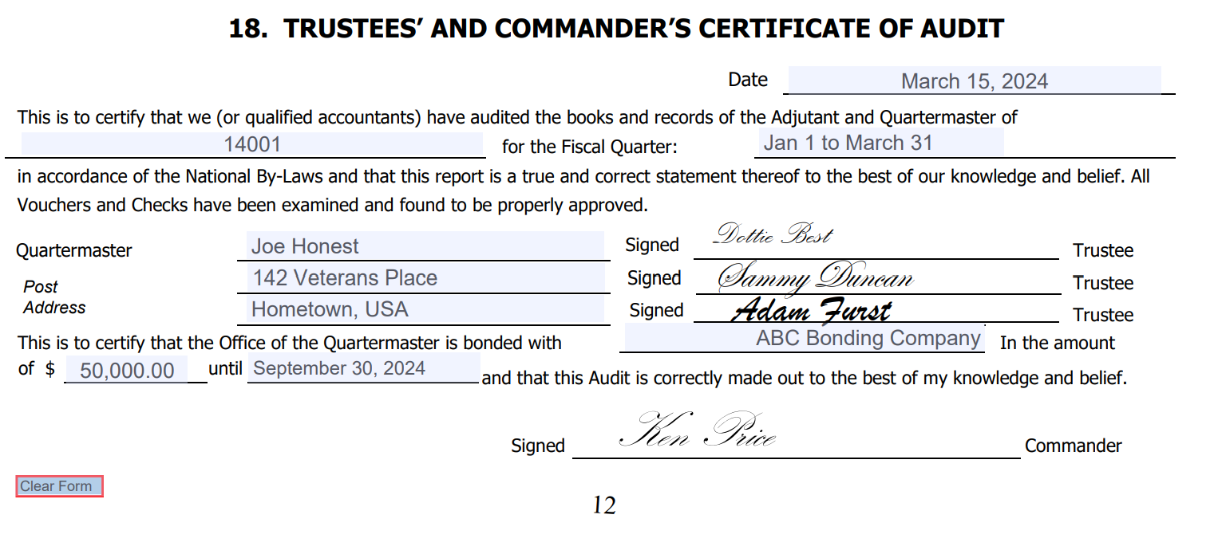

Slide 24
#18 TRUSTEES’ AND COMMANDER’S CERTIFICATE OF AUDIT:
Enter the date the audit is prepared, the Post name and number and the quarter for which the audit is prepared. The Post Commander and Trustees must sign the audit prior to submittal to the Department.
Enter the name of the Post Quartermaster, the name of the bonding company, the amount of the bond (verify in #17 Total that amount equal to or exceeds Total and the expiration date of the bond.
Remember, it is the duty of the Post Trustees to conduct the quarterly audits. It is the duty of the Commander to see that audits are made.

Slide 25
#18 TRUSTEES’ AND COMMANDER’S CERTIFICATE OF AUDIT: (Cont.)
The completed form, with the signature of the Post Trustees to attest to its accuracy, together with the signature of the Post Commander, should be forwarded to the Department Quartermaster. The Post Trustees should also sign the General Ledger at the ending point of the current audit period.

