Slide 1
All-State Requirements

Slide 2
All-State Requirements
Achieving All-State status in the VFW Department of Florida for the 2026–2027 program year is a comprehensive "health check" for a District. It requires meeting specific benchmarks in membership, financial compliance, and community programs.
The following breakdown is based on the Department of Florida's 2026–2027 requirements under State Commander Randy Cash

Slide 3
1. Membership Benchmarks
Membership is the primary driver. To be eligible for All-State, a District must achieve:
101% in Total Membership, 85% Retention and 1 Legacy Life (new/upgrade) for each post in the District: This goal must be reached by APRIL 30, 2027. FOR 1ST ROUND JUNE 30TH FOR SECOND ROUND MEMBERSHIP ONLY
  Note: To receive your All-State cap at the State Convention, you must hit this number by April 18, 2027.
Recruiting Events: Should attend at least two (2) recruiting drives by posts in the district and submit report to Department.

Slide 4
2. Financial & Administrative Compliance
A District cannot be "All-State" if its house isn't in order.
Quartermaster Bonding: All accountable officers must be bonded by August 31, 2026.
Quarterly Audits: All four quarterly Trustee Audits must be submitted to Department HQ and received by April 18, 2027.
District Inspection: Must have a "clean" inspection report on file with no uncorrected deficiencies.
No Arrearages: The District must not owe any money to Department, or National (this includes delegate dues).
Election Report: The 2027–2028 Post Election Report must be submitted by June 1, 2027.

Slide 5
Bonding Requirements Overview
Bonding Periods:
Officer Positions: September 1 – August 31 (annually)
Position Positions: October 1 – September 30 (annually)
Bonding Costs:
Officer Bonding: $5 per $1,000 Example $40,000 bond is $200 per officer bonded
Position Bonding: $8 per $1,000 Example $20,000 bond for Canteen Manager is $160
Procedures:
Bonding forms are available on the Department website (see Reports and Forms section).
The entire form must be completed and signed by the individual named on the form.
When increasing the bond amount, you must fill out the original bond form again along with the bond increase form and submit both of them.
  Example: If increasing from $100,000 to $150,000, pay only for the $50,000 increase.

Slide 6
2. Financial & Administrative Compliance (Cont.)
A District cannot be "All-State" if its house isn't in order.
990s must be turned in by 11/15/2026
All post insurance Liquor Liability/Liability/Workers Comp must be up to date and on file with Department.
Department Raffle tickets purchased by the District and posts in the District.

Slide 7
3. Mandatory Program Participation
Districts and posts must demonstrate they are active in the VFW's core missions:
Voice of Democracy (VOD): Submit at least one entry to the District for judging.
Patriot’s Pen: Submit at least one entry to the District for judging.
Public Servant Awards: Submit at least one entry (Police, Fire, EMT, or 911 Dispatcher) to the Department Chairman.
VFW Member of the Year: Submit one nomination to the Department.
Note: Posts and Districts will be required to use the Scholars app for all VoD/PP submissions.

Slide 8
4. Community Service & Reporting
All activity must be documented on the Department Online Reporting System at vfwfl.org.
Quarterly Reporting: Community service reports (10) must be submitted for each post in the District every quarter:
  July–Sept | Oct–Dec | Jan–March | April–June
Department Attendance: 100% attendance at all Department meetings (in person/virtual) by at least one District representative.(CMDR/SVC/JVC)
Legislative Reporting: 1 Per Quarter per District

Slide 9
5. Donations
The District must make sure 75% of all posts in the District make the following minimum financial contributions:
Department Funds: Minimum $100-$300 depending on the size of the post to (Commander’s Project, Unmet Needs, or Disaster Relief, VAVS, Village Donation, Because We Care).
National VMS, DPAA and National Home: Minimum $150 and $75 donation(including District must donate $300) to Veterans & Military Support Services.
  National Home minimum $100-$300 depending on the size of the Post.

Slide 10
Post Visitations
District Commanders shall ensure at least 3 visits to each post in the District.
1 Must be a meeting
1 Should be a social visit
Last one is visit by a Line Officer who is not the District Commander (Sr Vice, Jr Vice, Chief of Staff)

Slide 11
Others
District attendance to QM School, Department SOI and District SOI must have been satisfactory attended by all the posts in the district.
District attendance to the District meetings by the posts in a satisfactory manner.
Chairman Form turned in by the District and ALL posts in the District.

Slide 12
Key Deadlines Summary
Requirement | Deadline
QM Bonding | August 31, 2026
VOD/Patriot’s Pen Entries | December 15th, 2026 (to Dept) VIA SA
District Inspections | February 15, 2027
All-State Entry Form | April 1, 2027
All Audits Received | April 30, 2027
101% Membership (for Convention recognition) | April 30, 2027
Final Membership Deadline | June 30, 2027

Slide 13
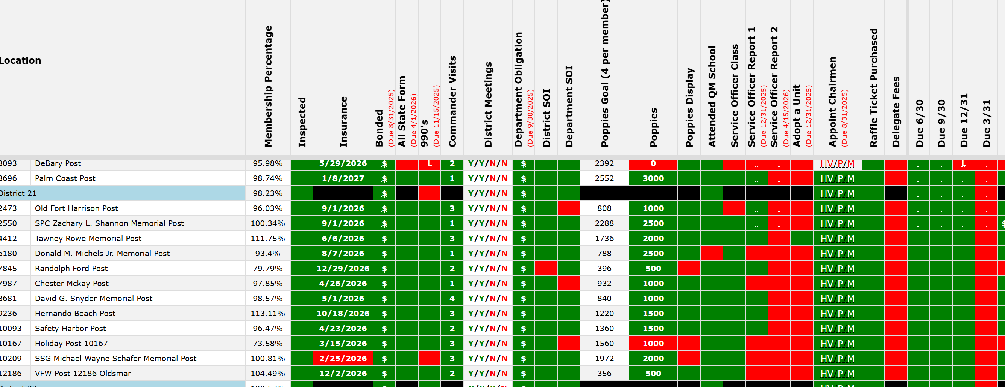

Slide 14
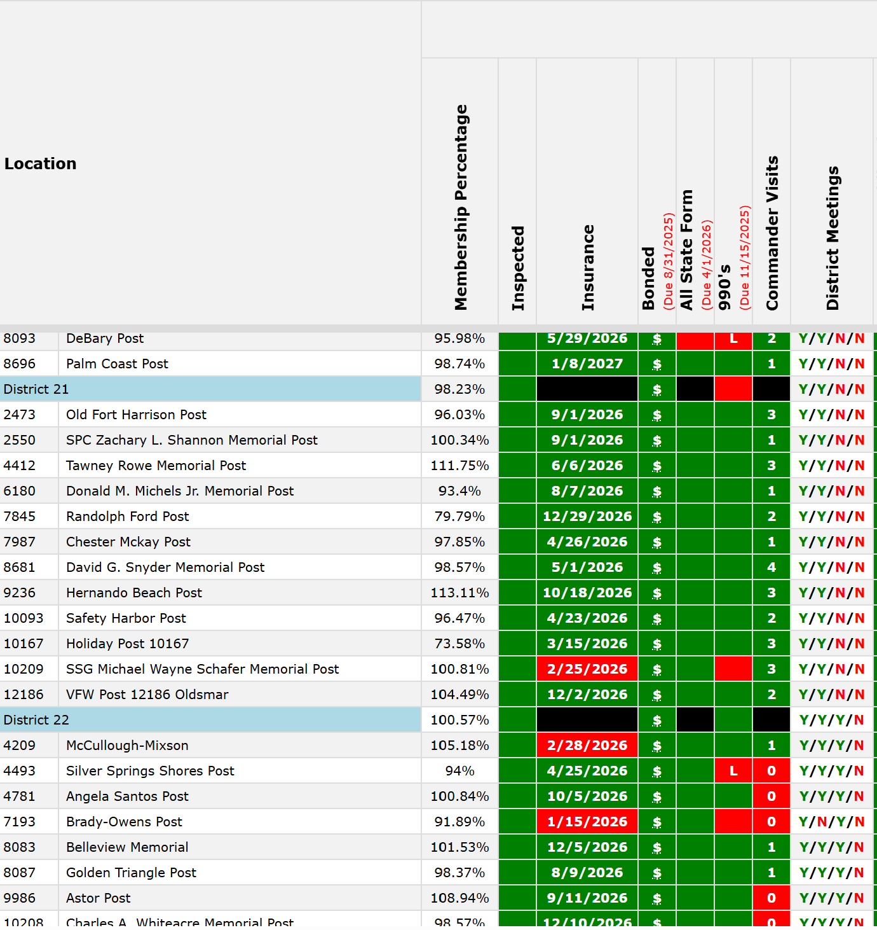

Slide 15
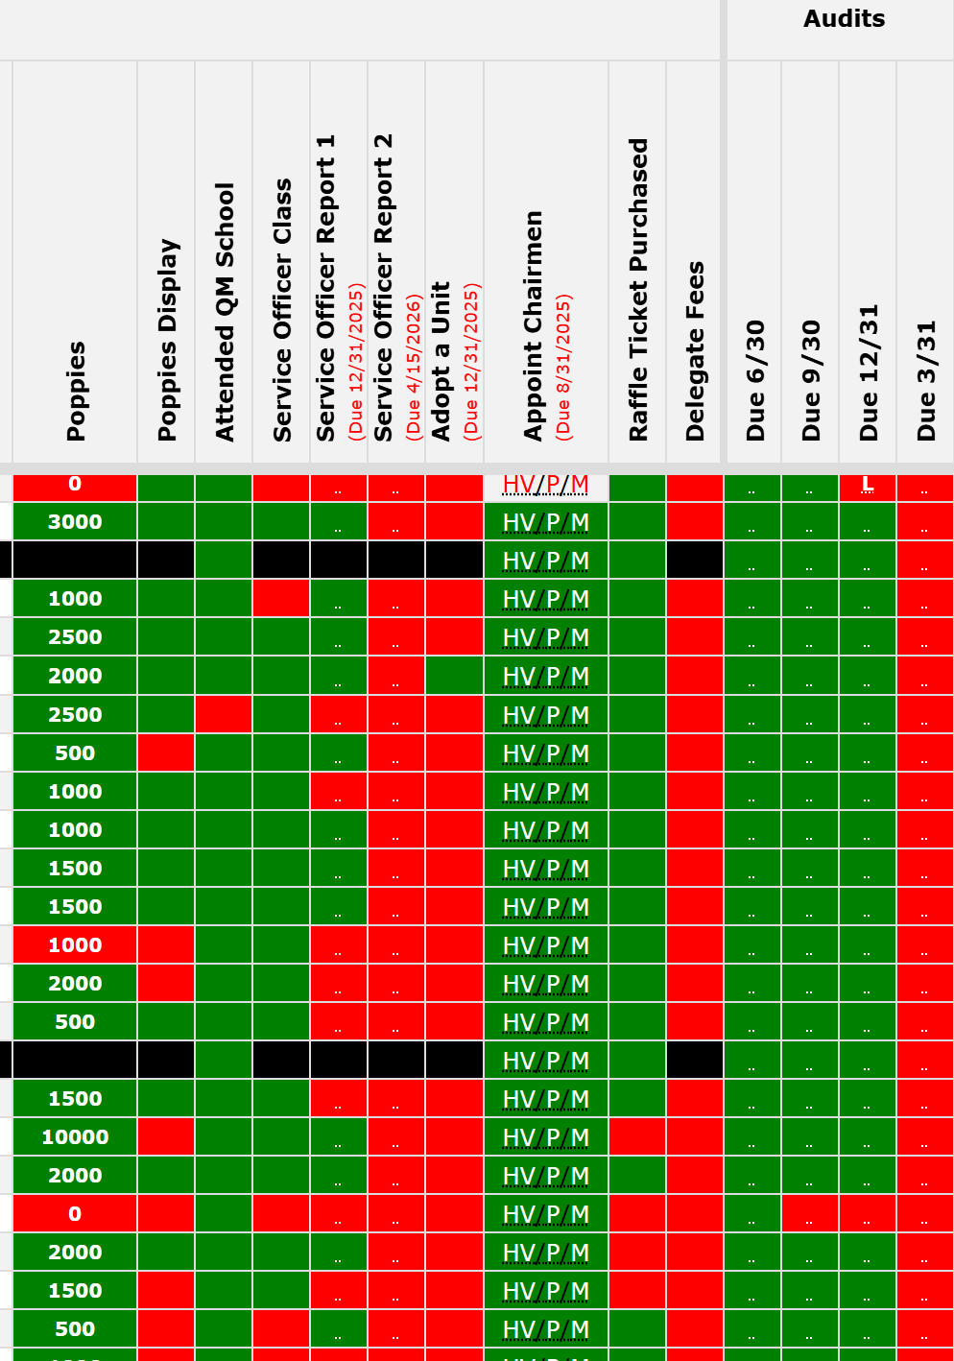

Slide 16
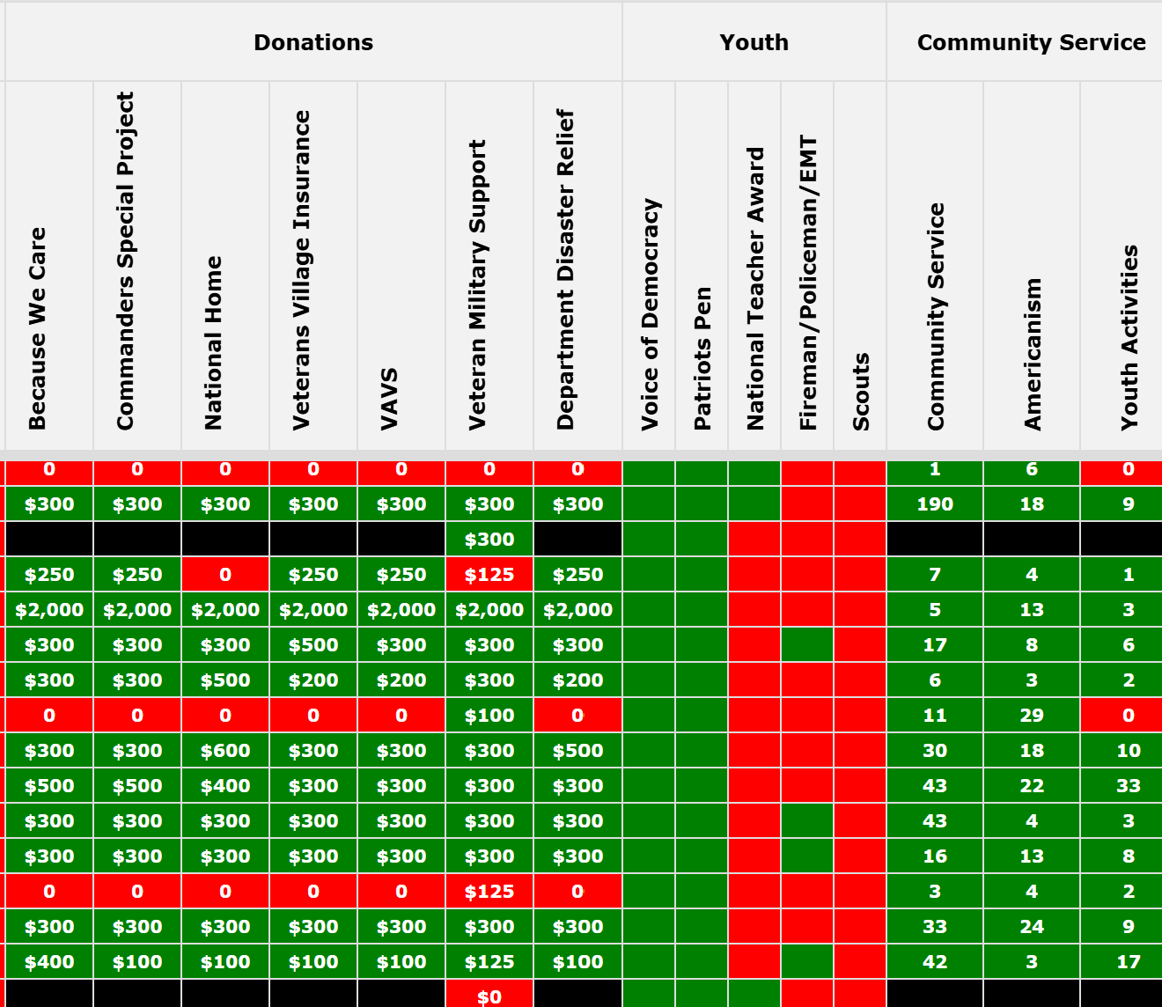

Slide 17
All-American Requirements

Slide 18
All-American Requirements
Achieving All-American status in the VFW for the 2026–2027 program year is a comprehensive "health check" for a District. It requires meeting specific benchmarks in membership, community service, and community programs.
The following breakdown is based on the National 2026–2027 requirements under Commander-in-Chief Cory Geisler

Slide 19
1. Membership Benchmarks
Membership is the primary driver. To be eligible for All-American, a District must achieve:
100%+1 in Total Membership, 80% Retention: This goal must be reached by June 30, 2027.
Recruiting Events: Should attend at least two (2) recruiting drives by posts in the district and submit report to Department.
To receive your All-American cap at National, you must be in the top 10 in the nation in your division.

Slide 20
Donations
The District must make the following minimum financial contributions:
National VMS and National Home: Minimum $300 donation to Veterans & Military Support Services.
DPAA Support: The District is required to make a minimum restricted donation of $100 to National in support of the Defense Personnel POW/MIA Accounting Agency.

Slide 21
Mandatory Program Participation
Posts must demonstrate they are active in the VFW's core missions and submissions must be completed by January 31st 2027:
Voice of Democracy (VOD): Submit at least one entry to the Department for judging.
Patriot’s Pen: Submit at least one entry to the Department for judging.
National Citizenship Education Teachers Award: must advance a teacher to Department for judging.

Slide 22
All-American District Awards
All Districts that meet the listed criteria will receive an All-American District Streamer, an All-American District Commander’s Citation, and recognition in the VFW Magazine.
In addition, the top 10 Districts in each membership division will receive:
- All-American District Commander’s Cap
- All-American District Commander’s Badge
- All-American District Commander’s lapel pin
These awards for the top 10 District Commanders will be presented on stage at the 128h National Convention. The top two District Commanders in each division will receive a $1,000 award to recognize their leadership. Commanders must attend the 128th National Convention in order to receive this award

