Slide 1
All-State Requirements

Slide 2
All-State Requirements
Achieving All-State status in the VFW Department of Florida for the 2026–2027 program year is a comprehensive "health check" for a Post. It requires meeting specific benchmarks in membership, financial compliance, and community programs.
The following breakdown is based on the Department of Florida's 2026–2027 requirements under State Commander Randy Cash

Slide 3
1. Membership Benchmarks
Membership is the primary driver. To be eligible for All-State, a Post must achieve:
102%-8%(depending on Division) in Total Membership, 80% Retention and 1 Legacy Life (new/upgrade): This goal must be reached by June 30, 2027.
  Note: To receive your All-State cap at the State Convention, you must hit this number by April 18, 2027.
Recruiting Events: Conduct at least two (2) recruiting drives and post them to the National Dashboard (or Department reporting system).

Slide 4
Department Commander’s Expectations
Division | Division Size (2026-2027) | Proposed All-State Quota
Division 1 | 501 – UP | 102%
Division 2 | 351 – 500 | 102%
Division 3 | 246 – 350 | 102%
Division 4 | 190 – 245 | 103%
Division 5 | 150 – 189 | 104%
Division 6 | 125 – 149 | 105%
Division 7 | 105 – 124 | 106%
Division 8 | 90 – 104 | 107%
Division 9 | 70 – 89 | 107.5%
Division 10 | 10-69 | 108%
Plus 1 New Legacy Life member or Legacy Life Upgrade
And 80% Retention

Slide 5
2. Financial & Administrative Compliance
A Post cannot be "All-State" if its house isn't in order.
Quartermaster Bonding: All accountable officers must be bonded by August 31, 2026.
Quarterly Audits: All four quarterly Trustee Audits must be submitted to Department HQ and received by April 18, 2027.
Post Inspection: Must have a "clean" inspection report on file with no uncorrected deficiencies.
No Arrearages: The Post must not owe any money to District, Department, or National (this includes delegate dues).
Election Report: The 2027–2028 Post Election Report must be submitted by June 1, 2027.

Slide 6
Bonding Requirements Overview
Bonding Periods:
Officer Positions: September 1 – August 31 (annually)
Position Positions: October 1 – September 30 (annually)
Bonding Costs:
Officer Bonding: $5 per $1,000 Example $40,000 bond is $200 per officer bonded
Position Bonding: $8 per $1,000 Example $20,000 bond for Canteen Manager is $160
Procedures:
Bonding forms are available on the Department website (see Reports and Forms section).
The entire form must be completed and signed by the individual named on the form.
When increasing the bond amount, you must fill out the original bond form again along with the bond increase form and submit both of them.
  Example: If increasing from $100,000 to $150,000, pay only for the $50,000 increase.

Slide 7
3. Mandatory Program Participation
Posts must demonstrate they are active in the VFW's core missions:
Voice of Democracy (VOD): Submit at least one entry to the District for judging.
Patriot’s Pen: Submit at least one entry to the District for judging.
Public Servant Awards: Submit at least one entry (Police, Fire, EMT, or 911 Dispatcher) to the Department Chairman.
VFW Member of the Year: Submit one nomination to the District.
Buddy Poppy: Purchase a minimum of 500 poppies and conduct at least two (2) Buddy Poppy drives.

Slide 8
4. Community Service & Reporting
All activity must be documented on the Department Online Reporting System at vfwfl.org.
Quarterly Reporting: 10 Community service reports must be submitted for every quarter:
  July–Sept | Oct–Dec | Jan–March | April–June
VFW Day of Service: Participate in a "Day of Service" event in May and register it through the national portal.
District Attendance: 100% attendance at all District meetings by at least one Post representative.

Slide 9
5. Donations
The Post must make the following minimum financial contributions:
Department Funds: Minimum $75 to at least one (Commander’s Project, State VOD, Unmet Needs, or Disaster Relief).
National VMS: Minimum $50 donation to Veterans & Military Support Services.
  Note: If you are also aiming for All-American, this donation must be at least $125.

Slide 10
Others
Attendance to QM School, Department SOI and District SOI must have been satisfactory attended the posts.
Attendance to the District meetings by the post in a satisfactory manner.
Chairman Form turned in by the posts.

Slide 11
Key Deadlines Summary
Requirement | Deadline
QM Bonding | August 31, 2026
VOD/Patriot’s Pen Entries | October 31, 2026 (to Post)
Post Inspections | February 15, 2027
All-State Entry Form | April 1, 2027
All Audits Received | April 30, 2027
101% Membership (for Convention recognition) | April 30, 2027
Final Membership Deadline | June 30, 2027

Slide 12
Pro Tip: The All-State Entry Form is mandatory if you want to be judged. It is found on the Florida VFW website under "Resources > Reports and Forms."

Slide 13
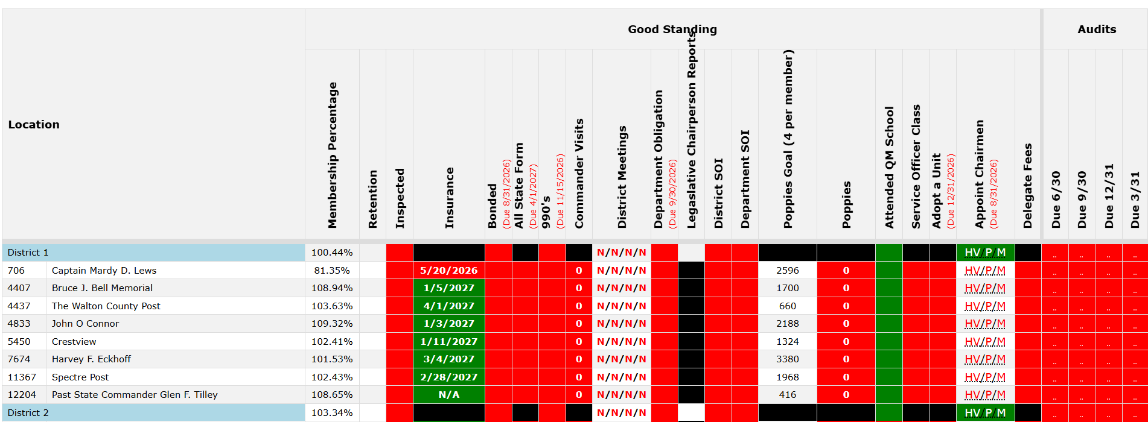

Slide 14
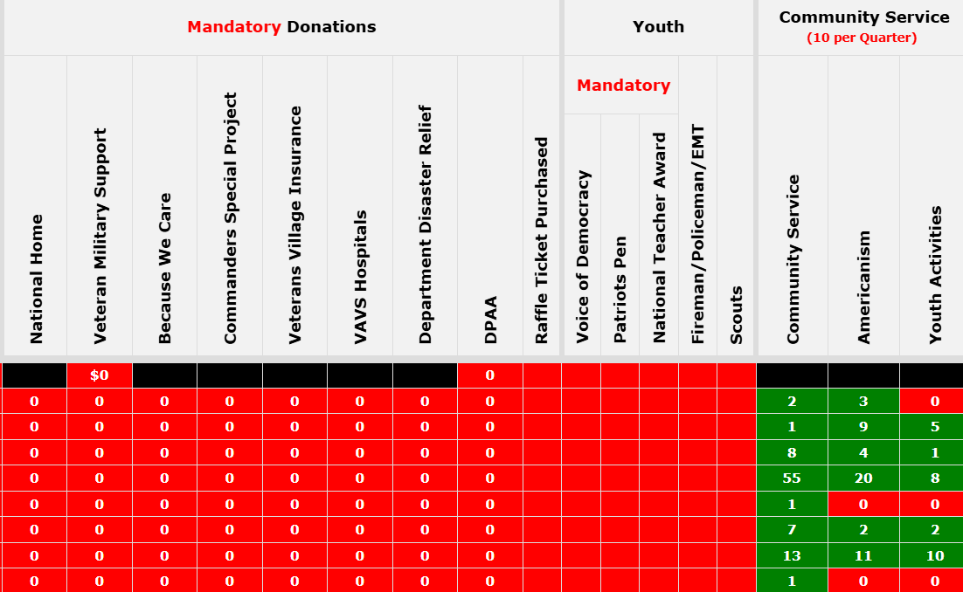

Slide 15
All-American Requirements

Slide 16
All-American Requirements
Achieving All-American status in the VFW for the 2026–2027 program year is a comprehensive "health check" for a Post. It requires meeting specific benchmarks in membership, community service, and community programs.
The following breakdown is based on the National 2026–2027 requirements under Commander-in-Chief Cory Geisler

Slide 17
1. Membership Benchmarks
Membership is the primary driver. To be eligible for All-American, a Post must achieve:
103%-13%(depending on Division) in Total Membership, 80% Retention This goal must be reached by June 30, 2027.
  Note: To receive your All-American cap at the National Convention, you must hit this number by April 30, 2027, and be in the top 20 in your division Nation-wide.
Recruiting Events: Conduct at least two (2) recruiting drives and post them to the National Dashboard (or Department reporting system).

Slide 18
All-American Post Award
All Posts that meet the listed criteria will receive: An All-American Post Streamer, a Post Home Citation, and will be recognized in the VFW Magazine.
In addition, the top 20 Posts in each membership division will be awarded on stage at the National Convention and receive:
- All-American Post Commander’s Citation
- All-American Post Commander’s Cap
- All-American Post Commander’s Badge
- All-American Post Commander’s lapel pin
The Top five Post Commanders in each division will receive a $1,000 award to recognize their leadership. Commanders must attend the 128th National Convention in order to receive this award

Slide 19
National Membership Goals
National Division | Membership Size | National Quota | Retention
Division 1 | 501 – UP | 103% | 80%
Division 2 | 351 – 500 | 104% | 80%
Division 3 | 246 – 350 | 105% | 80%
Division 4 | 190 – 245 | 106% | 80%
Division 5 | 150 – 189 | 107% | 80%
Division 6 | 125 – 149 | 108% | 80%
Division 7 | 105 – 124 | 109% | 80%
Division 8 | 90 – 104 | 110% | 80%
Division 9 | 70 – 89 | 111% | 80%
Division 10 | 50 – 69 | 112% | 80%
Division 11 | 10 – 49 | 113% | 80%

Slide 20
2. Mandatory Program Participation
Posts must demonstrate they are active in the VFW's core missions and submissions must be completed by January 31st 2027:
Voice of Democracy (VOD): Submit at least one entry to the District for judging.
Patriot’s Pen: Submit at least one entry to the District for judging.
National Citizenship Education Teachers Award –Post must advance a teacher to District; if no District judging applies then advance to Department for judging

Slide 21
3. Community Service & Reporting
All activity must be documented on the Department Online Reporting System at vfwfl.org.
Quarterly Reporting: 10 Community service reports must be submitted for every quarter:
  July–Sept | Oct–Dec | Jan–March | April–June
VFW Day of Service: Participate in a "Day of Service" event in May and register it through the national portal.

Slide 22
VFW Day of Service
How it works:
Post must find a community service event in the month of May 2027. It must take place in the month of May…no exceptions. It is highly recommended that you partner with your Auxiliary.
Post must register the event at https://todaysvfw.org/day-of-service/
Post completes the event.
Post reports the event on the VFW Dept of Florida reporting system under community service then Day of Service option.
Day of Service on National Dashboard turns green in a few days.

Slide 23
4. Donations
The Post must make the following minimum financial contributions:
Donations must be processed through the National Programs Dashboard.
National VMS: Minimum $125 donation to Veterans & Military Support Services.
DPAA Support: The Post is required to make a minimum restricted donation of $75 to National in support of the Defense Personnel POW/MIA Accounting Agency.
The following donation must be done with the order forms through Department:
Buddy Poppy: Purchase at least 5 Buddy Poppies per member, with a minimum overall purchase of 500. .

Slide 24
Others
Post Standing & Restrictions
Charter Age: The Post must have been chartered for at least a full calendar year by July 1 of the award year.
Awards & Stipends: Posts that qualify receive All-American recognition and stipends to assist Post Commanders/Quartermasters with travel and lodging to the VFW National Convention.
Election Report: Ensure the 2027-2028 election report is submitted to National Headquarters within 30 days of election. National must also have an accurate and current copy of the 2026-2027 report during the year. This means if anything changes in your election report during the year, you must update the election report anytime there is a change.

