Slide 1

2025-2026
Department SOI

Slide 2
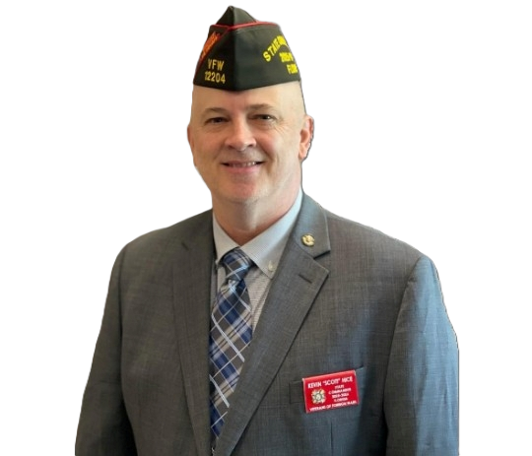
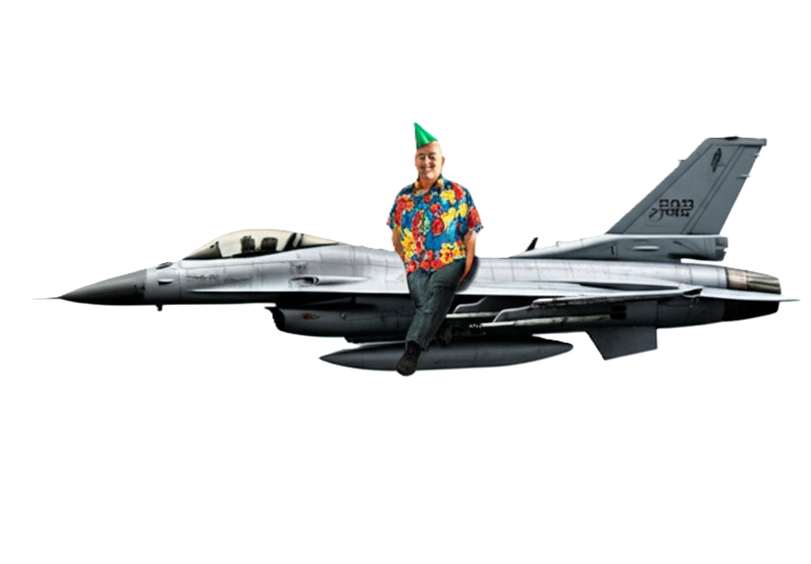
State Commander
Scott Hice

Slide 3

State A/q
John Coleman
jcoleman@vfwfl.org

Slide 4

Glenn Wright
alL American
Year in review

Slide 5
Community Service
332.60% Increase Total VFW/Aux Volunteer Hours
2023-2024: 145,946
2024-2025: 631,361
MEMBERSHIP
2023-2024 50,196
2024-2025 51,796
1839 Life member upgrades # 1 in nation
103.15% Membership #11 nation

Slide 6
LYNN ROLF
DIRECTOR VFW PROGRAMS
LROLF@VFW.ORG

Slide 7
Programs Update
By Lynn W. Rolf III
August 2025

Slide 8
Agenda
Part 1 Programs Update

Slide 9
Teacher Program Update
3 National Winners ($1000) will be provided to school for further programs
3 Grade levels
Not a requirement- Still report participation through dashboard
Posts are encouraged more than ever to recognize our educators

Slide 10
Youth Programs
Voice of Democracy 79th Year
Theme
“How are you showing patriotism and support for our country?”
Patriots Pen Same

Slide 11
Buddy Poppy AA Requirement
Requirement for All American
Post must order
Cost is $250 per 1000 Buddy Poppy (.25 per Buddy Poppy vs. .10 per Buddy Poppy) plus shipping July 1
New order form online for Department orders
Faster delivery
Higher quality
Automatically updated on dashboard once invoiced nightly
Reconciliation by Department
Donations in lieu of receiving Buddy Poppies for same cost. Funds will be transferred to NVS.

Slide 12
Community Service AA Requirement
Posts must submit at least 1 Community Service report within the 4 QTRs NLT June 30th (Year does not end March 31st) Jul-Sep, Oct-Dec, Jan-Mar, April-Jun
- Strategic goal for all posts report during the event and 365 days a year (Roll up or summaries bad business practice)
- Departments and Posts on Website solution are automatically loaded into the tool daily
- Those departments without will be able to use the dashboard tool to report CS from posts to department

Slide 13
Community Service
New Best practice guide available on training and support
Lots of misinformation of what VFW CS is.
Protect ourselves from ourselves (IRS Audit)
https://www.vfw.org/my-vfw/vfw-training-and-support/community-service-youth-scholarships-and-activities

Slide 14

Military Appreciation Program
Grants only submitted through the dashboard
Tracker on funds left along with KPIs associated with each grant. If required reports not received will not be able to receive another grant. Each Post authorized $5000

Slide 15
Deadlines
Teacher of the Year to National on February 1
VOD & PP Department winners to National January 15th No exceptions. All Departments will use Scholars App for their judging to ease the delivery to National. No more reporting through the dashboard if Posts, Districts, and Departments are used.
June 30th midnight system resets. Will pick the top post from each department for the national awards
Public Servant National Awards February 1.
All Program reporting is due January 31st.

Slide 16
Awards
Request through the Programs dashboard tool (100 yr old Bday, Lifesaving, Memorial commendation, chairperson) Only way to request. Do not send Emails to AG or the Chief. Will not be handled any other way. Developing a Citation (Pizza delivery type) status bar.
National Awards will be reset after the Committee meeting to enable 365-day submissions moving forward. (Fraternal, Patriotic, Educational, Historical, Citizenship, and distinguished service). Only submitted through the dashboard.

Slide 17
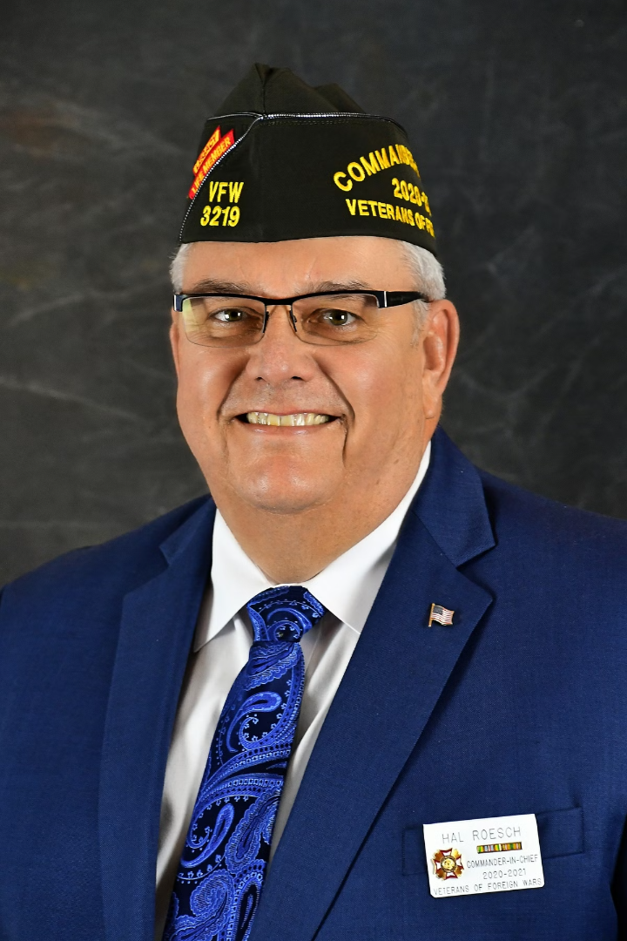

THE VFW FOUNDATION CAN HELP YOUR POST!
HAL ROESCH
EXECUTIVE DIRECTOR
VFW FOUNDATION

Slide 18
THREE WAYS WE HELP:
1
VFW FOUNDATION GRANTS
2
FUNDRAISING RESEARCH
3
PASS THROUGH DONATIONS

Slide 19
1. GRANTS:
The VFW Foundation is proud to offer funding through three (3) grant opportunities which are scheduled to close on June 1, 2025. Grants may close sooner if all budgeted funding is exhausted before the deadline.
Grants are open exclusively to VFW entities (Posts & Auxiliaries).
Go to: VFW.ORG/GRANTS
Detailed guidelines can be found on the application forms of each grant.
All grants are reimbursement based. Applicants will need to do a project and then submit an application with proof of how the funding was spent.
Applicants are highly encouraged to contact the VFW Foundation prior to starting a project to ensure it qualifies. Questions may be directed to Mary Spencer, MAP Coordinator, mspencer@vfw.org 816-968-2779

Slide 20
TYPES OF GRANTS:
A. VFW #StillServing Grant
The purpose of this grant is to help VFW organizations defray expenses for costs incurred while actively serving their community through impactful projects. To receive this grant, the applicant must have completed a project that was directly operated by the members of their organization. Multiple Post or Auxiliary members must have actively engaged their communities while completing the project.
Examples include but are not limited to:
Hosting a PTSD stand down event.
Facilitating a coat drive for the homeless.
Providing meals to food insecure individuals during the holidays.
Distributing books to children while visiting a school.
Bringing food and gifts to residents of a VA facility.
Both a VFW Post and its Auxiliary, and a District and its Auxiliary, can receive funding of up to $1,500, but each applicant organization must have its own unique project. The minimum of $500 must be met each time you are submitting an application in order to qualify.

Slide 21
TYPES OF GRANTS:
B. Post Assistance Grant
The Post Assistance Grant is offered exclusively to VFW Posts to offset expenses incurred for building repairs and equipment that enhances or restores the Post’s ability to serve veterans and their community.
Auxiliaries, Districts, Departments and other VFW subordinate organizations, etc., may not apply.
VFW Posts may receive up to $2,500 in reimbursement for qualifying projects. The minimum amount is $500. Applicants are limited to receiving this grant once every three years.
Examples include:
Purchases of materials or the hiring of a professional to repair a defect or renovation on property owned by the Post.
Purchases of equipment that enable a Post to better serve or sustain the service they provide to their community.

Slide 22
TYPES OF GRANTS:
C. UTCH Grant
The Uniting to Combat Hunger & Homelessness Grant (UTCH) is a matching grant of up to $1,500 available to VFW Posts or Auxiliaries for monetary, food, or item donations to local food banks, pantries or homeless relief organizations in their communities.
The VFW Foundation will provide a $1 match for every pound of food or dollar donated to food insecurity organizations.
The VFW Foundation will provide a $1 match for every $1 spent purchasing qualified items to donate to a homeless shelter as well as $1 match for every $1 donated to a homeless relief organization.
A minimum of 500 pounds or $500 must be met each time you are submitting an application in order to qualify. A Post or its Auxiliary may receive this grant but not both.

Slide 23
2. FUNDRAISING RESEARCH:
The VFW Foundation can research charitable foundations in your geographic area to identify potential grant funding for
your Post.
Simply, provide us with your Zip Code and we will email you detailed information on available foundations. This includes their contact information, board officer list, other charities the foundation(s) has funded, typical monetary size of grants, application process to request funding, etc.
Contact Christopher Johnson, Grants Manager, cjohnson@vfw.org 816-968-1154

Slide 24

3. PASS THROUGH DONATIONS:
Most VFW Posts are classified by the IRS as a 501(c)(19) nonprofit. While this is considered a full nonprofit in almost every way by the IRS (including tax deductibility), many donors prefer to make charitable contributions only to a 501(c)(3).
100% of all money will return to your Post most usually within two weeks with no administrative or any other charges removed.
Thus, the VFW Foundation often extends the use of our 501(c)(3) to VFW Posts to aid them in acquiring gifts. In this capacity, we become a "fiscal agent" for the Post.
Additionally, the donor will receive a tax acknowledgement letter directly from the VFW Foundation.
Therefore, if the donor agrees, have them make their check payable to the "VFW FOUNDATION" and send it to us with instructions that it is designated for your Post.
If you or the potential donor has questions, contact Richard Freiburghouse, Director of Donor Relations, rfreiburghouse@vfw.org 816-968-1124

Slide 25
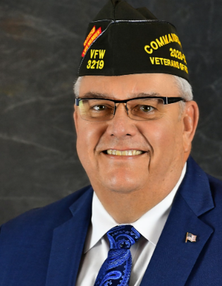
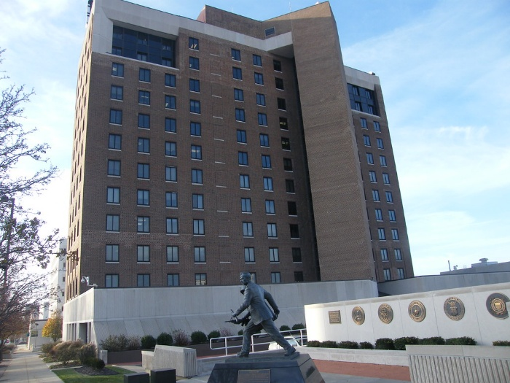
THANK YOU & GOOD LUCK
IN YOUR FUNDRAISING ENDEAVORS!
The VFW Foundation has its office in the VFW National Headquarters building in Kansas City, Missouri. In the foreground of the photo is the Citizen Soldier historical marker.
HAL ROESCH
EXECUTIVE DIRECTOR
VFW FOUNDATION

Slide 26
Questions?

Slide 27
VFW Programs Townhall Part II
Emerging Tech

Slide 28

VFW Scholars App
Judging tool 100% online
Department mandatory (Pass the Winner to National automatically)
Option for Departments to use at District and Post
1. No Cost
2. Link-based allows students to input everything (prevents chasing of information)
3. Post tailored QR Code and link to share
4. Insert scholarship amount
5. VOD & PP
6. * Does not eliminate chairman-personal interaction
must still share
7. No more reporting through the dashboard
Training is accessible but not used. We track who completes or
even logs in.

Slide 29

Combat Tested Gaming
The fastest-growing veterans-only gaming community
New market for us
Has already saved lives
Tournaments and league play
VA benefits questions
VFW resources

Slide 30
Purpose
The VFW has positioned itself to connect any active-duty service member, reserve component, national guardsman, and veterans to play video games to relieve stress, connect with friends, and have fun.
Video games have evolved significantly over the years, transforming from mere recreational activities to powerful tools that offer numerous benefits for individuals of all ages and backgrounds.
This VFW Program explores the positive impact video games can have on veterans, focusing on their mental health, social engagement, and skill development

Slide 31
Mission
The VFW E-Sports CTG promotes health, wellness, and comradeship through online gaming.
Esports and Gaming
The gaming industry is a $189.3 billion industry growing at a rate of 19.6%
2.3 billion people game worldwide
Esports revenue in 2019 was $1.1B with a 37% CAGR (Compound Annual Growth Rate)
Esports audience is over 500 M+ in 2024

Slide 32
Video Games Enhancing Mental Health
A. Stress Reduction:
1. Immersive gameplay and escapism.
2. Mindfulness-based gaming and relaxation techniques.
B. Therapeutic Impact:
1. Addressing symptoms of post-traumatic stress disorder (PTSD).
2. Virtual reality (VR) exposure therapy

Slide 33
Promoting Social Engagement
A. Building Camaraderie:
1. Online multiplayer games.
2. Veterans-specific gaming communities.
B. Facilitating Communication:
1. Interacting with fellow veterans.
2. Bridging the gap between military and civilian populations.

Slide 34
VA Relationship
Absolutely Key
Relationships built- VR, Foreign Military groups, other gaming groups,
Your Imagination- (Denton Post #2205) examples of ideas

Slide 35
Dashboard Intent
  Streamline all reports
  Instant
  Transparency
  The post is where everything starts, and all work happens

Slide 36
Programs Dashboard Tool
Focus mindset shift from AA to reporting
Seen successes Posts reporting.
Commander, SVC, JVC, QM, and Adjutant granted entry permissions (Post & District) from the online election report. (DISTRICT ISSUE)
More getting enrolled in OMS
Community Service reports will be directly scraped from those with our website solutions program(VA, TX & CO have . API established)
Community Service will be entered through the tool for those not on the WS platform. (Post to Department)
Visualization tool is incredibly powerful for recruiting and telling our story
All citation requests and awards are through Dashboard; there is no other way to submit.
All grants- MAP and Foundation through the dashboard. It will show the status of funds available before the $ runs out. To include some ROI metrics of each event. Have to submit a close-out report otherwise Post & Department will no longer receive a grant moving forward.

Slide 37
QUESTIONS?
Lynn W. Rolf III
816.968.1116
lrolf@vfw.org

Slide 38
BREAK TIME
PLEASE BE BACK ON TIME

Slide 39
DISASTER RELIEF
SEAN GOLDER
SGOLDER@VFWFL.ORG

Slide 40
REPORTING SITE
JOHN COLEMAN
JCOLEMAN@VFWFL.ORG

Slide 41

VOD
HEATHER FRANK
STATEVOD@VFWFL.ORG

Slide 42

PATRIOT PEN
DR. BRIAN FRANK
STATEPP@VFWFL.ORG

Slide 43

TEACHER OF THE YEAR
”THE GODFATHER”
TONY SALVO

Slide 44
PD/FD/EMT/DISP
”THE GRIZ”
DAVE BEAR

Slide 45
HOSPITAL REPORTS
STATE SURGEON
MIKE CLINE

Slide 46
SCOUT OF THE YEAR
RONNIE “DOC” HOLLADAY

Slide 47
L UNCH BREAK
PLEASE BE BACK ON TIME

Slide 48
COMMUNITY SERVICE
SEAN GOLDER

Slide 49
STATE INSPECTOR
DON BULT

Slide 50
STATE INSPECTOR
Don Bult
inspector@vfwfl.org
(904) 529-8869

Slide 51
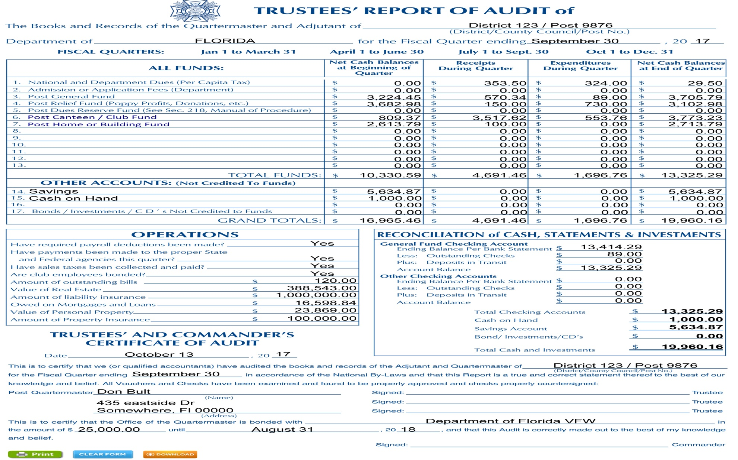

Slide 52
Audits
Are Due No Later Than
June Audit – July 31
Sept Audit – Oct 30
Dec Audit – Jan 31
Mar Audit – Apr 30

Slide 53
Inspections
To be done between
December 1, 2025 and February 28, 2026

Slide 54
All Discrepancies
need to be
corrected by
March 30, 2026

Slide 55
The District Inspector will schedule when inspections are done
Be prepared

Slide 56
House Committee
Must have iaw
Section II

Slide 57
The Canteen Rules
give the
requirements for the
House Committee

Slide 58
The canteen reports
to the
house committee
with a canteen Report

Slide 59
Post XXXX
CANTEEN REPORT
MONTH OF ______________
Sold Bought Profit/Loss
Liquor
Beer
Wine
Soda
Food
Snacks
Drink Overhead Items for drinks
(Straws, Cups, napkins, Fruit etc.)
Total

Slide 60
The House Committee
Is
Responsible
for the
Canteen Inventory
Trustees Audit

Slide 61
The House Committee
Reports to the
Post membership.
House Committee recommends
Post Membership approves

Slide 62
Conduct and Suspension
Are covered in
Sections
VII and VIII

Slide 63
The VFW
Does NOT
Have
Social/Associate Members

Slide 64
Ensure you keep DABT
Updated with person in charge of
Canteen

Slide 65
BECAUSE WE CARE
DAVID CAIN

Slide 66
MEMBERSHIP OVERVIEW
KEN MICHAEL
DEPT MAL DIR

Slide 67


Membership Training
Not your Grandfather’s Retention

Slide 68
50% of Life Membership
Starting around September 15th
Annual member must have been on the roster prior to 50% of Life membership starting.
Annual member will pay for 50%
Post will pay 100%
Must fill out the 50% off form and submit to HQs for reimbursement from Department.
This will help you on several fronts:
  You will get credit for annual to life conversion
  You won’t have to keep trying to get that member to renew.

Slide 69
50% of Life Membership for MAL Transfers
Good to go now to do this
You must check the MAL member’s DD214 or eligibility documents.
The MAL must transfer into your post to be eligible.

Slide 70
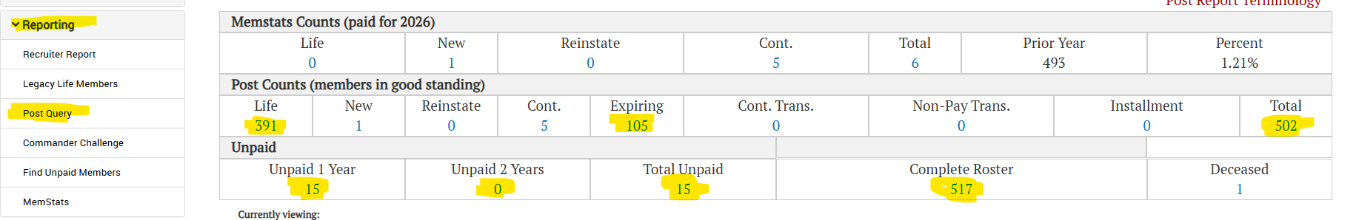
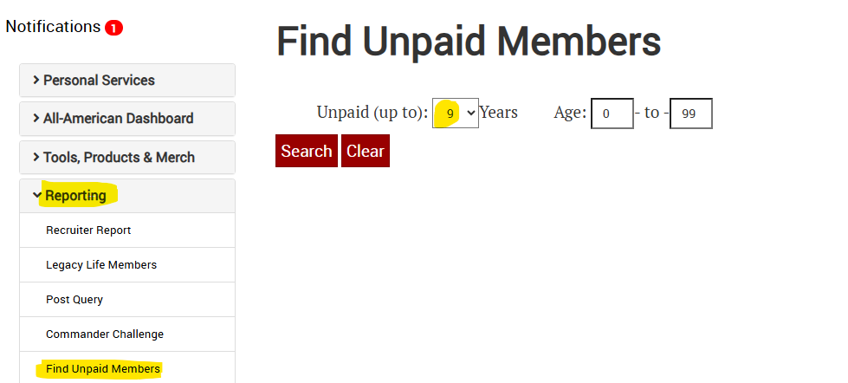
Membership Rosters

Slide 71
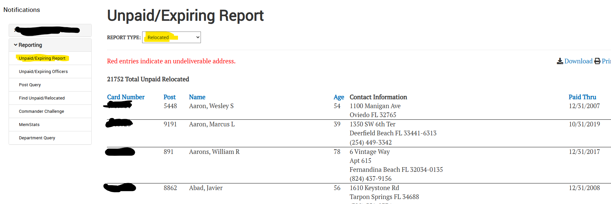
Membership Roster -- Relocated

Slide 72
MAL Membership Roster
Request it at : mal@vfwfl.org
Make sure to do this often (quarterly)
MAL can be a gold mine.

Slide 73
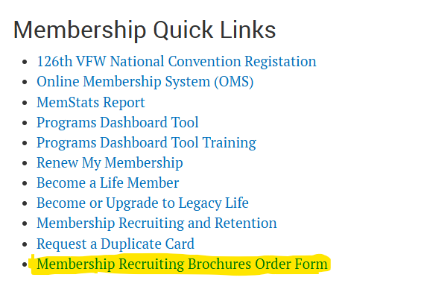

Membership Drives
Get out in the community and setup recruiting tables at events.
Every event in your post can be a recruiting event.
Get your brochures and pamphlets from the VFW

Slide 74
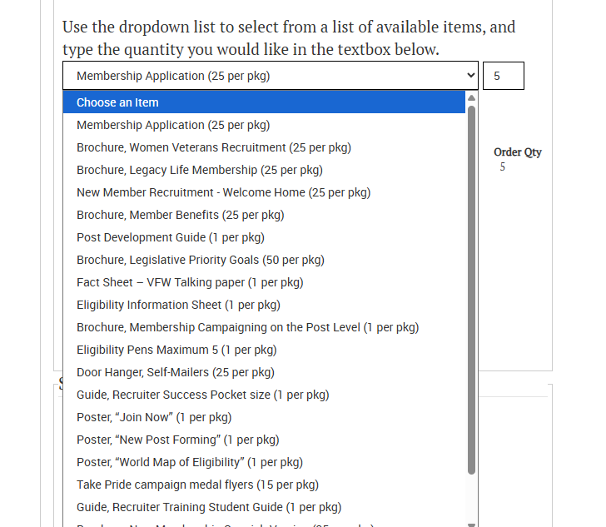
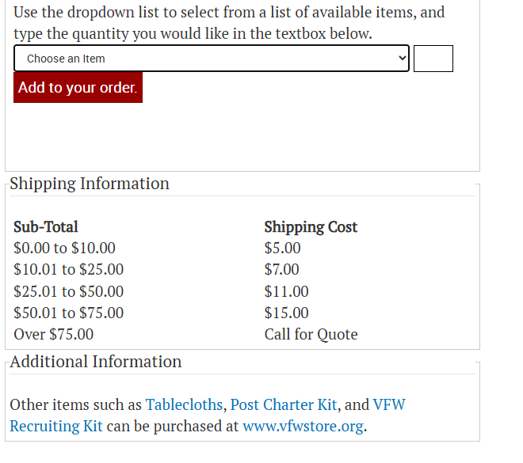
Membership Drives

Slide 75
Membership Goals
September 30th – 75%
October 31st -- 85%
November 30th – 95%
December 31st – 100%
January 30th – 101% Qualifies you for All-American
February 28th – 102% Qualifies you for All-State
March – June – Concentrate on Programs because you made it!!

