Slide 1
DEPARTMENT OF FLORIDA
DEPT. SCHOOL OF INSTRUCTION – MEMBERSHIP 2024 - 2025

Slide 2
STATE COMMANDER
Glenn Wright
gwright@vfwfl.org
STATE ADJUTANT/QUARTERMASTER
Eugene “Gene” Perrino, SR.
gperrino@vfwfl.org
(352) 622-5126

Slide 3
Contact Information
Membership Director:
Scott Hice - 850 305-0064
shice@vfwfl.org

Slide 4
Assistant Membership Director:
Ron Holladay – 850-602-6395
rholladay1960@hotmail.com
Members At Large Director
Wayne Tuttle – 810-610-9361
warvet1976@gmail.com
Assistant Member At Large Director
Tom Randall - (954) 790-5739
trandall@vfwfl.org

Slide 5
Membership Program
Notes:
Commander in Chief Al Lipphardt’s Theme Operation

Slide 6
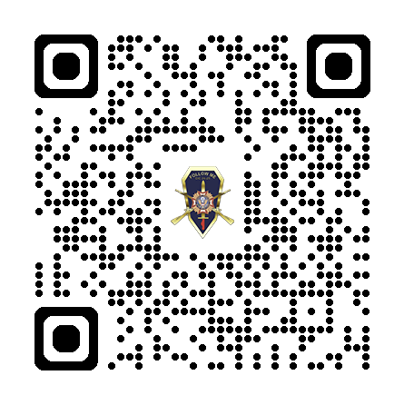
Scan QR Code for Presentation
Notes:
VFW National Membership Program

Slide 7
Membership Program
Membership Mission:
To recruit, retain and mentor a stable membership base including all generations of veterans. To cultivate a membership that is well versed in institutional knowledge and actively involved at all levels of the organization and in the local community. To establish Posts with an established vision of service, leadership, and community outreach.
1. Build a strong organization through recruiting new members while retaining our current membership, creating a solid baseline for the future.
2. Work together to achieve VFW’s goals. The VFW National Headquarters staff is available to assist in coordinating programs, developing membership initiatives, and building awareness among our membership and the entire veteran community.

Slide 8
“Efforts are to be appreciated. Achievements are to be celebrated.” To incentivize the necessary tasks of recruiting and retention, which are essential to the continued growth and strength of the Veterans of Foreign Wars, a series of award programs will be established and overseen by the Membership Department under the direction of the Adjutant General. These programs will be directly related to membership growth and program participation, and awards will be assigned to those individuals as well as Posts, Districts, and Departments that show excellence above and beyond the standard.
Commander’s Intent
Notes:
Highlight Efforts & Achievements

Slide 9
Membership Program
2024-2025 updates in the membership program from this point forward will be notated in red, unless otherwise noted.
Membership Requirements page 4
- Achieve 102% in Membership
- For everyone to recruit at least one new member and then mentor that member.
- Increase membership drives and/or events.
- Develop new Posts and/or revitalize existing Posts.
- Increase Life Membership and Legacy Life Membership

Slide 10
Service & Support
Service & Support
Membership Resources:
In order to assist our Posts, Districts, and Departments in meeting the goals set out by the Commander-in-Chief in this membership program, the National Headquarters has a wealth of resources at your disposal. Many of those are available free of charge to our members.
Membership materials ranging from applications, recruiting brochures, posters, and benefits brochures can be ordered directly from the Membership Department using the Membership Order Form (located under Membership Quick Links once you log into vfw.org).
Resources for Post Development, Membership Campaigns, and Mentorship such as training guides, videos, and webinars are available in the Training & Support section on vfw.org
Promotional tools such as radio spots, sample advertisements, public service announcements, and media kits are all available through the Media Room on vfw.org
See the trend? Just about anything you will need is at vfw.org, check it out.

Slide 11
Service & Support
Service & Support
Department Leadership: Department officers will provide resources, support, and training where available including Schools of Instruction, Unpaid/Relocated lists, and other tools and incentives to enable membership growth and the mission of recruiting, retention, and mentorship.
National Headquarters: The VFW National Headquarters staff is ready and trained to answer any questions you may have concerning membership, VFW programs, or other issues. National Headquarters staff will be available for remote training (ZOOM), when necessary, feel free to contact the Membership Department to schedule.
You can contact our Member Service Center directly at 1.833.VFW.VETS or msc@vfw.org, or the Membership Department at 1.888.JOIN.VFW or membership@vfw.org.

Slide 12
All-American Post Criteria
All-American Post Criteria
Membership must be at least 102%
Post-Election Report must be submitted to National Headquarters
Meet all the following Program Participation Criteria by January 31st, 2025: Voice of Democracy - minimum of one entry advanced to District judging (Overseas Post can donate $125 to National in lieu of entry)
Patriots Pen - minimum of one entry advanced to District judging (Overseas Post can donate $125 to National in lieu of entry)
Donate to Veterans & Military Support Programs Services, minimum of $125
A Post must submit a community service report quarterly to their department for submission to the All-American Dashboard. The quarters are July-Sept, Oct-Dec, Jan-March, and April-June. One of these community service activities must be for the VFW Day of Service. Learn more at https://todaysvfw.org/vfw-day-of-service/
Must purchase a minimum of 500 Buddy Poppies

Slide 13
All-American Post Award
All-American Post Award
All Posts that meet the qualifying percentage of 102% and the program participation criteria will receive an All-American Banner, Post Streamer and be recognized in the VFW magazine.
The Top 15 Posts in each Division will receive:
Acknowledgment in VFW Magazine
Acknowledgement during the All-American Awards Ceremony at the National Convention
All-American Post citation
All-American Post streamer
All-American citation - commander
All-American name badge – commander
All-American cap (commander only, quartermaster, adjutant, and Post members may purchase cap)
All-American lapel pin (commander only, quartermaster may purchase pin)

Slide 14
All-American Post Award
New: The top five Post commanders in each division will also receive five nights paid hotel stay* at the VFW National Convention and reserved seating at the VFW National Convention joint opening session.
New: Division Captains and Co-Captains: The commander of the top Post in each membership division will be designated as the Team Captain, with the 2nd through 5th place commanders designated as Co-Captains. The All-American caps for these Captains and Co-Captains will bear a special designation.

Slide 15
All-American District Criteria
All-American District Criteria
Membership must be at least 102%
District-Election Report must be submitted to National Headquarters.
Meet all the following Program Participation criteria by January 31st, 2025: Voice of Democracy - minimum of one entry advanced to Department judging (Overseas District donate $125 to National in lieu of entry)
Patriots Pen - minimum of one entry advanced to Department judging (Overseas District donate $125 to National in lieu of entry)

Slide 16
All-American District Award
All-American District Award
All Districts that meet the qualifying percentage of 102% and the program participation criteria will receive an All-American District Commander Citation, All-American Streamer and be recognized in the VFW magazine.
The Top 10 Districts in each Division will receive:
All-American District streamer
All-American District citation - commander
All-American name badge - commander
All-American cap (commander only, quartermaster may purchase cap)
All-American lapel pin (commander only, quartermaster may purchase pin)
Acknowledgement during the All-American Awards Ceremony at the National Convention

Slide 17
All-American District Award
New: The top two District commanders in each division will also receive five nights paid hotel stay* at the VFW National Convention and reserved seating at the VFW National Convention joint opening session. Page 11-12
New: Division Captains and Co-Captain: The commander of the top District in each membership division will be designated as the Team Captain, with the 2nd place commander designated as Co-Captain. The All-American caps for these Captains and Co-Captains will bear a special designation.

Slide 18
All-American Department Criteria
All-American Department Criteria
Membership must be at least 102%.
Department must submit Department legislative chairman reports monthly through the Program dashboard tool.
Meet all the following Program Participation criteria by January 31st, 2025: Voice of Democracy - An entry advanced to National judging
Patriot’s Pen - An entry advanced to National judging
Veterans & Military Support Programs – Must complete State/Department fundraiser and proceeds donated to Veterans & Military Support Programs, Kansas City, Mo.

Slide 19
All-American Department Award
All-American Department Award
Acknowledgement during the All-American Awards Ceremony at the National Convention
All-American Department streamer
All-American Department citation - commander
All-American name badge - commander
All-American cap - commander – quartermaster, and adjutant may purchase cap.
All-American lapel pin - commander - quartermaster may purchase pin.
Five nights paid hotel stay* for the 2024-2025 Commander attending the VFW National Convention.
Reserved seating at the VFW National Convention Joint Opening Session

Slide 20
All-American Notes
Any member in a Post that achieves All-American status can purchase a “Post Member” cap. Those members must be in the Post during the membership year. Adjutants may purchase a cap. Quartermasters may purchase a cap and/or Quartermaster Pin. Commanders who were not in the top 15 in their Division may purchase a cap, Commander’s Pin, and/or Post Commander Citation.
Donations made to replace Voice of Democracy and Patriot’s Pen by eligible overseas Posts, Districts, or Departments must be made through the All-American Dashboard, not through any other means.
Veterans & Military Support Programs Services Donations for Post/District/Department as listed above will only be accepted through the All-American Dashboard.

Slide 21
Membership Recruiting Awards
Individual Recruiting Awards:
1/5/10/15 members recruited: recruiting pin
25 members recruited: Commander-in-Chief’s Coin
50 members recruited: Commander-in-Chief backpack
75 members recruited: Commander-in-Chief’s Medallion Set
100 members recruited: Century Cap or $50 VFW Store credit & citation
Recruiting Awards will be sent out five times during the year to the Post, to be given out at a Post meeting to those members who have recruited new members. Mailings will take place near the end of October, January, March, May, and then after the end of the membership year.

Slide 22
Early Bird Award
Early Bird Award—VFW Legislative Conference
The top two Posts in each division on Jan. 1, 2025, will each be awarded a 5-night hotel stay for the VFW Legislative Conference in Washington D.C. One room will be booked per award/Post.

Slide 23
New Member Award & Operation: All In
New Member Award:
Each Post that brings in a total of 15 New members will each be awarded a travel charger with the official VFW Commander-in-Chief logo. A Post may receive this award up to five times during the year!
“Operation: All In” Award:
The top two Post commanders and the top two District commanders in each division who achieve 102% membership by June 30th, 2025, will each be awarded a five-night hotel accommodation at the National Convention.

Slide 24
102% Post, District & Department
105% “Above & Beyond” Drawing
102% Post, District & Department:
A distinctive streamer will be awarded to every Post, District and State/Department that achieves 102% or greater in membership by June 30th, 2025.
105% “Above And Beyond” Drawing:
Each Post and District commander that meets or exceeds 105% in membership by June 30, 2025, will receive an entry in this drawing. Twenty Post commanders and Twelve District commanders will receive a $1,000 stipend to be used toward attending the VFW National Convention.

Slide 25
Post Division Recruiting Challenge
Post Division Recruiting Challenge:
For every 10 new members recruited between July 1, 2024, and June 30th, 2025, Posts will earn one entry to be entered into a drawing. One Post per division will receive a $1,000 membership grant deposited into the Post account.

Slide 26
Legacy Life Membership Acquisition
Legacy Life Membership Acquisition:
Each Post that achieves the cumulative benchmarks of 25, 50 and 75 Legacy Life Members will be awarded a Legacy Society Post Proclamation.
Each Post that achieves the distinctive benchmark of 100, 250, or 500 Legacy Life members by June 30th, 2025, commander or Post representative will receive a 5-night hotel accommodation at the VFW National Convention, reserved seating at the VFW National Convention joint opening session and a Legacy Society Post Proclamation.

Slide 27
Top Recruiter Awards
Top Department Recruiter:
The top Recruiter in every Department by June 30th, 2025, will receive an engraved Cavalry Saber. Note: Minimum of 25 new members required to win this award.
Elite Recruiter:
Any VFW member who signs up 250 or more new members by June 30th, 2025, will receive a 5-night hotel accommodation at the VFW National Convention and a distinctive cap, citation, and name badge. In the event that an Elite Recruiter has already received a 5-night hotel accommodation from another award, a $1,000 stipend will be issued at the National Convention.
Recruiter of the Year:
The Elite Recruiter who signs up the greatest number of new members greater than 250 by June 30th, 2025, will receive an additional $1,000 stipend, reserved seating at the VFW National Convention joint opening session, a distinctive cap, citation, and name badge, and the Commander-in-Chief’s Crystal Eagle trophy.

Slide 28
Life Member Recruiter Award / New Post Development Grant
Life Member Recruiter Award:
Any VFW member who recruits at least 75 New Life members by June 30th, 2025, will receive a special citation from the Commander-in-Chief and a Recruiter Satchel with the Commander-in-Chief’s logo.
New Post Development Department Grant:
For each new Post chartered the Department Quartermaster will receive a $250 credit from the VFW Store to be used towards necessary materials for the new Post. Department Commanders and Quartermasters may apply for this grant directly through the National Membership Department.

Slide 29
Commander-in-Chief’s Challenge
Commander-in-Chief’s Challenge:
To emphasize the importance of Life Membership as the backbone of our membership strength, the Commander-in-Chief is issuing the following challenge to all VFW Posts. Each month through the year, Posts will accumulate points as follows:
New Annual Member: 1 point
Annual or Lapsed Member converts to Life Member: 5 points
New Life Member: 10 points
Each month, the Post that leads their membership division in points will receive a special award designated by the Commander-in-Chief. In addition, at the end of the year every Post who has led their division in the monthly challenges will be featured on a video display at the National Convention to recognize their achievements.

Slide 30
Triple Crown
Triple Crown:
The Triple Crown is one of the most prestigious membership awards that an individual can achieve. It requires being named as an All-American Commander at Post, District, and Department level. Leaders who attain this level of excellence will be recognized at an Awards Banquet at the National Convention with a special Triple Crown pin.

Slide 31
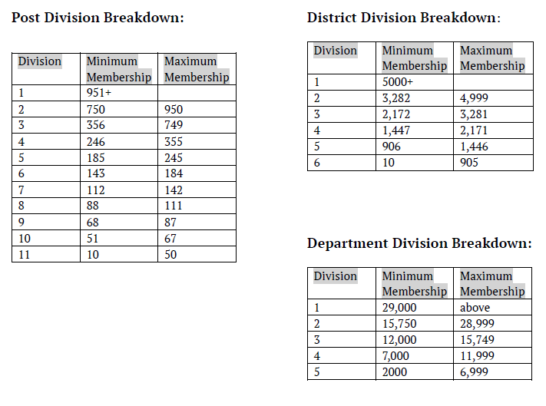
Post, Division & Dept Breakdown

Slide 32
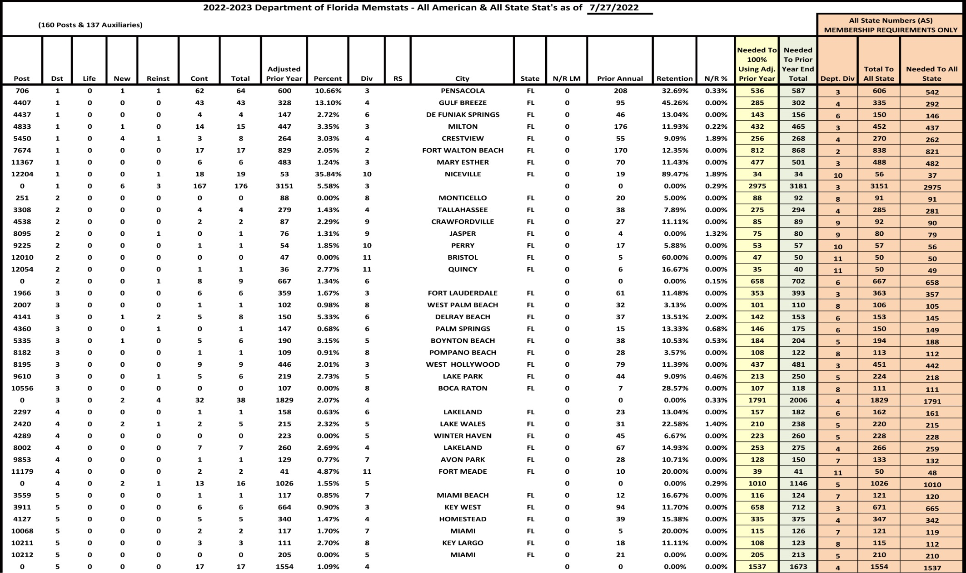
Memstats From FL Membership Director
Notes:
19 Districts,156 Post & 137 Auxiliaries
Spin numbers to give total to 102% and total to reach All State requirement by Division

Slide 33
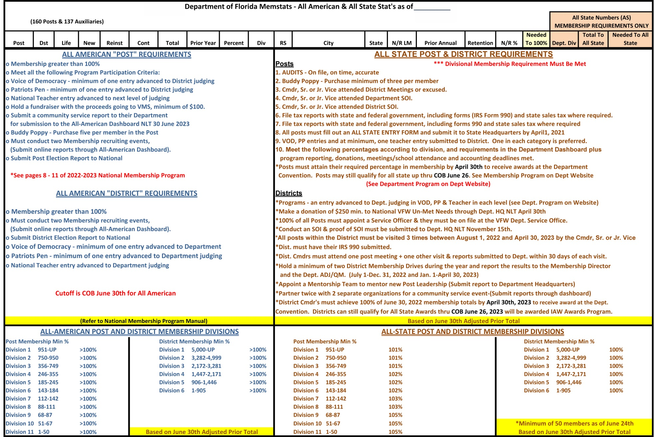
All American & All State Membership Requirements For 2024 - 2025
Notes:
Page list all Criteria for All State & All American (Taken directly from the National & State Membership Programs)

Slide 34
Membership Monday Webinars
The Membership Department is continuing training at all levels. Monthly recorded webinars, where we take questions from any member.
The webinars are posted to the VFW National Headquarters Online Membership system at www.vfw.org/my-vfw “VFW Training & Support” in the “Membership Recruiting & Retention section.”
They are also located on the VFW YouTube page at www.youtube.com/c/VFWHQ and the VFW Membership Facebook page www.facebook.com/VFWmembershipHQ
Questions and topics can be submitted by email to membership@vfw.org

Slide 35
Contact Information
Membership Department
888.564.6839 (888.joinvfw)
membership@vfw.org

Slide 36
QUESTIONS
Scott Hice
(850) 305-0064
shice@vfwfl.org

